Slide 1
STORI Plots Enable Accurate Tracking of Individual Ion Signals
Jared O. Kafader, † Steven C. Beu, ⊥ Bryan P. Early, † Rafael D. Melani, † Ken R. Durbin, † Vlad Zabrouskov, ‡ Alexander A. Makarov, § Joshua T. Maze, # Deven L. Shinholt, # Ping F. Yip, ‡ Neil L. Kelleher, † Philip D. Compton, † Michael W. Senko *,‡
†Departments of Chemistry and Molecular Biosciences, the Chemistry of Life Processes Institute, the Proteomics Center of Excellence at Northwestern University, Evanston, Illinois 60208, United States
⊥S.C. Beu Consulting, Austin, Texas 78729, United States
‡Thermo Fisher Scientific, San Jose, California 95134, United States
#Thermo Fisher Scientific, Austin, Texas 78728, United States
§Thermo Fisher Scientific, Bremen 28199, Germany
Supporting Information
Table of Contents
Figure S1. STORI magnitude slope as a function of selection ion frequency for main text Figure 1. The slope follows the ion peak shape. At the optimized apex frequency of 141373.0479 kHz the slope is the highest value of 1320588 and further decreases as the frequency is deviated to slightly higher and lower values.
Figure S2. Changes in STORI real (black), imaginary (pink), and magnitude (red) plots as a function of selected ion frequency. As the optimal base frequency of 141373.0479 kHz (top panel) is shifted to slightly lower (a) -240.5 Hz (b) -51 Hz and higher (c) +157.2 Hz (d) +240.5 Hz values. Observations include deviations from linear real and imaginary components if the optimal frequency is not selected and lower magnitude STORI slopes further illustrated in Figure S2.
Figure S3. Myoglobin +25 double ion signal with real (black), imaginary (pink), and magnitude (red) STORI plots demonstrating the disintegration of one of the ions at ~0.5 seconds.

Slide 2
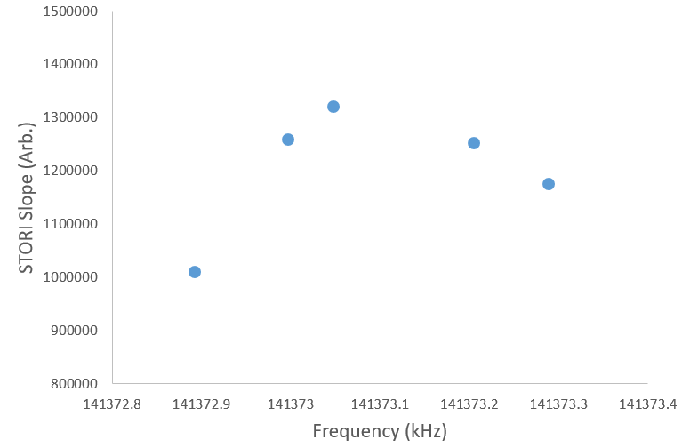
Figure S1. STORI magnitude slope as a function of selection ion. The slope follows the ion peak shape. At the optimized apex frequency of 141373.0479 kHz the slope is the highest value of 1,320,588 and further decreases as the frequency is deviated to slightly higher and lower values.

Slide 3
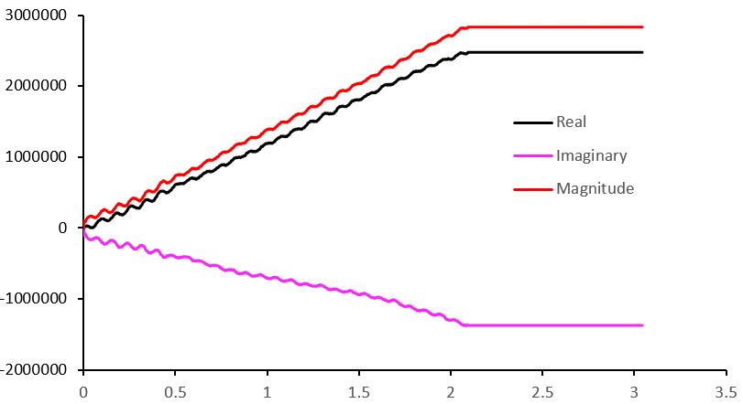
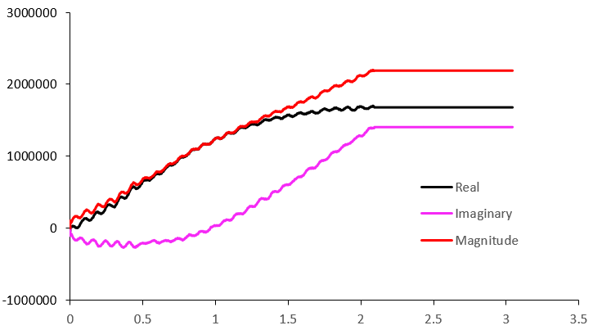
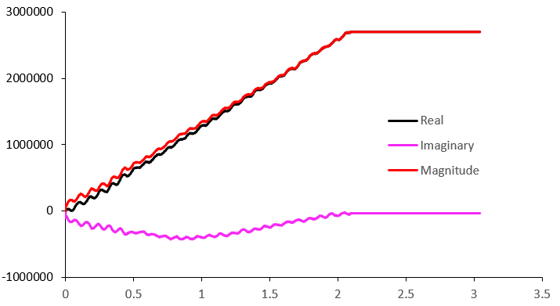
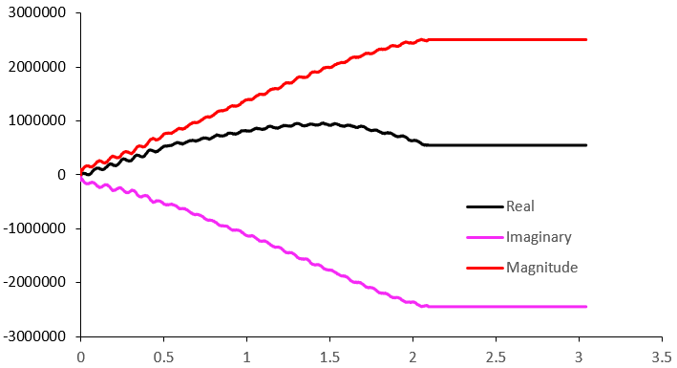
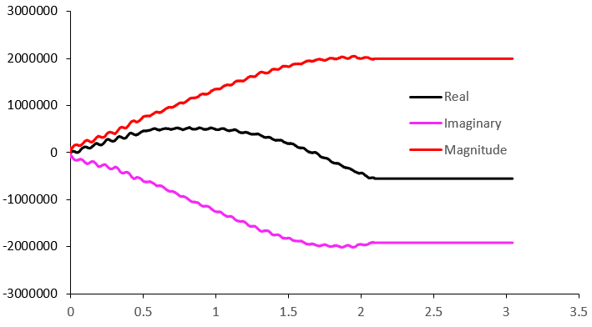
Optimal
a)
b)
Integrated Signal (Arb.)
c)
d)
b)
Time (Sec)
Figure S2. Changes in STORI real (black), imaginary (pink), and magnitude (red) plots as a function of selected ion frequency. As the optimal base frequency of 141373.0479 kHz (top panel) is shifted to slightly lower (a) -240.5 Hz (b) -51 Hz and higher (c) +157.2 Hz (d) +240.5 Hz values. Observations include deviations from linear real and imaginary components if the optimal frequency is not selected and lower magnitude STORI slopes further illustrated in Figure S2.

Slide 4
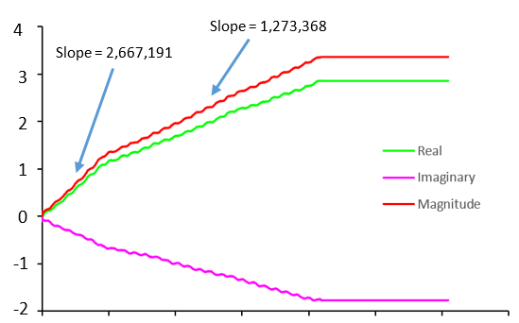

Figure S3. Myoglobin +25 double ion signal with real (black), imaginary (pink), and magnitude (red) STORI plots demonstrating the disintegration of one of the ions at ~0.5 seconds.

