Slide 1
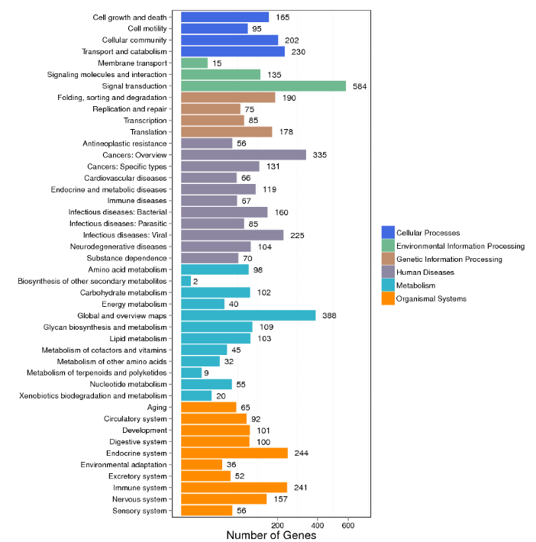
Additional Figure S1
A
B

Slide 2

c

