Slide 1
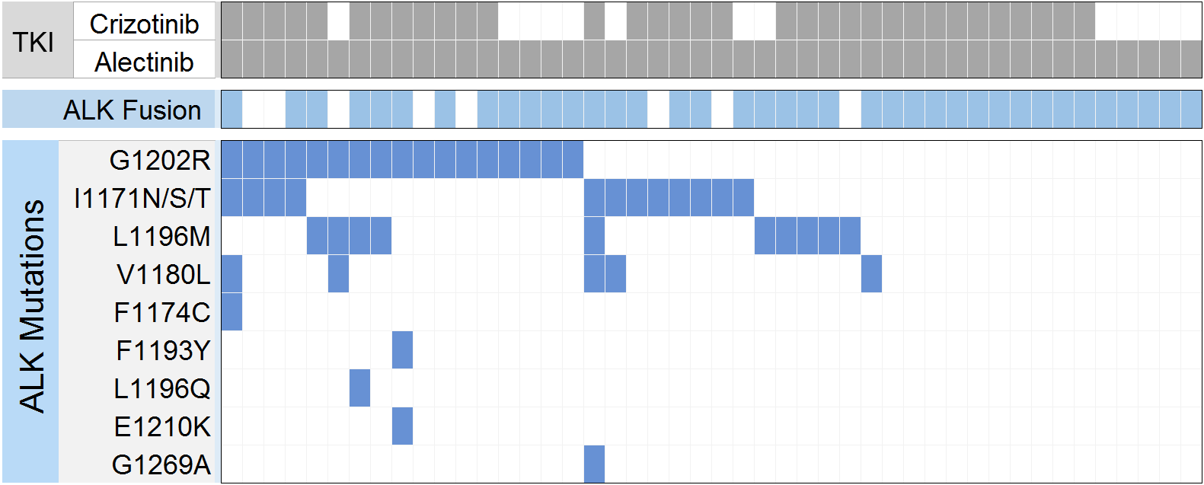
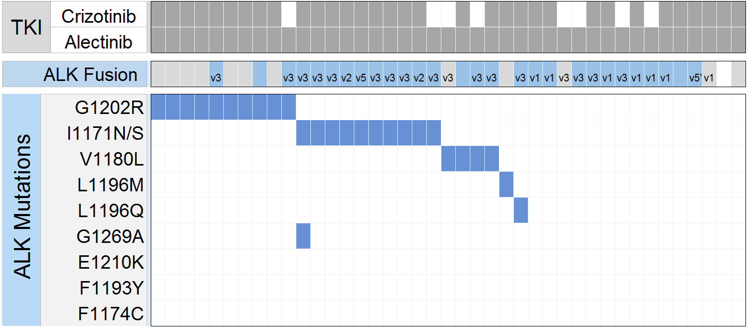
Supplementary Figure 1
Post-Alectinib Plasma
Post-Alectinib Tumor Biopsy
Total
Total
5
10
17
4
10

Slide 2
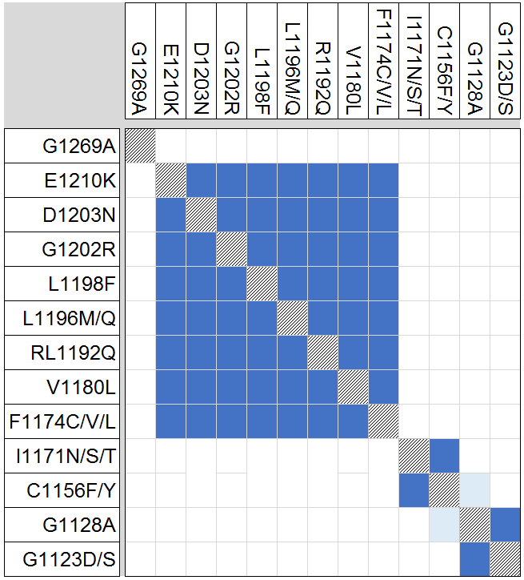
Supplementary Figure 2
Assessable for Allelic Configuration
Potentially Assessable for Allelic Configuration
Allelic Configuration Not Assessable

Slide 3
Supplementary Figure 3

