Slide 1
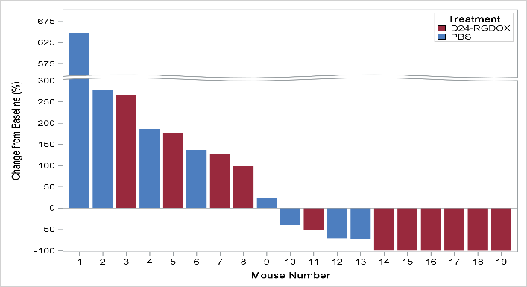
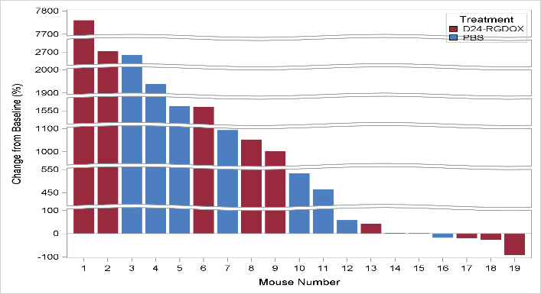
A
s.c. tumor
PBS
D24-DRGDOX
Bioluminescence (p/s)
Day 8 Day 15 Day 21 Day 25 Day 28 Day 35 Day 57
Day 8 Day 15 Day 21 Day 25 Day 28 Day 35 Day 57 Day 90
i.c. tumor
Bioluminescence (p/s)
Day 15 Day 21 Day 25 Day 28 Day 35 Day 57
Day 15 Day 21 Day 25 Day 28 Day 35 Day 57 Day 90
B
s.c. tumor
i.c. tumor
D24-RGDOX
D24-RGDOX
PBS
PBS
Change from baseline (%)
Fig. S3. A, Quantification of the tumor bioluminescence in the mice from the indicated treatment groups. D24-RGDOX: Delta-24-RGDOX. B, Waterfall plots showing tumor burden change from baseline in mice of indicated treatment groups base on the bioluminescence from the tumor. Baseline time point: Day 8 for s.c. tumor, Day 15 for i.c. tumor. Evaluation time point: Day 57 or the last time point before euthanasia.

