Slide 1
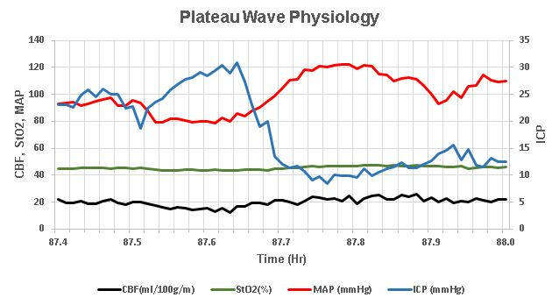
Plateau Wave Physiology
CBF, StO2, MAP
ICP
Time (Hr)
CBF (ml/100g/m)
StO2(%)
MAP (mmHg)
ICP(mmHg)
SDC 16. Plateau wave physiology in a NeuroICU patient. In a UPenn neuroICU patient with heterogeneous injury and impaired intracranial compliance, decrements in blood pressure were associated with increments in ICP, with reversal of the ICP increase as MAP increases. These are not classic plateau waves but indicate the presence of plateau wave physiology. Notably a small decrement in optical CBF and optical brain oxygen saturation associate with increases in ICP. CBF-cerebral blood flow, StO2-brain tissue oxygen saturation, MAP-mean arterial pressure, ICP-intracranial pressure

