Slide 1
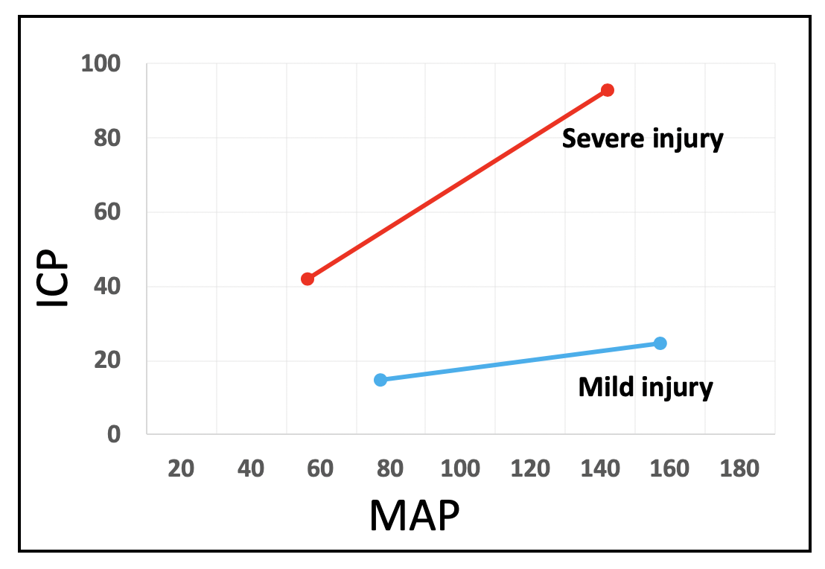
SDC 18. ICP increases with hypertension in the injured brain-conceptual illustration. In the normal or minimally injured brain ICP is minimally affected by increases in MAP, within the usual autoregulatory range. In contrast, in the brain with significant injury, depicted in this figure by an initially high ICP, similar changes in MAP produce significant and corresponding changes in ICP, presumably because hypertension creates a hypervolemic hyperemic increased ICP subset in brain tissue that passively vasodilates and is dysregulated or has impaired blood-brain barrier. ICP-intracranial pressure (mmHg); MAP-mean arterial pressure (mmHg)

