Slide 1
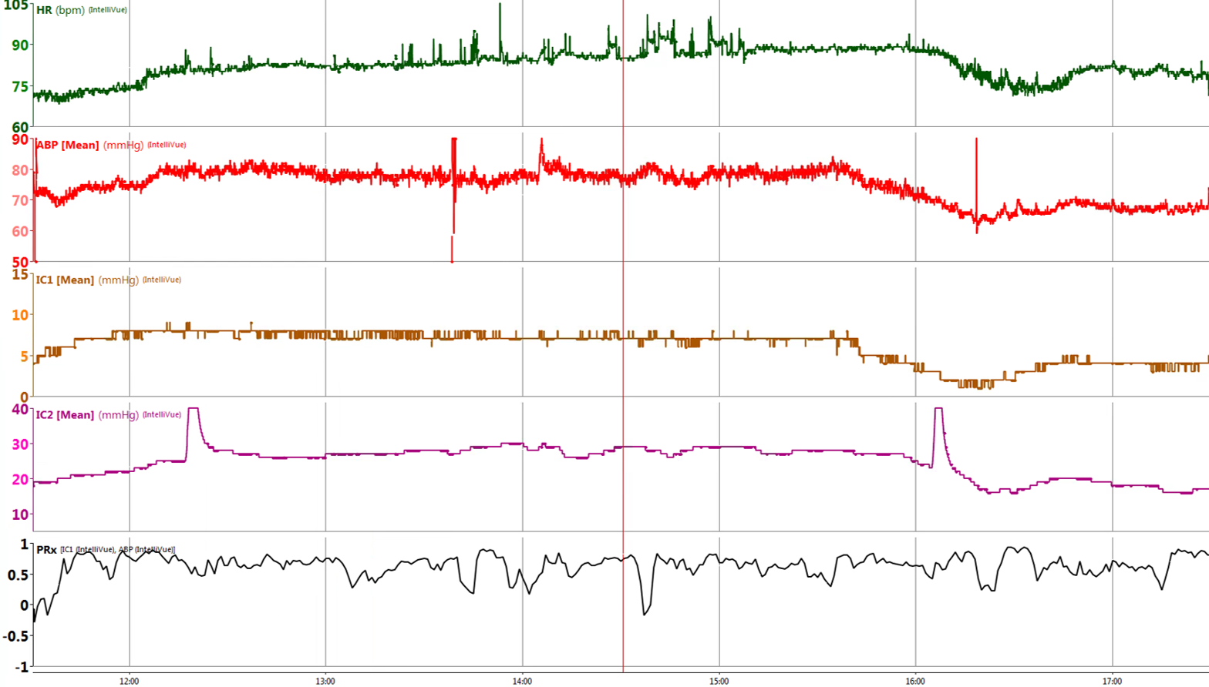
SDC 19. Loss of autoregulation with hyperemic intracranial hypertension. This graph is from a UPenn NeuroICU patient after subarachnoid hemorrhage. Changes in blood pressure are directly reflected with proportionate changes in intracranial pressure (panel labelled IC1) and PbO2 (panel labelled IC2) indicating hyperemia (cerebral blood flow not measured in this case). PbO2 spikes are due to oxygen challenges to test the monitor. Continuous Prx assessment in the bottom panel generally indicates high Prx, suggesting poor autoregulation with a generally high correlation between blood pressure and ICP. HR-heart rate, ABP-arterial blood pressure, IC1-intracranial pressure, IC2-PbO2.Prx, intracranial based autoregulation index 17, 18 based on correlation of blood pressure with intracranial pressure
Czosnyka M, Hutchinson PJ, Balestreri M, et al. Monitoring and interpretation of intracranial pressure after head injury. Acta Neurochir Suppl 2006;96: 114-8.
Steiner LA, Czosnyka M, Piechnik SK, et al. Continuous monitoring of cerebrovascular pressure reactivity allows determination of optimal cerebral perfusion pressure in patients with traumatic brain injury. Crit Care Med 2002;30: 733-738.

