Slide 1
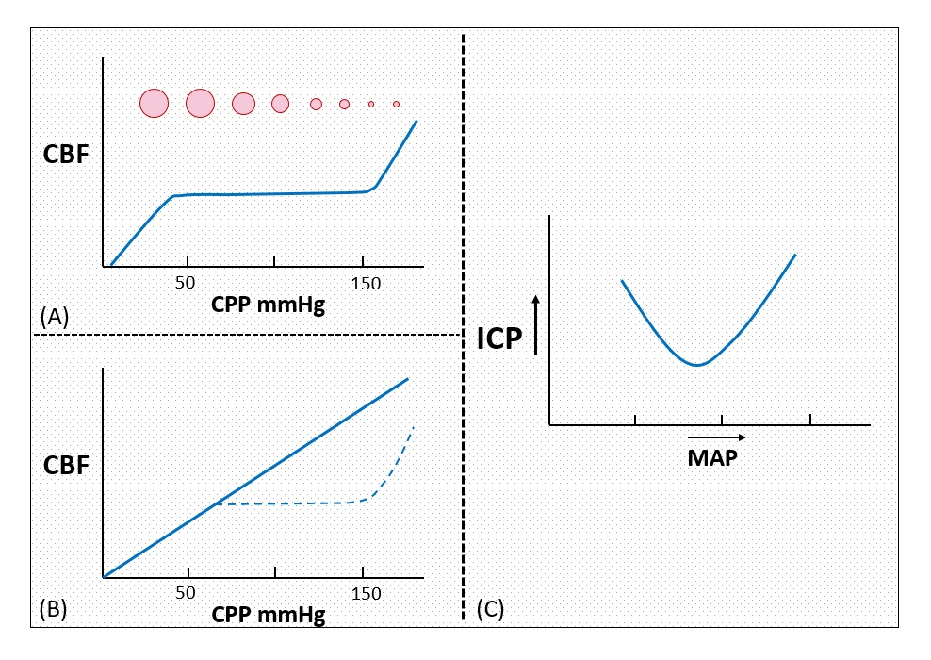

SDC 22. Bimodal ICP response to blood pressure-conceptual illustration. In a heterogeneously injured brain with areas of (A) normal and (B) abnormal autoregulation, (C) a bimodal response of ICP to MAP is expected based on physiology depicted in figure 1. MAP-mean arterial pressure, CBF-cerebral blood flow, CPP-cerebral perfusion pressure

