Slide 1
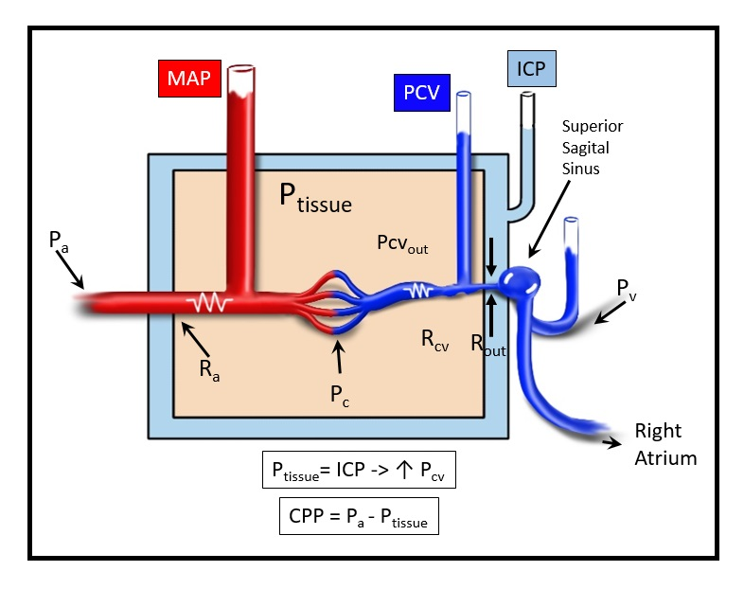
SDC 23
Mechanism of vasogenic edema from elevated ICP producing a venous outflow obstruction
Increased CSF pressure acts to produce a venous waterfall such that venous pressure and tissue pressure proximal to the venous obstruction increases as a consequence of elevated ICP. This in turn generates vasogenic edema (increased microvascular pressure, Pc) thereby increasing intracranial tissue volume to further increase ICP, resulting in a positive feedback cycle.⁴⁴ In this physiologic situation, extracranial venous pressure must exceed ICP in order to affect intracranial venous dynamics.
=
Pa,arterial blood pressure; Pc, capillary pressure; Pcv, cerebral venous pressure; Pv, extracranial venous pressure; MAP, mean arterial pressure; ICP, intracranial pressure; Ptissue, brain tissue pressure; Ra, arterial resistance; Rcv, resistance of brain tissue veins; Rout, resistance at venous outflow at point of Startling resistor

