Slide 1
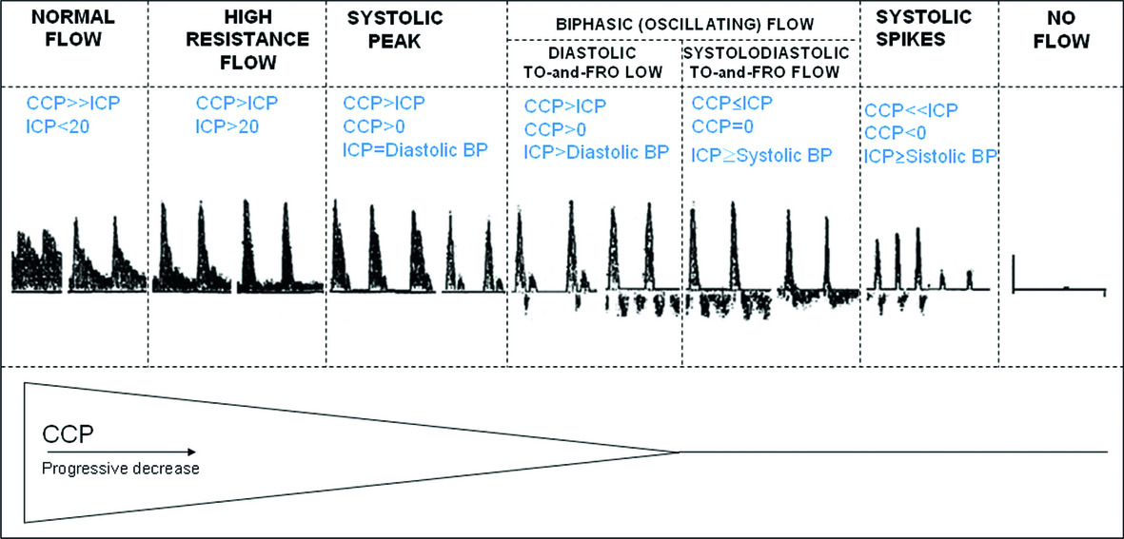
CPP→
Progressive Decrease
SDC 4. Cerebral oligemia with decreased cerebral perfusion pressure. A progressive decrement in cerebral perfusion pressure (low blood pressure and/or high intracranial pressure) produces a corresponding decrement in cerebral blood flow, illustrated here with TCD. Cerebral blood flow is normally continuous throughout the cardiac cycle. Initially increased ICP produces a high pulsatility waveform. As CPP decreases such that intracranial pressure exceeds critical closing pressure, cerebral blood flow during the cardiac cycle decreases to zero during diastole with flow arising only during systole. Further decrease in CPP eventually produces intracranial circulatory arrest reflected by reverse flow on TCD during diastole and eventually no detectable flow. Figure from Topcuoglu MA, with permission from John Wiley and Sons.
Topcuoglu MA:Transcranial Doppler ultrasound in neurovascular diseases: diagnostic and therapeutic aspects. Journal of Neurochemistry. 123(s2):39-51, 2012

