Slide 1
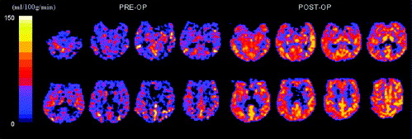
SDC 12. Anemia induced cerebral hyperemia in humans. Pre- and post-cardiac surgery CBF was determined in humans by magnetic resonance arterial spin labelling technique indicate a significant CBF increase post operatively. In this case, global CBF has increased from baseline(A) of 36 to 62 mL/min/100g on the fifth day after surgery. Of the 12 subjects reported, overall cerebral blood flow increased from preoperative 44.6 to 64.4 ml/100g/min postoperatively, for an average increase of 49.1% which was statistically associated with postoperative anemia. Figure from Floyd et.al., with permission from Elsevier
CBF, cerebral blood flow
Floyd T, McGarvey M, Ochroch E, et al. Perioperative changes in cerebral blood flow after cardiac surgery: influence of anemia and aging. Ann Thoracic Surg 2003;76 (6): 2037-42.

