Slide 1
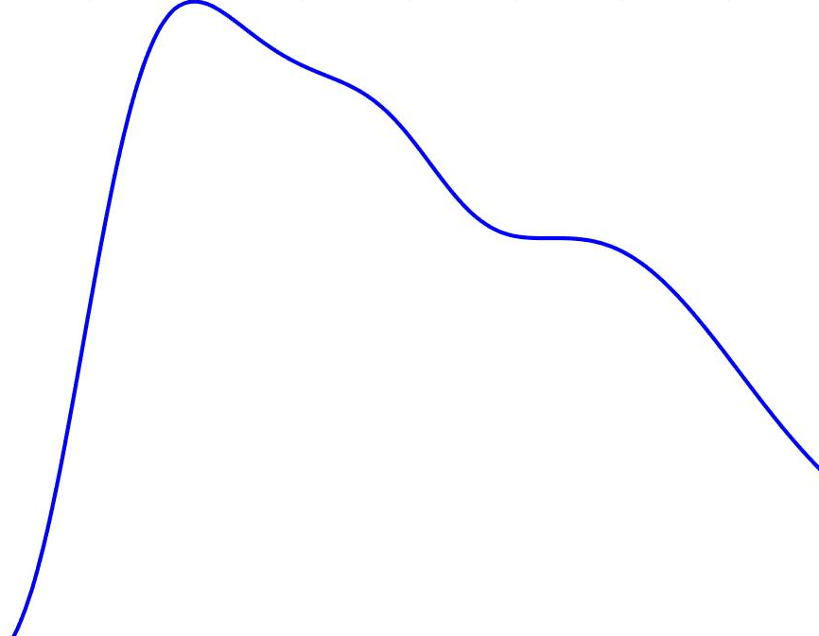
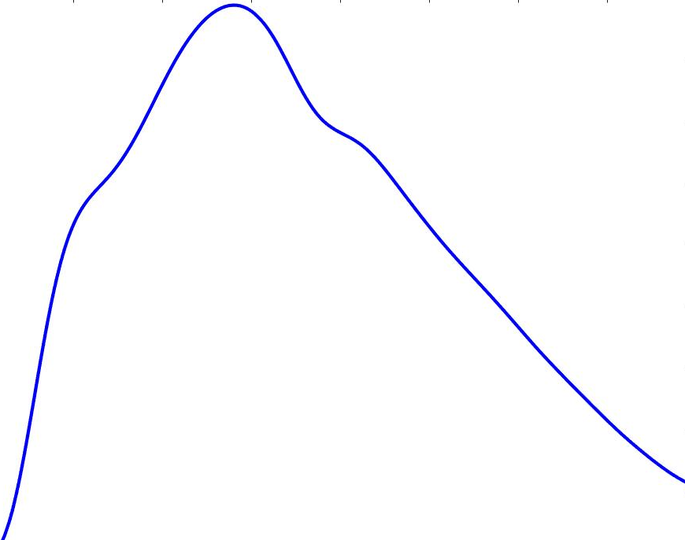
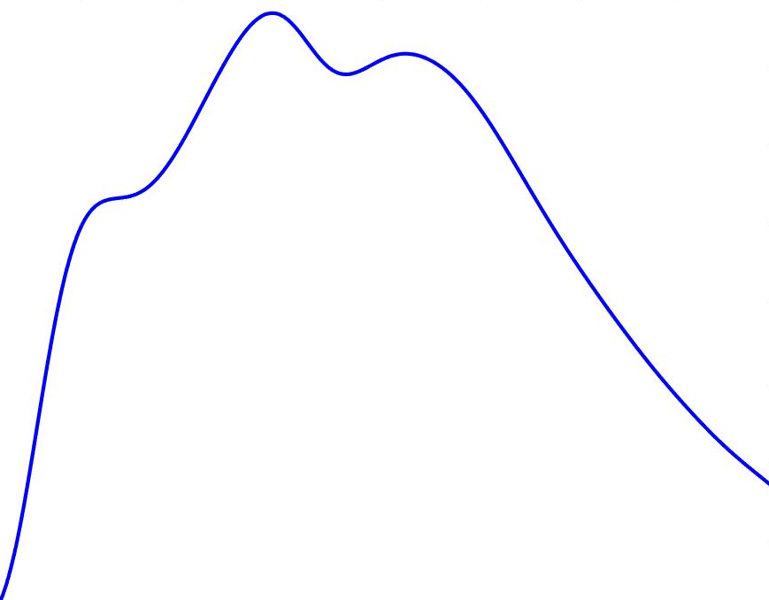
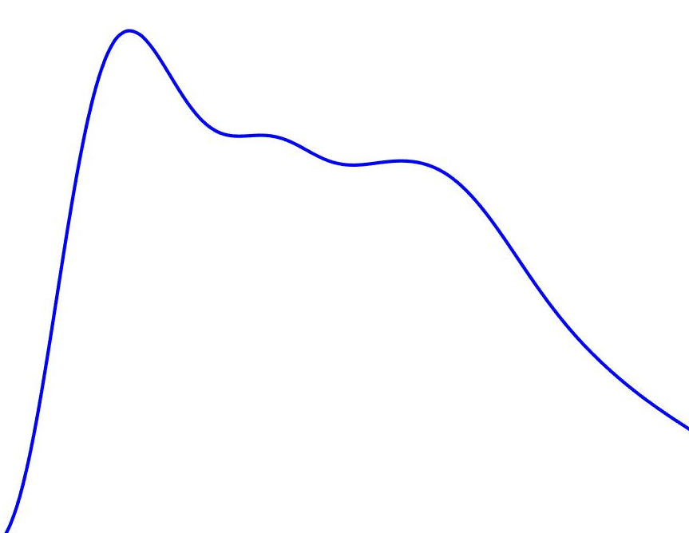
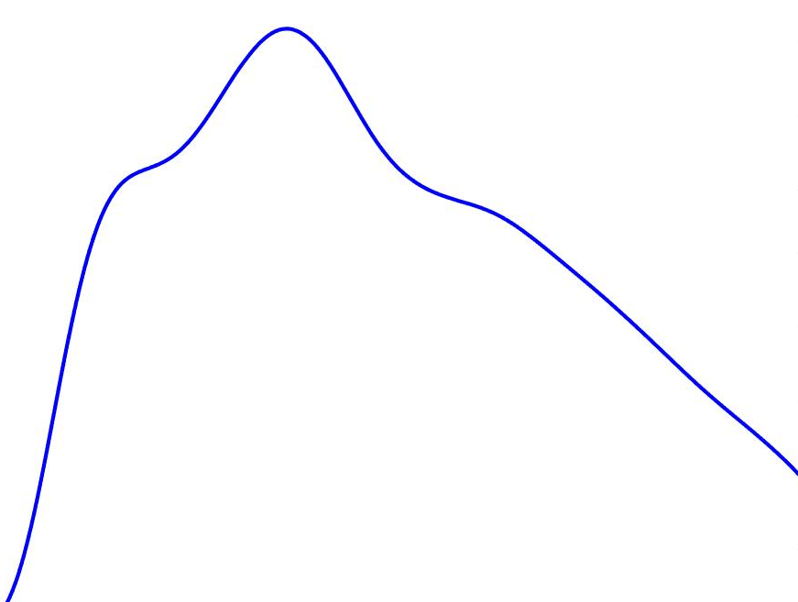
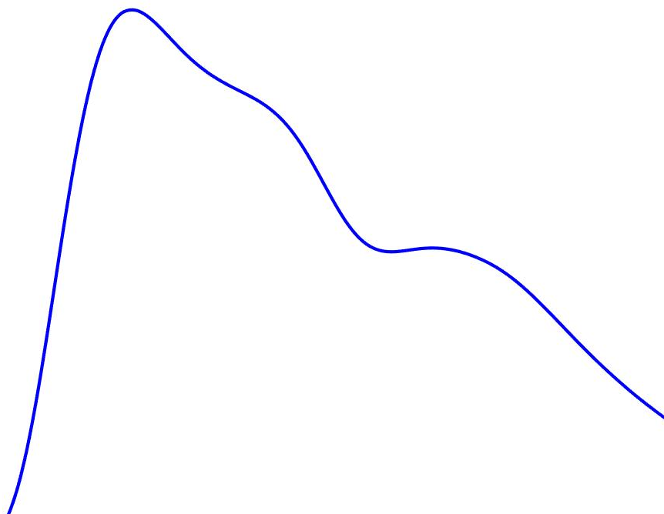


SDC 3. ICP waveform changes with decrements in compliance. Intracranial waveforms reflect the high compliance (normal) and low compliance state of the brain. Presumably, the percussion wave (P1) indicates arterial pulsation, the tidal wave (P2) represents the arterial pulse reflecting off the brain parenchyma, indicating cerebral compliance, and the dicrotic wave (P3) indicates the closure of the aortic valve. In the non-compliant waveform, the stroke volume associated with each cardiac cycle produces a larger increase in P2 reflecting the non-compliant state. Each waveforms was averaged and normalized based on expert review of 40 individual patient ICP waves.
ICP-intracranial pressure.

