Slide 1
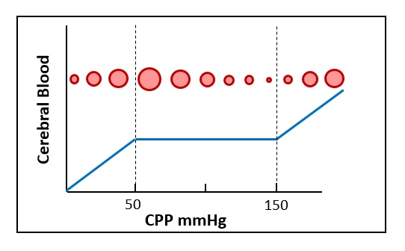
CBF (ml/min/100g)
CPP (mmHg)
SDC 5. Autoregulation of cerebral blood flow. CBF is maintained constant across a range of normal blood pressure, classically described as CPP 50-150 mmHg, although a higher lower limit of autoregulation has been suggested by Drummond. The upper and lower limits of autoregulation may also be at different levels in a given patient depending on prior chronic intracranial blood pressures. Note that the mechanism of autoregulation involves adjustment of intracranial vascular caliber. Below the lower limit of autoregulation vascular caliber theoretically can diminish whereas above the upper limit of autoregulation, vascular caliber may stay the same or enlarge. This impacts intracranial blood volume which may affect intracranial pressure as illustrated in supplemental digital content 2 intracranial compliance curve and described in the text. CBF-cerebral blood flow; CPP-cerebral perfusion pressure
Drummond JC. The lower limit of autoregulation: time to revise our thinking? Anesthesiology 1997;86: 1431-3

