Slide 1
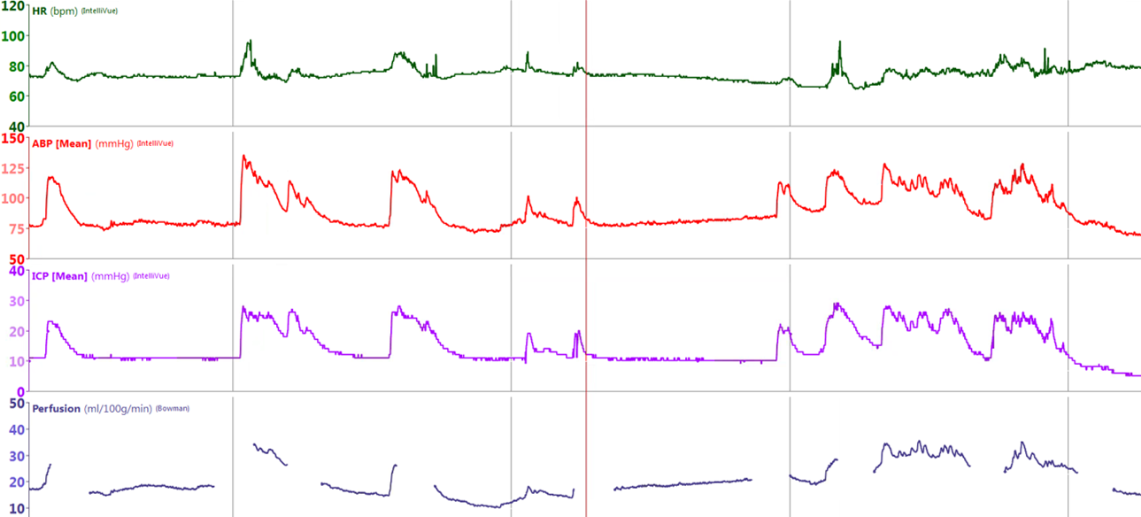
SDC 7. Hyperemic intracranial hypertension due to sympathetic storm. Physiologic graph from a UPenn NeuroICU patient after cardiac arrest with paroxysmal sympathetic hyperactivity. Episodes of tachycardia and hypertension associate with concurrent episodes of intracranial hypertension and cerebral hyperemia (thermodilution CBF monitor-labelled as perfusion in the graph). The thermodilution CBF monitor stops periodically to recalibrate, accounting for the periods with no data. Time between each grey bar is 30 minutes. CBF-cerebral blood flow; HR-heart rate; ABP-arterial blood pressure; ICP-intracranial pressure

