Slide 1
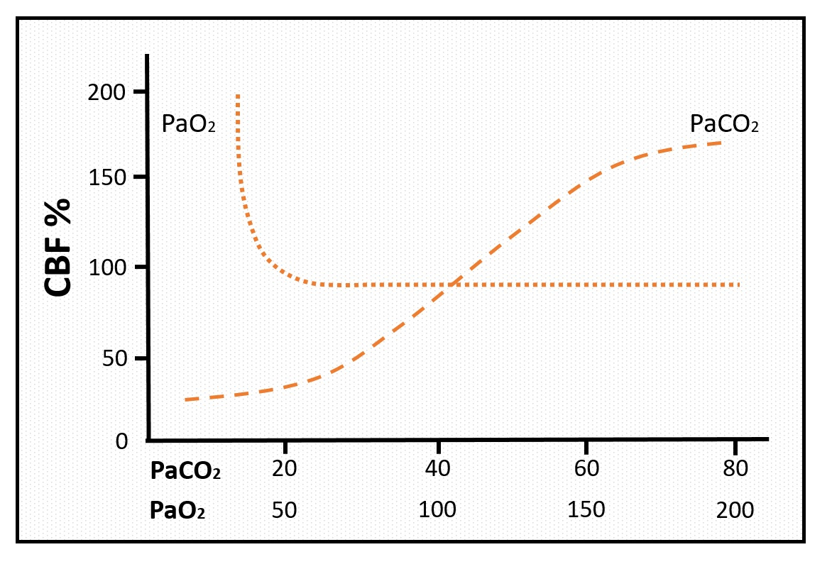
SDC 8. PaO₂ and PaCO₂ alter CBF. This figure approximates impact of PaO₂ and PaCO₂ (both in mmHg) on % change in CBF. Hyperoxia modestly decreases CBF, whereas PaO₂<50mmHg associates with marked increases in CBF. PaCO₂ on the other hand has a generally linear effect on CBF between about 20mmHg and 80mmHg, although this may be affected by accommodative mechanisms in chronic conditions. Notably hypercapnia and hypoxemia can be expected to associate with increased cerebral blood volume which could exacerbate elevated intracranial pressure in a poorly compliant brain. CBF-cerebral blood flow

