Slide 1
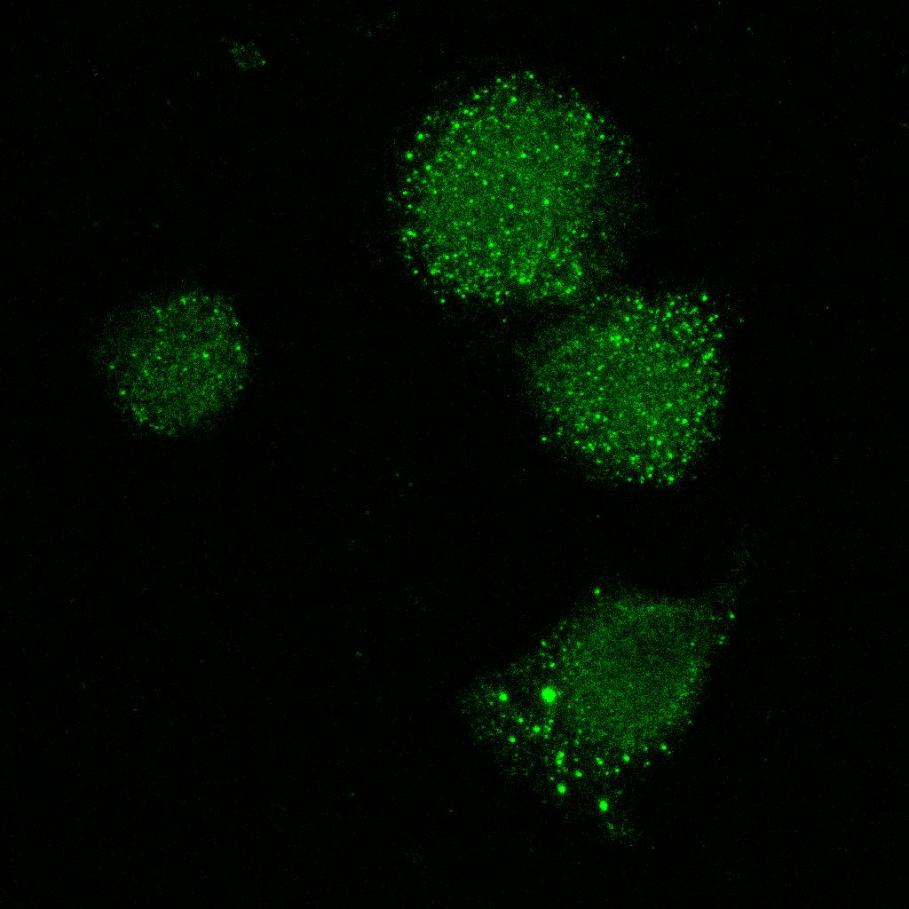
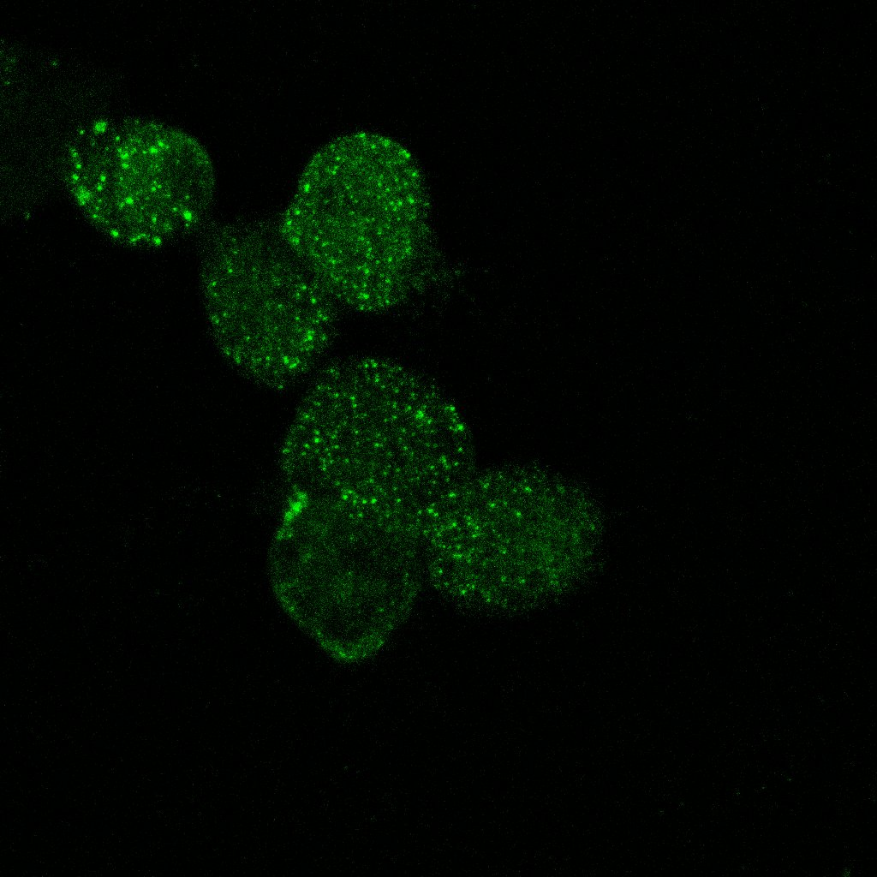
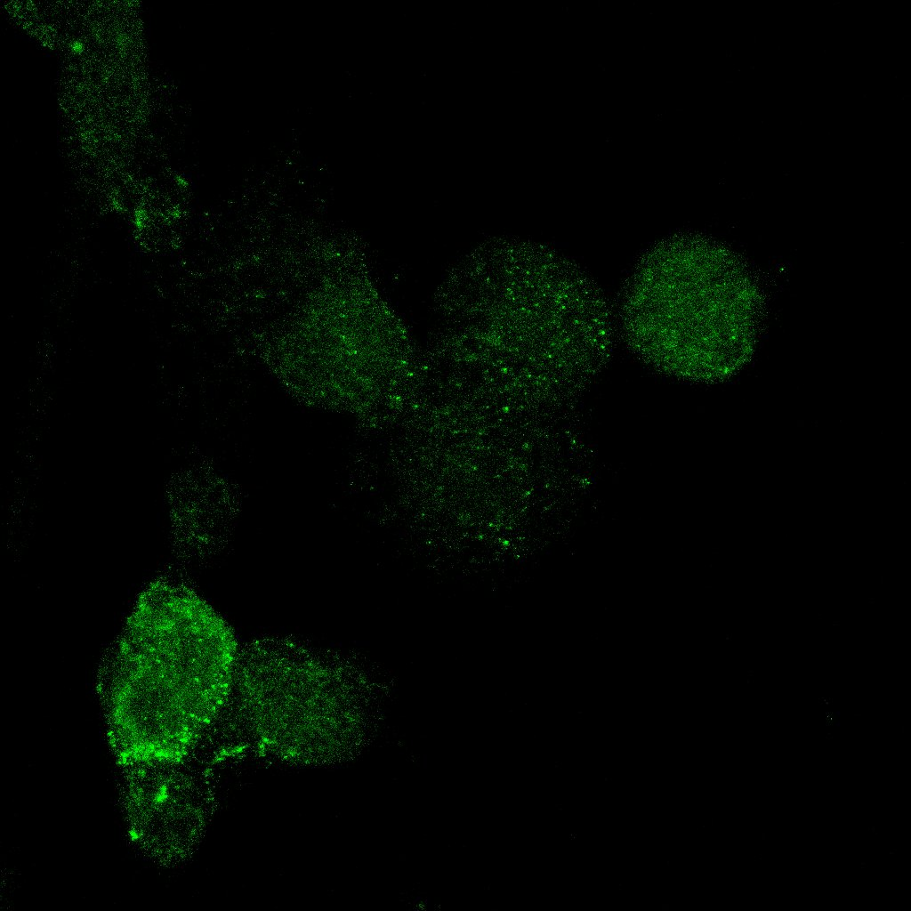
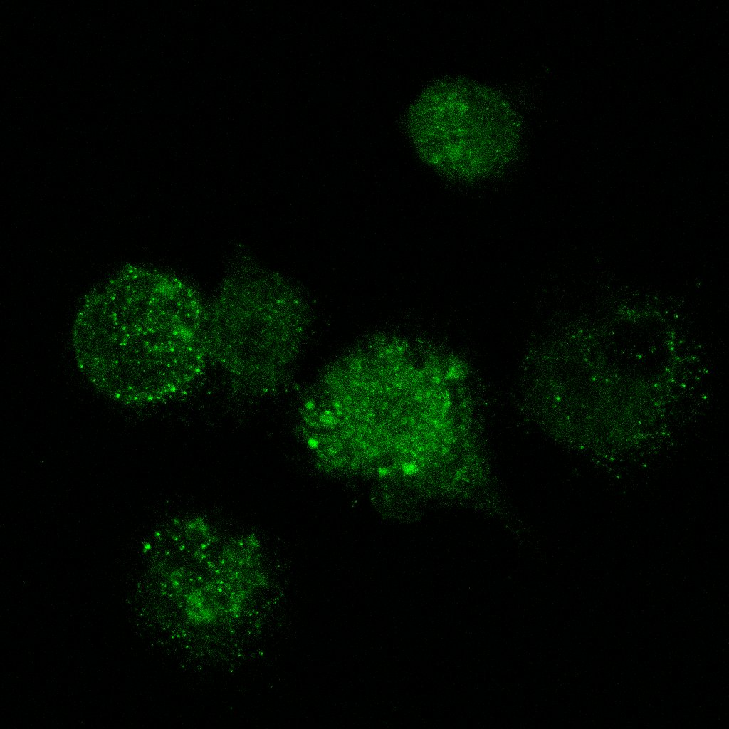
A.
(i)
(ii)
(iii)
B.
(i)
(ii)
(iii)
C.
D.
E.
Control
IPF
NT CQ
NT CQ
LC3B
Supplementary figure 3. A, B : (i) LC3b I, (ii)II and (iii) LC3bII/I densitometry analyses from western blots performed on 2 independent IPF/control cohorts, C and D : relative mRNA expression of p62 and Beclin1. E. Representative images of LC3b immunostained alveolar macrophages from IPF and control samples treated with CQ or left untreated. All graphs represent median and interquartile ranges, no significant differences observed according to Mann-Whitney test.
Notes:
Supplementary figure 3. A, B : (i) LC3b I, (ii)II and (iii) LC3bII/I densitometry analyses from western blots performed on 2 independent IPF/control cohorts, C and D : relative mRNA expression of p62 and Beclin1. E. Representative images of LC3b immunostained alveolar macrophages from IPF and control samples treated with CQ or left untreated. All graphs represent median and interquartile ranges, no significant differences observed according to Mann-Whitney test.

