Slide 1
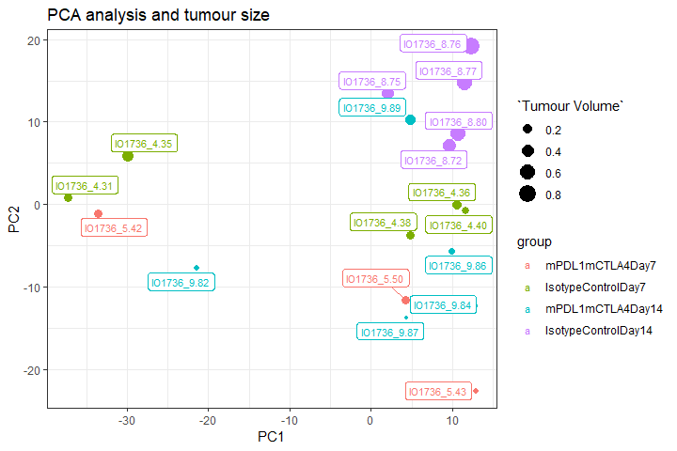
Supplementary Figure 4
Supplementary Figure 4 – Impact of tumor size on gene expression changes in CT-26
PCA plot indicating clustering of individual tumors. Samples are colored by treatment group and sized by tumor volume.

