Slide 1
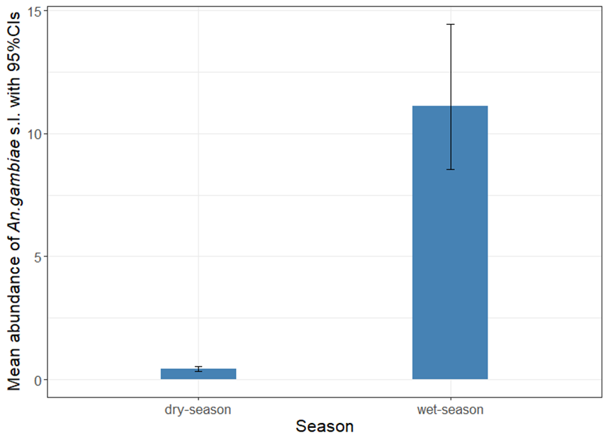
Additional Figure S5: Mean predicted number of An. gambiae s.l. collected per night and season over the trapping methods, location and village with 95% CIs. Dry season indicates An. gambiae s.l. collected from November to April whilst wet season corresponds to period between May and October.

