Slide 1
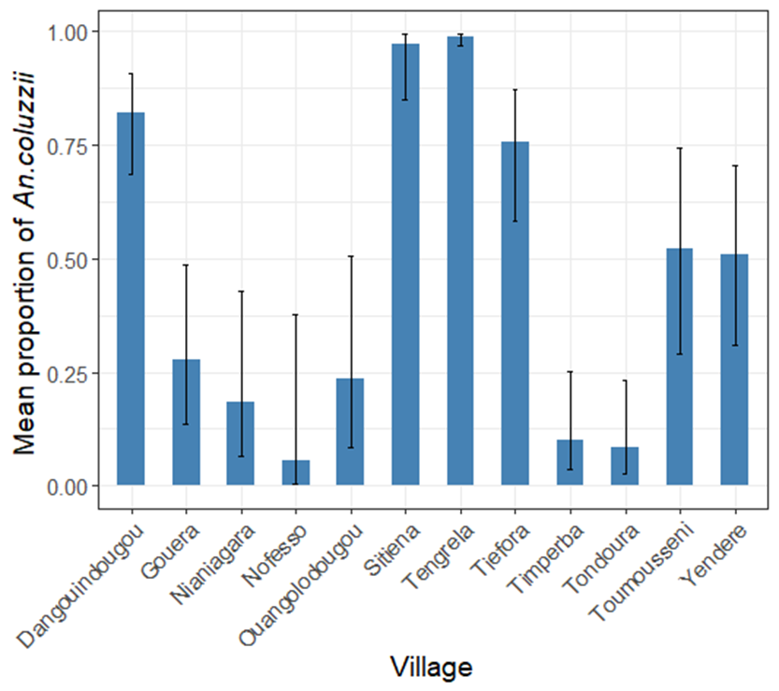
Additional Figure S6: Mean predicted proportion of An. coluzzii relative to An. gambiae collected per village from October 2016 to December 2017, pooled over the trapping location and methods, with 95% CIs.

