Slide 1
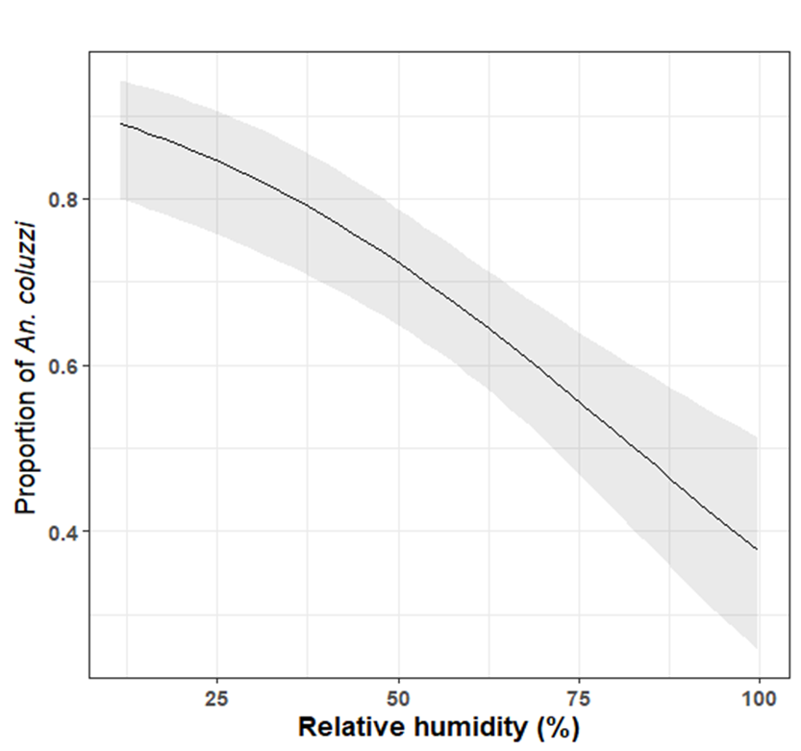
Additional Figure S7: Effect of the mean relative humidity on the estimation of the proportion of An. coluzzii. The solid black line is the regression line of the predicted proportions and the grey-shaded area indicate the 95% CIs.

