Slide 1
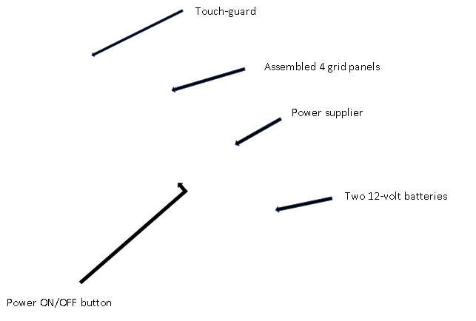
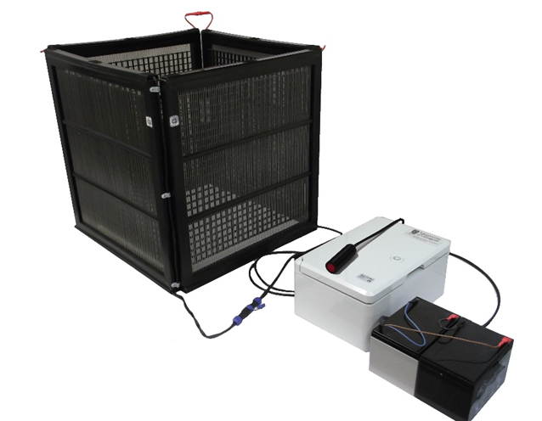
Additional Figure S1: Assembled Mosquito Electrocuting trap used for mosquito collections, connected to the power supplier and the 12-volt batteries.

