Slide 1
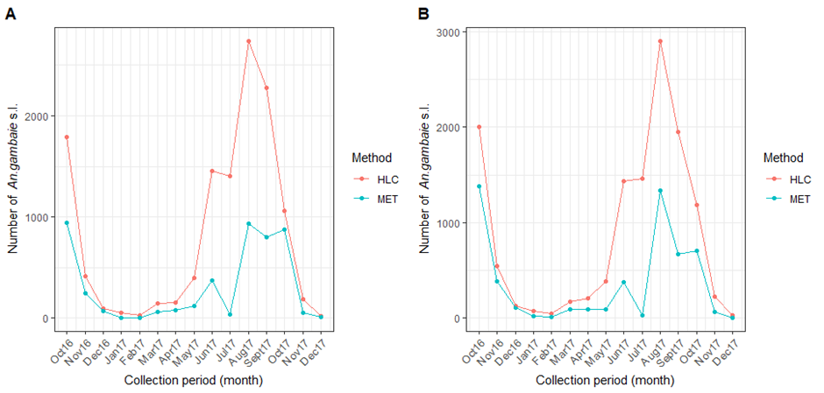
Additional Figure S3: Number (raw data) of An. gambiae s.l. collected per month from (October 2016 to December 2017 by trapping methods A) indoor and B) outdoor using Mosquito Electrocuting Trap (MET) and Human Landing Catch (HLC).

