Slide 1
JAMA Ophthalmology Journal Club Slides:
Glaucoma or Glaucoma Suspect in the First Year After Pediatric Lensectomy
Freedman SF, Kraker RT, Repka MX, et al; for the Pediatric Eye Disease Investigator Group (PEDIG). Incidence and management of glaucoma or glaucoma suspect in the first year after pediatric lensectomy. JAMA Ophthalmol. Published online November 21, 2019. doi:10.1001/jamaophthalmol.2019.4571

Slide 2
Introduction
Importance:
  Diagnosis of glaucoma or glaucoma suspect may occur following cataract removal in children. Identifying the risk for and factors associated with glaucoma or glaucoma suspect can guide clinical practice.
Objective:
  To estimate the incidence of glaucoma and glaucoma suspect and describe its management in the first year following lensectomy in children before age 13 years.

Slide 3
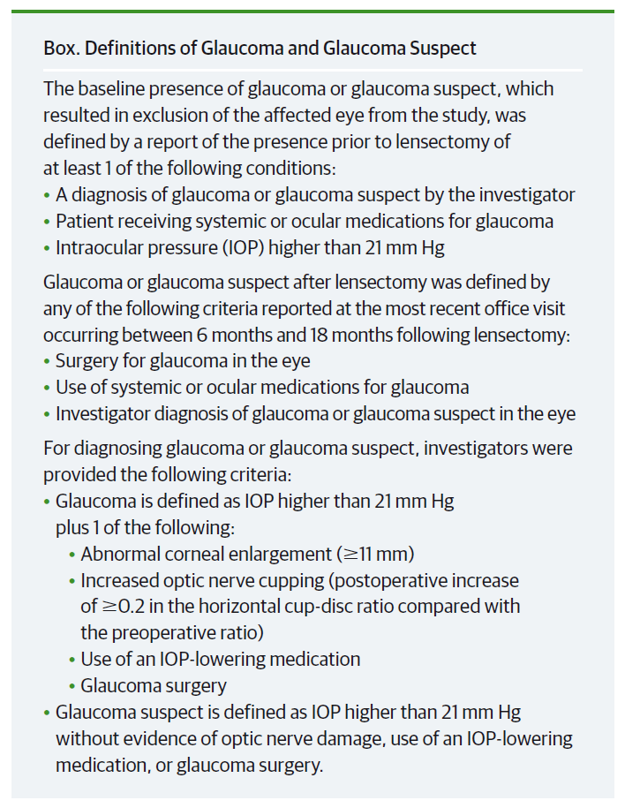
Methods
Definitions of Glaucoma and Glaucoma Suspect

Slide 4
Methods
Study Design, Setting, and Participants:
  A multicenter clinical research registry with sites in the United States (n = 57), Canada (n = 3), and the United Kingdom (n = 1).
  Children who underwent unilateral or bilateral lensectomy and were enrolled in the registry within 45 days after lensectomy were included.
Main Outcomes:
  Incidence risk of glaucoma or glaucoma suspect, using standardized definitions, within 1 year after lensectomy.
  Determine whether any of the following factors reported at lensectomy are associated with the risk of developing glaucoma or glaucoma suspect within 1 year following lensectomy: race/ethnicity, sex, age at lensectomy, laterality of lensectomy, other ocular abnormalities, anterior vitrectomy, intraocular lens implantation, and the occurrence of intraoperative complications.

Slide 5
Methods
Limitations:
  Overall, 17.8% of children were excluded from analyses because they had no documented office visit between 6 and 18 months after lensectomy.
  Our ability to identify risk factors for glaucoma or glaucoma suspect was limited by the low rate of glaucoma and glaucoma suspect.
  Anterior vitrectomy and aphakia were more frequent in younger children, making it difficult to separate the contributions of these surgical variables from the contribution of age to the observed association with glaucoma and glaucoma suspect.

Slide 6
Results
A total of 970 eyes of 702 patients were included in the analysis (353 [50.3%] male and 427 [60.8%] white; mean age at lensectomy, 3.4 years (range, 0.04-12.9 years).
Glaucoma or glaucoma suspect diagnosed in 66 of 970 eyes (adjusted overall incidence risk, 6.3%; 95% CI, 4.8%-8.3%).
The presence of glaucoma in 52 of these 66 eyes (adjusted incidence risk = 4.7%) was established on the basis of glaucoma surgery (n = 23), investigator diagnosis of glaucoma (n = 17), or use of glaucoma medications without investigator diagnosis of glaucoma (n = 12)
Treatment included surgery in 23 of 66 eyes (34.8%), medication alone for 26 eyes (39.4%), and observation alone for 17 eyes (25.8%).
No association was observed between risk of developing glaucoma or glaucoma suspect and any of the following factors: sex, race/ethnicity, anterior segment abnormalities, anterior vitrectomy at lensectomy, laterality of lensectomy, and presence of intraoperative complications.

Slide 7
Results
Univariate Relative Risks of Developing Glaucoma or
Glaucoma Suspect 1 Year After Lensectomy
Filled squares represent the relative risk of glaucoma or glaucoma suspect, and error bars represent the corresponding 99% CI. Associations between risk factors and the development of glaucoma or glaucoma suspect are considered significant if the 99% CI does not include 1.

Slide 8
Results
Baseline Factors Associated with Glaucoma or Glaucoma Suspect
Two factors were associated with glaucoma or glaucoma suspect:
  Age at lensectomy
  Primary intraocular implant
Because primary intraocular implantation was highly correlated with age at lensectomy, the association of those 2 factors could not be separated.
Factor at Time of Lensectomy | Total Eyes | N with Glaucoma or Glaucoma Suspect | % with Glaucoma or Glaucoma Suspect (99% CI) | Relative Risk (99% CI)
Age at Lensectomy
≤3 months | 256 | 41 | 15.7 (10.1 to 24.5) | 4.57 (2.19 to 9.57)
>3 months to <13 years | 714 | 25 | 3.4 (1.9 to 6.2) | 1 [Reference]
Primary IOL Implant
No (aphakia) | 438 | 53 | 11.2 (7.6 to 16.7) | 4.29 (1.84 to 10.01)
Yes (pseudophakia) | 532 | 13 | 2.6 (1.2 to 5.6) | 1 [Reference]

Slide 9
Comment
Glaucoma or glaucoma suspect was reported in few eyes (6.3%) in the first year after lensectomy.
Risk of glaucoma or glaucoma suspect in the first year after lensectomy in this registry was lower than that reported by other studies (but this registry included older children).^{1,2}
Because age at lensectomy (<3 mo) was highly associated with continuing to have aphakia in our study, we could not separate the association of young age with aphakia.
Therefore, we conclude that either age ≤3 months at lensectomy, aphakia or both are associated with the risk of developing glaucoma or glaucoma suspect in the first year following lensectomy.
¹Solebo AL, Russell-Eggitt I, Cumberland PM, Rahi JS. Risks and outcomes associated with primary intraocular lens implantation in children under 2 years of age: the IoLunder2 cohort study. Br J Ophthalmol. 2015;99(11):1471-1476.
²Beck AD, Freedman SF, Lynn MJ, Bothun ED, Neely DE, Lambert SR. Glaucoma-related adverse events in the Infant Aphakia Treatment Study: 1-year results. Arch Ophthalmol. 2012;130(3):300-305.

Slide 10
Contact Information
If you have questions, please contact the corresponding author:
  Sharon F. Freedman, MD, Jaeb Center for Health Research, 15310 Amberly Dr, Ste 350, Tampa, FL 33647 (pedig@jaeb.org).
  Funding/Support
This study was supported by grants EY011751 (Mr Kraker), EY023198 (Dr Wallace), and EY018810 from the National Eye Institute of the National Institutes of Health, Department of Health and Human Services.
Conflict of Interest Disclosures
None reported.

