Slide 1





Saline-push Improves Rubidium-82
PET Image Quality
Journal of Nuclear Cardiology | Official Journal of the American Society of Nuclear Cardiology
  Jennifer M Renaud, Kai Yi Wu, Kimberly Gardner,
  May Aung, Rob SB Beanlands, Robert A deKemp
  University of Ottawa Heart Institute, Ontario, Canada
Institution
Picture/Logo
Optional
Copyright American Society of Nuclear Cardiology

Slide 2
BACKGROUND
Journal of Nuclear Cardiology | Official Journal of the American Society of Nuclear Cardiology
1- Rubidium-82 (⁸²Rb) PET is used widely for myocardial perfusion imaging.
2- Maintaining image quality over the full shelf-life of the generator is a challenge using ⁸²Rb PET in patients who are obese or have low cardiac output.
3- This study investigated if an additional saline-push following the ⁸²Rb elution improves image quality.
Copyright American Society of Nuclear Cardiology

Slide 3
METHODS
Journal of Nuclear Cardiology | Official Journal of the American Society of Nuclear Cardiology
Study type: Retrospective, observational, paired cohort.
Study subjects: Six scans (4 rest, 2 stress) performed without (-push) and then with (+push) 26 mL saline flush of the ⁸²Rb- generator tubing, patient IV lines, peripheral and central veins.
Study endpoints:
  Primary end point(s): Changes in image counts, SNR, CNR and blood background noise (COV)
  Secondary end point(s): Correlation with LVEF
Study variables:
  Elution mode: ± saline-push
  Eluted ⁸²Rb activity
  Patient LVEF
Copyright American Society of Nuclear Cardiology

Slide 4
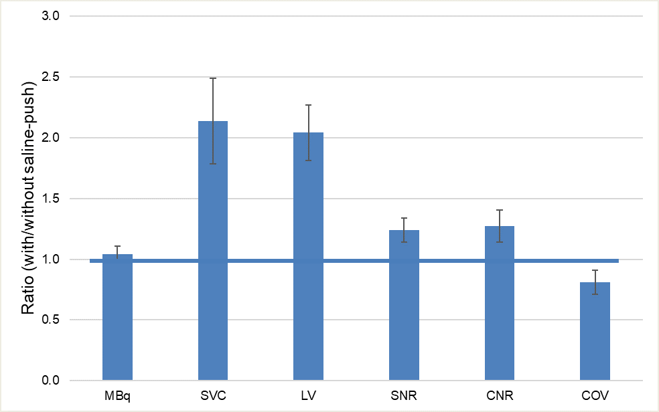
RESULTS
Journal of Nuclear Cardiology | Official Journal of the American Society of Nuclear Cardiology
Effects on ⁸²Rb image quality with vs. without saline-push. Total ⁸²Rb activity (MBq) eluted from the generator was unchanged, but the activity delivered to the heart (SVC) and retained in the LV myocardium increased by more than 2-fold. LV-to-blood SNR and CNR increased by 24% and 27%, with concordant decrease in the blood background COV by 19% (all p≤0.01).
Error bars are ±95% confidence intervals of the mean.
Copyright American Society of Nuclear Cardiology

Slide 5
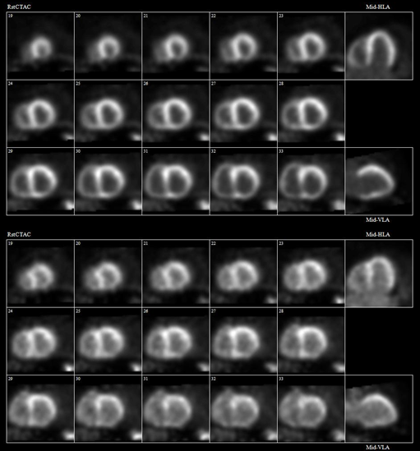
RESULTS
Journal of Nuclear Cardiology | Official Journal of the American Society of Nuclear Cardiology
A
⁸²Rb PET perfusion images at rest in patient #1 (59-year-old male, 138 kg, BMI=48, LVEF=25%) obtained with (A) and without (B) the additional 26 mL saline-push following elution of the prescribed activity from the generator. Image quality and myocardium-to-blood contrast are improved markedly using the saline-push.
B
Copyright American Society of Nuclear Cardiology

Slide 6
CONCLUSIONS
Journal of Nuclear Cardiology | Official Journal of the American Society of Nuclear Cardiology
1- Saline-push of 25-30 mL is recommended following elution of the prescribed activity from a ⁸²Rb generator to flush the infuser tubing, patient IV lines, and to increase venous return to the heart.
2- This simple technique increases myocardial uptake by 2X, and image SNR and CNR by 25%.
3- The benefits to improve image quality may be highest in patients with low cardiac output to help accelerate clearance from the blood pool.
Copyright American Society of Nuclear Cardiology

