Slide 1
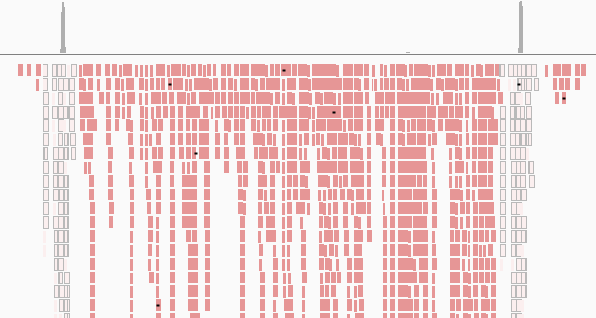
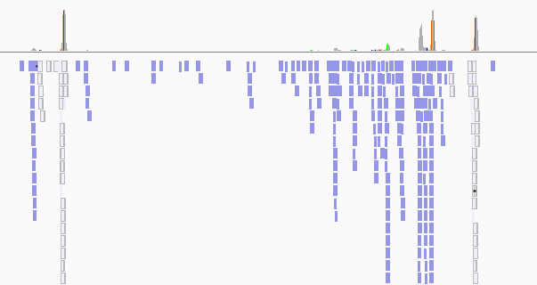
Additional figure 1
7000
5’LTR
3’LTR
200
Additional Figure 1. CAGE result of TBX-4B cells.
Sense (top) and anti-sense (bottom) transcripts of TBX-4B aligning the proviral sequence are shown separately.

