Slide 1
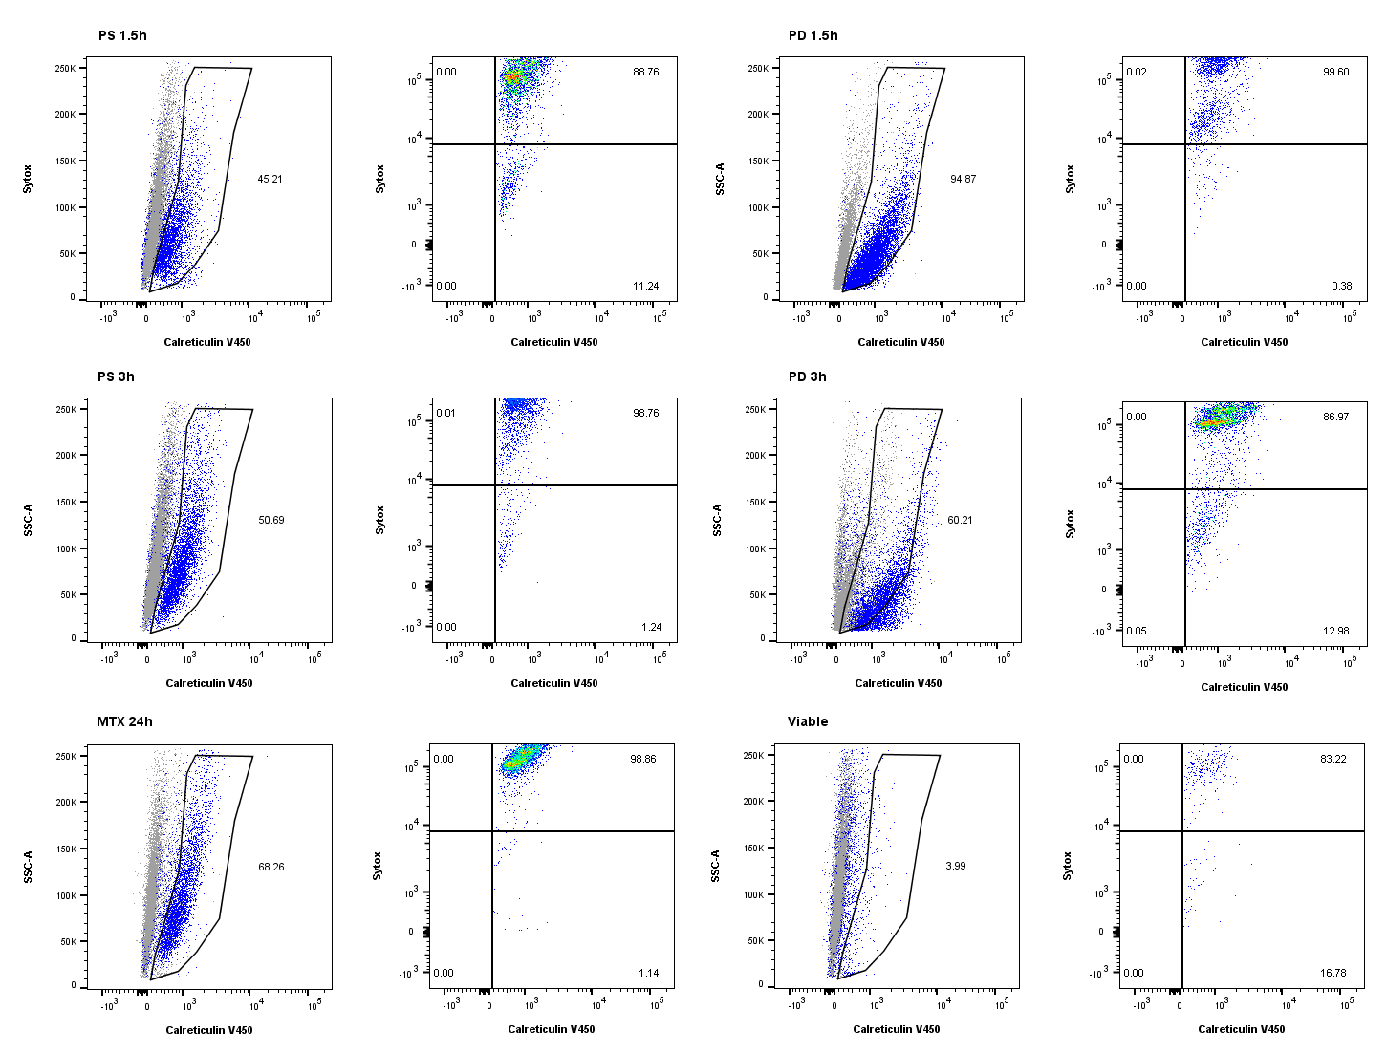
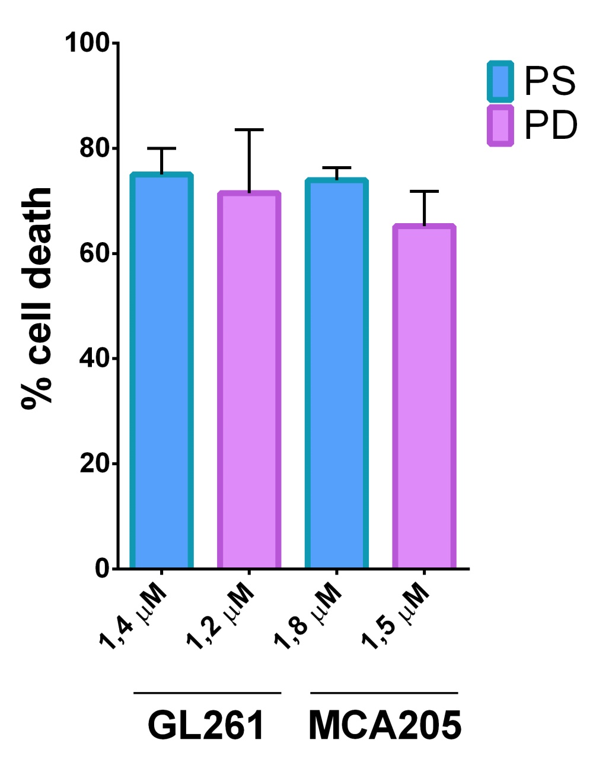
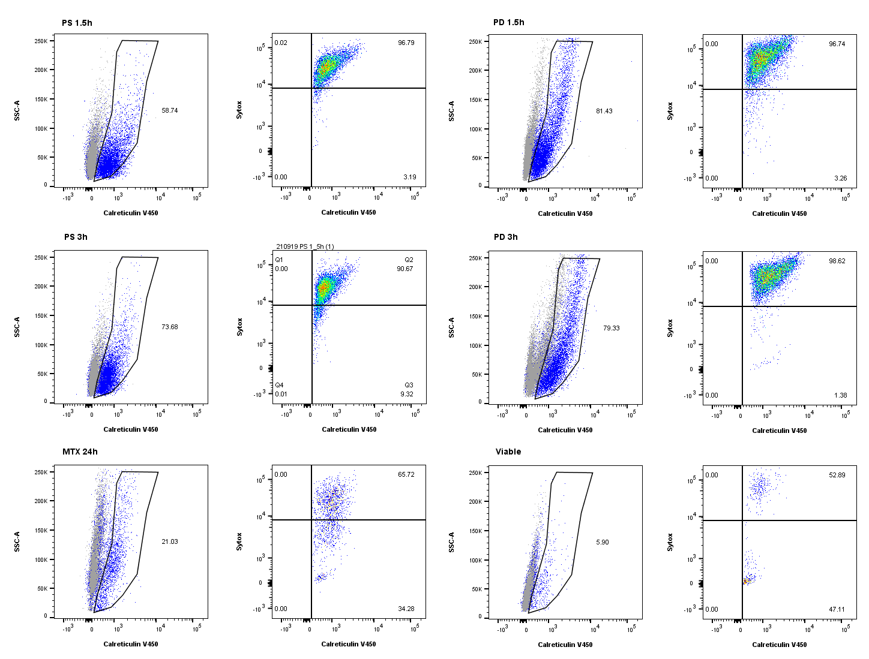
A
PS 1,5h
PD 1,5h
C
PS 3h
PD 3h
MTX
live GL261
B
PS 1,5h
PD 1,5h
PS 3h
PD 3h
MTX
live MCA205
Supplementary Figure 2

