Slide 1
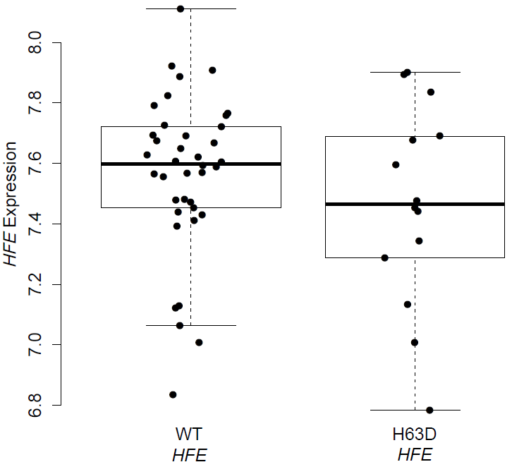
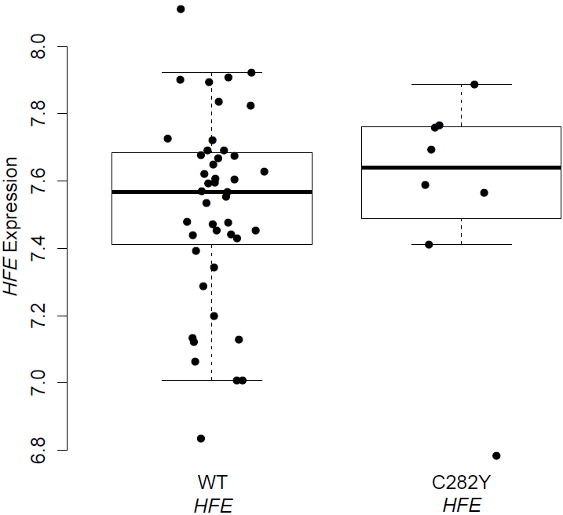
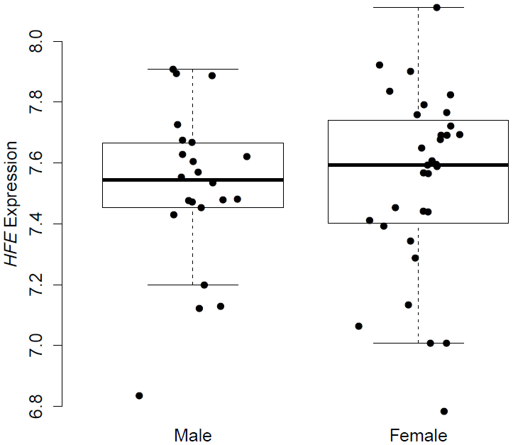
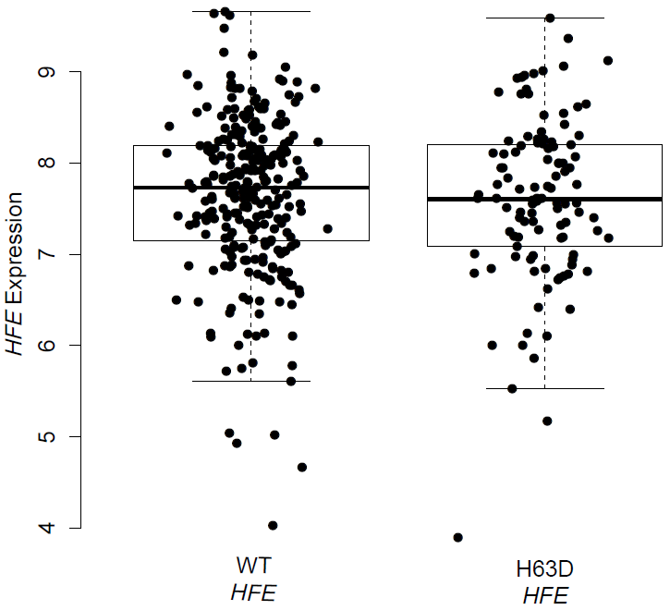
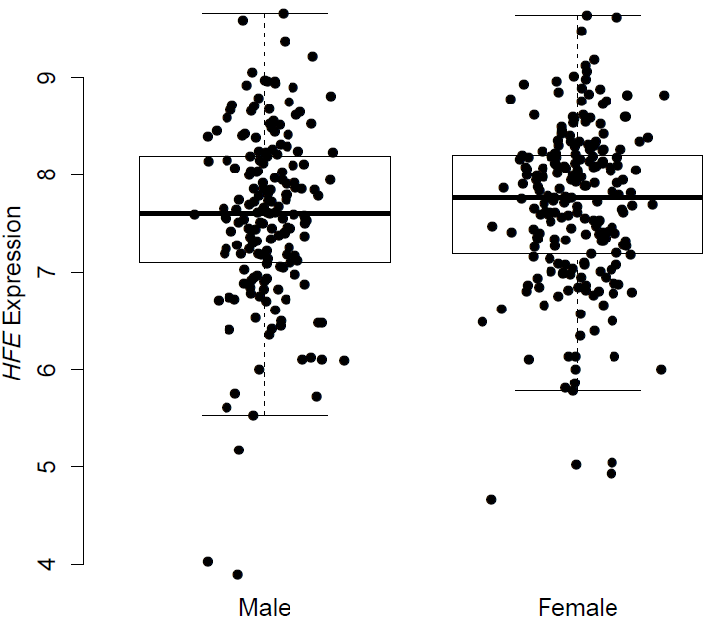
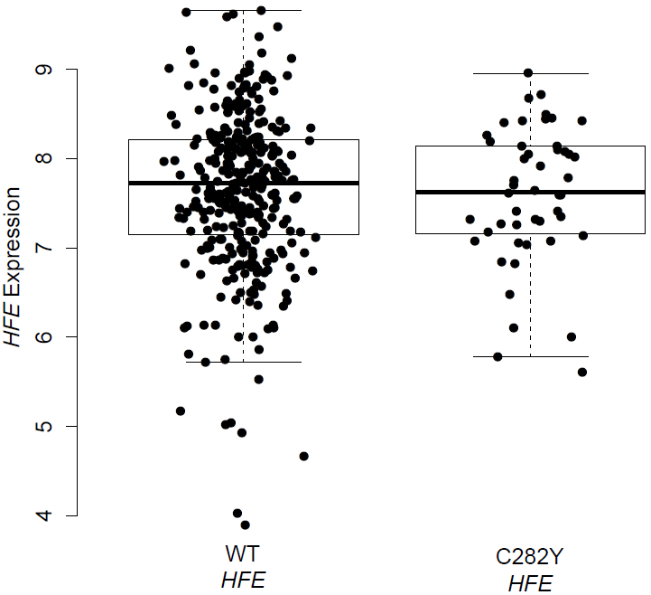
A.
B.
C.
Matched Normal
p=0.352
Matched Normal
p=0.509
Matched Normal
p=0.619
Primary Tumor
p=0.642
Primary Tumor
p=0.671
Primary Tumor
p=0.188

