Slide 1
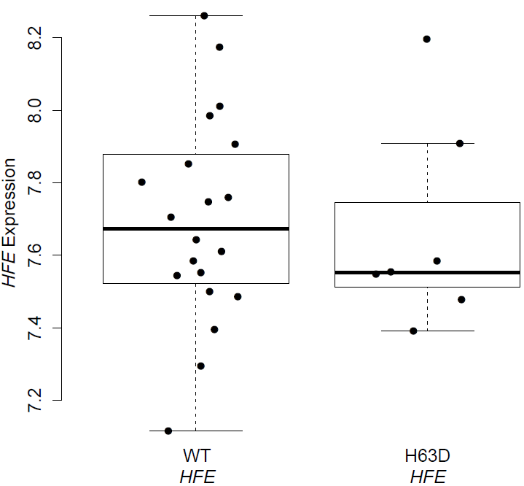
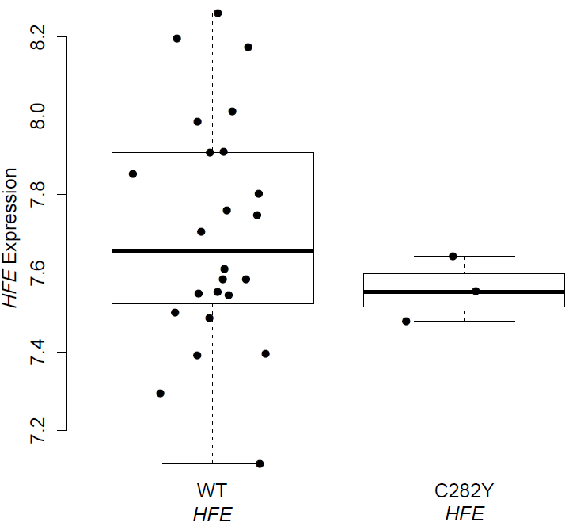
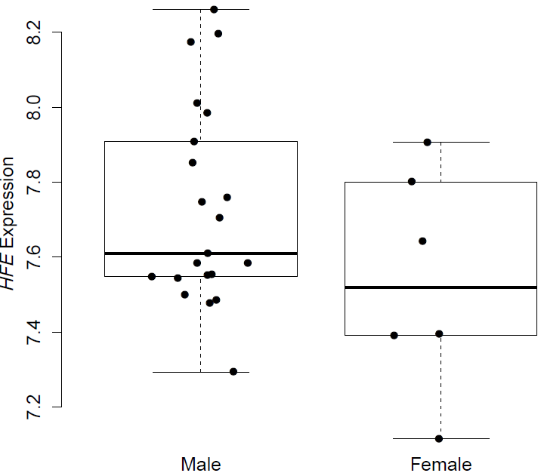
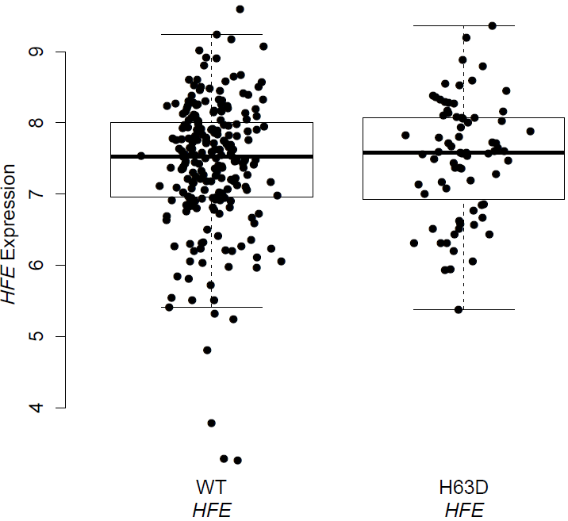
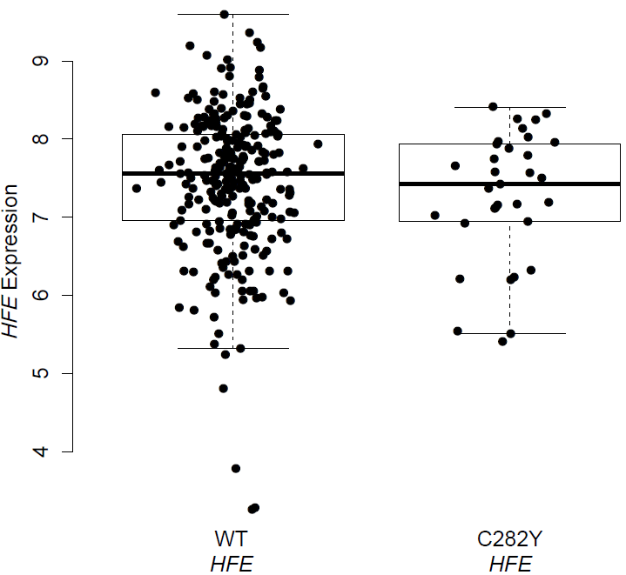
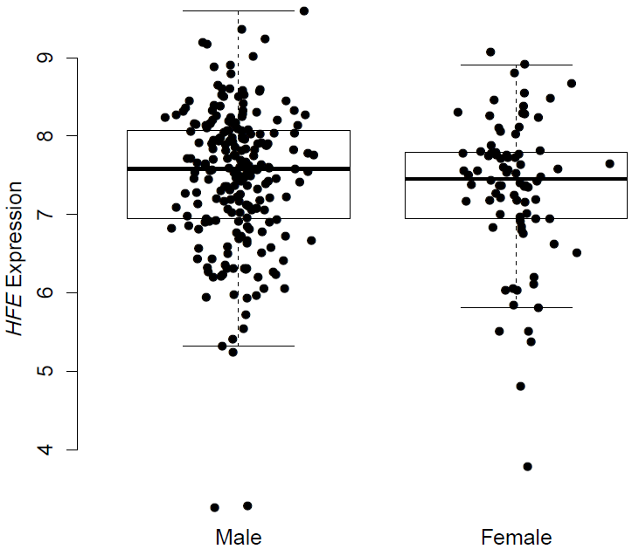
A.
B.
C.
Matched Normal
p=0.607
Matched Normal
p=0.437
Matched Normal
p=0.239
Primary Tumor
p=0.517
Primary Tumor
p=0.295
Primary Tumor
p=0.219

