Slide 1
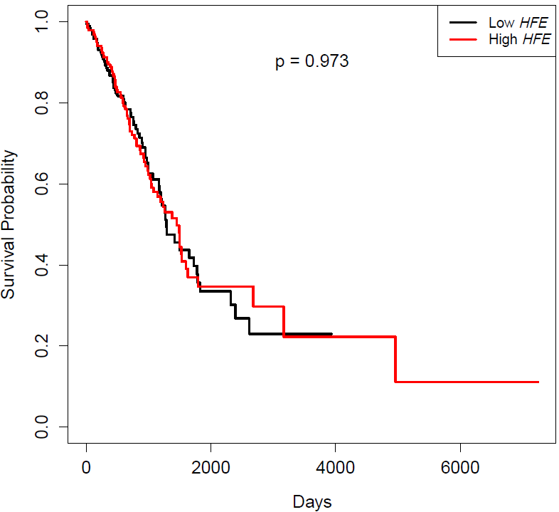
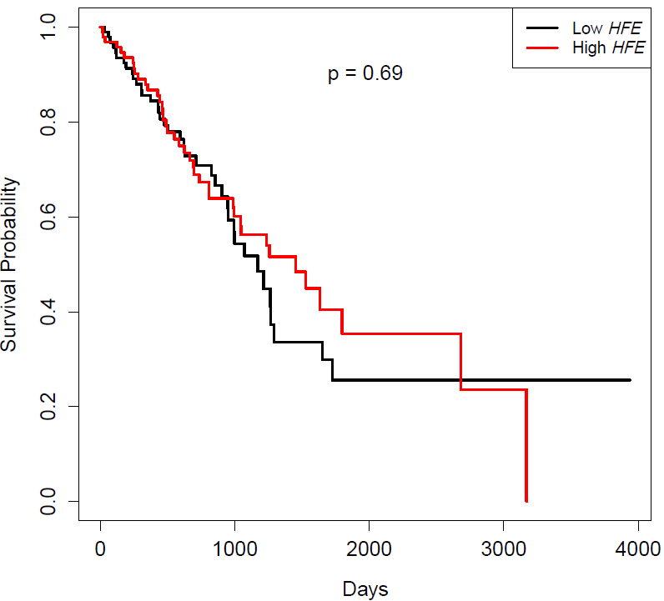
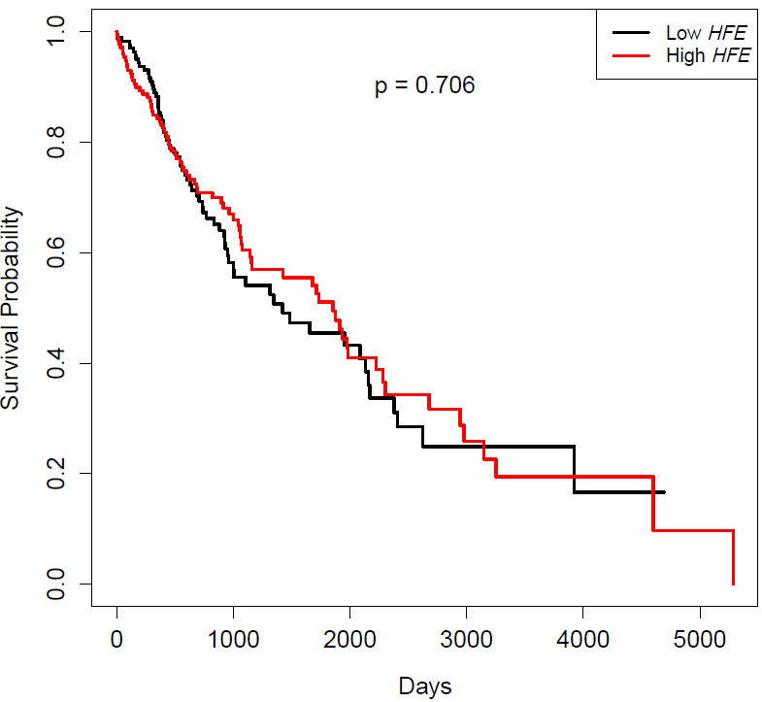
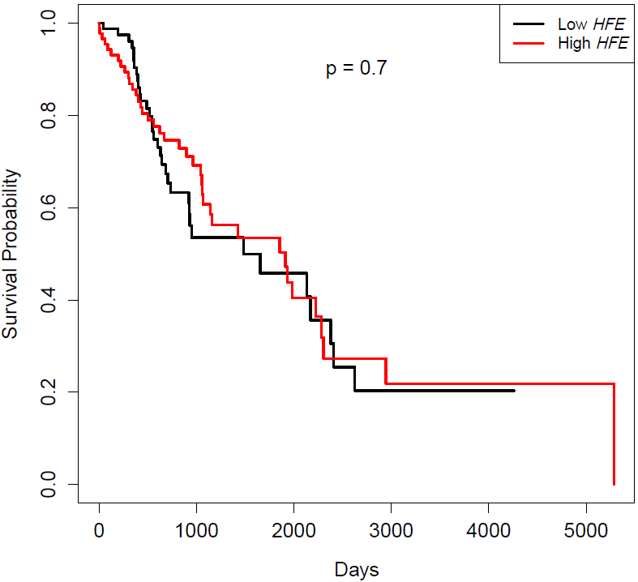
A.
B.
p=0.973
p=0.690
LUAD: lower 50% vs. upper 50%
LUAD: lower 25% vs. upper 75%
C.
D.
p=0.706
p=0.700
LUSC: lower 50% vs. upper 50%
LUSC: lower 25% vs. upper 75%

