Slide 1
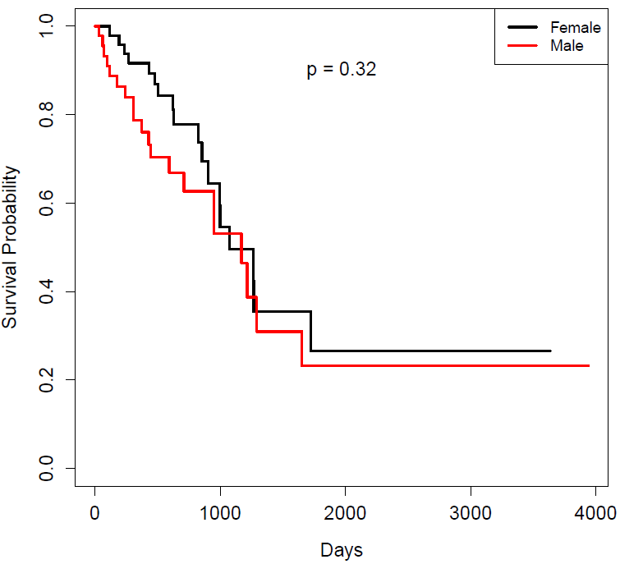
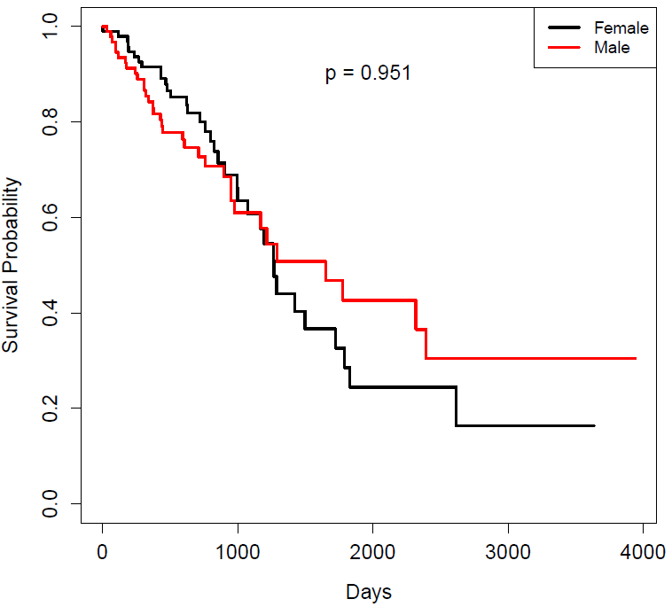
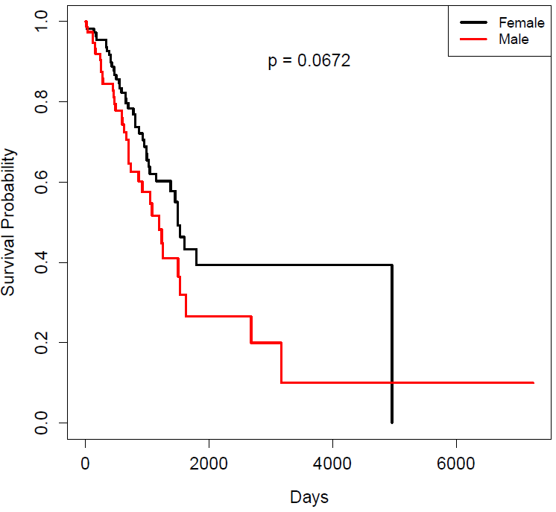
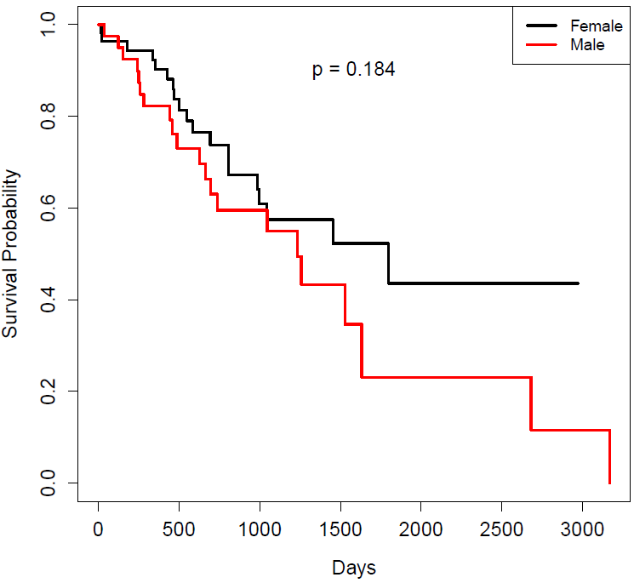
A.
B.
p=0.3209
p=0.951
LUAD: lower 25%
LUAD: lower 50%
C.
D.
p=0.0672
p=0.184
LUAD: upper 50%
LUAD: upper 75%

