Slide 1
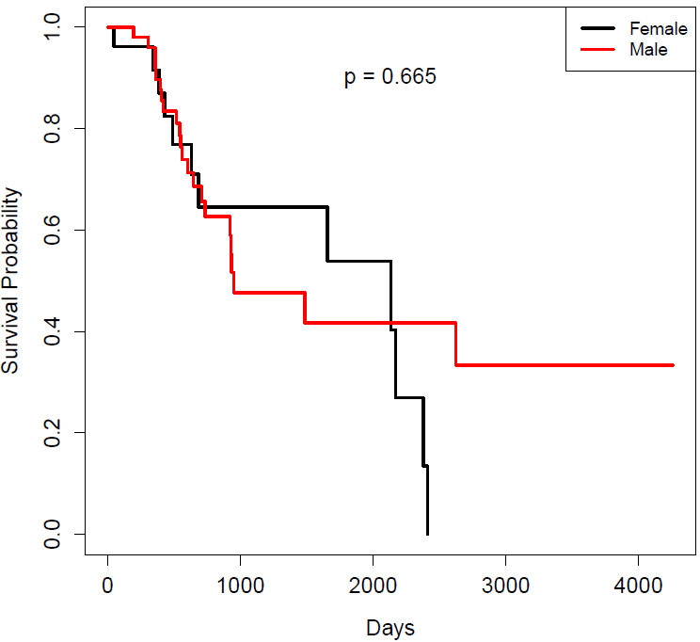
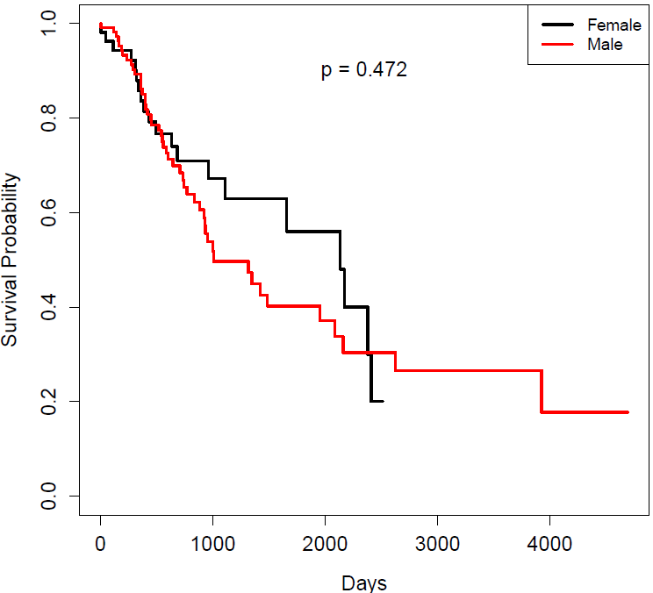
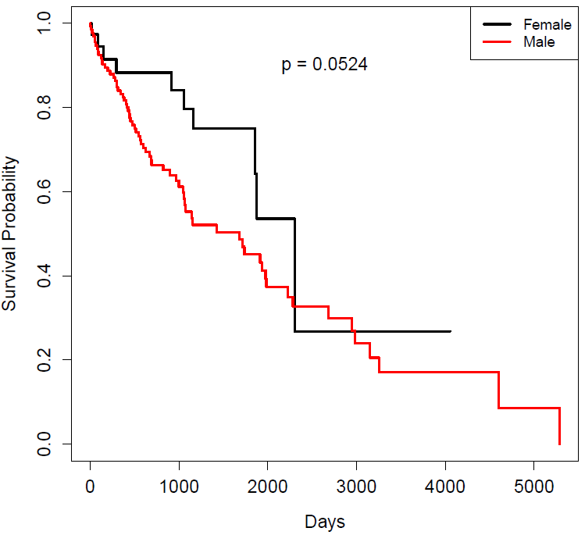
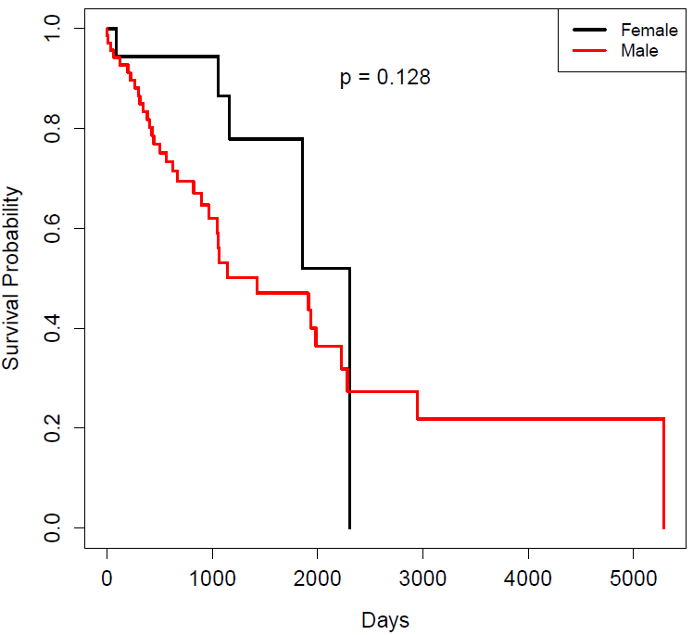
A.
B.
p=0.665
p=0.472
LUSC: lower 25%
LUSC: lower 50%
C.
D.
p=0.0524
p=0.128
LUSC: upper 50%
LUSC: upper 75%

