Slide 1
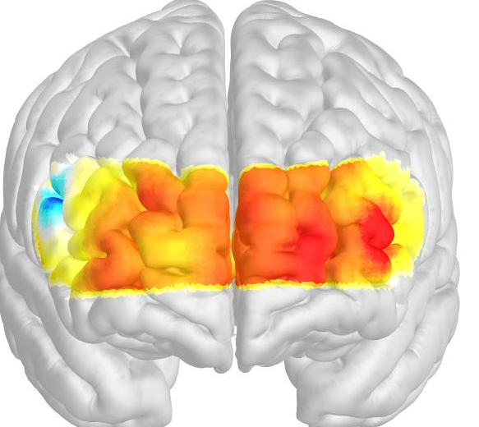
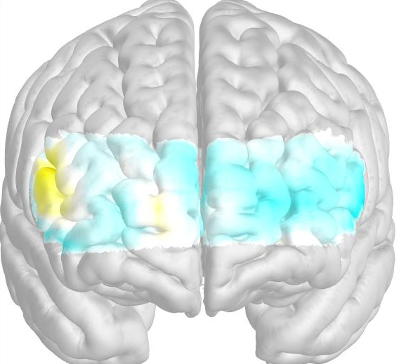
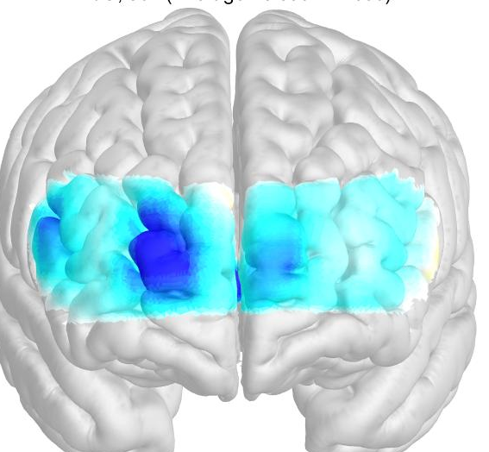
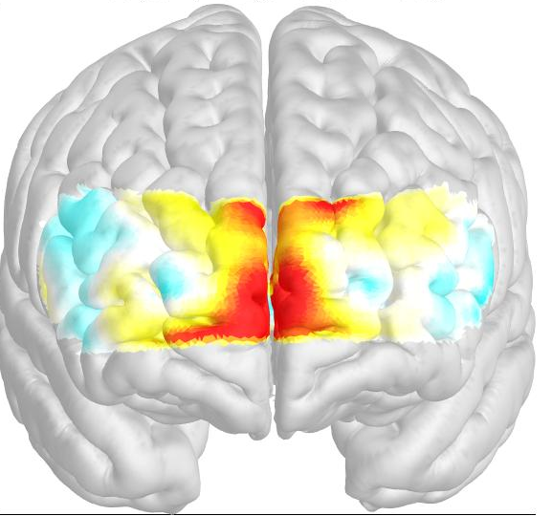
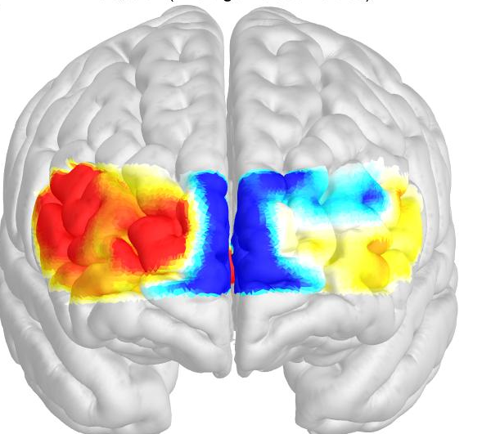
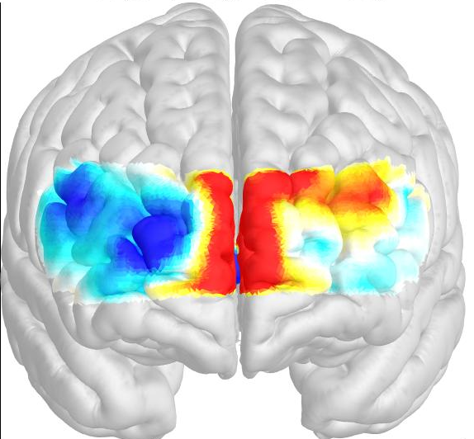
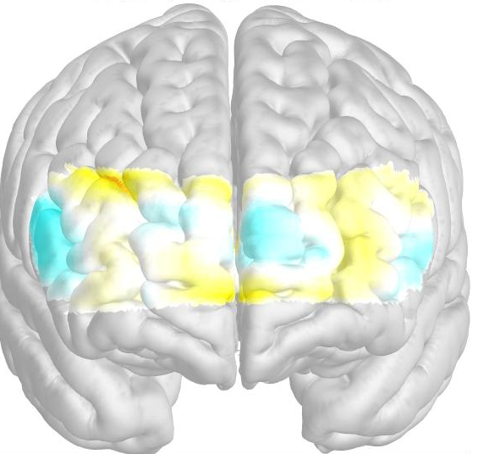
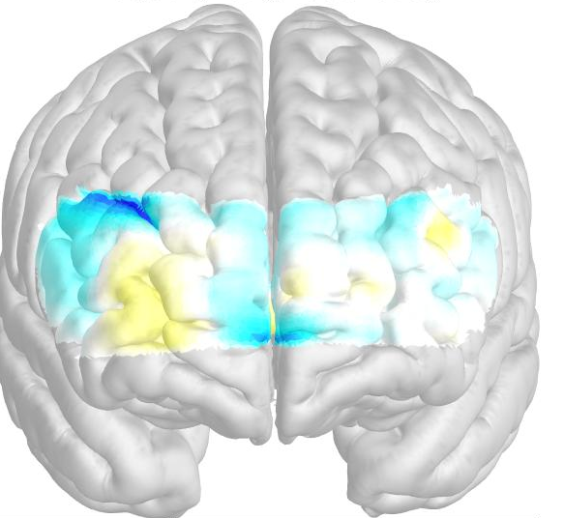
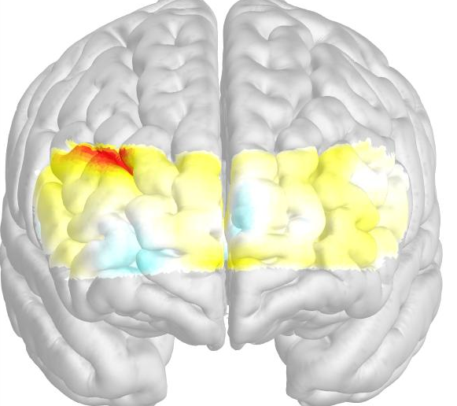
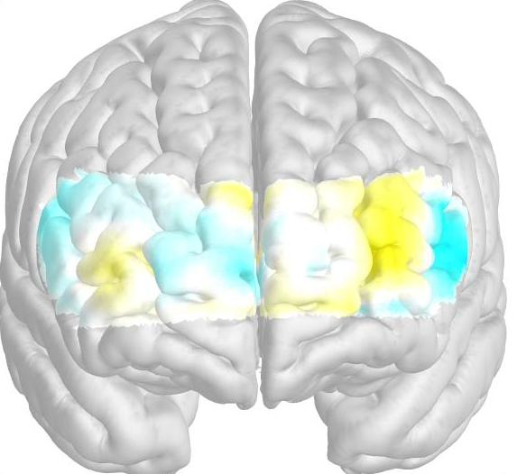
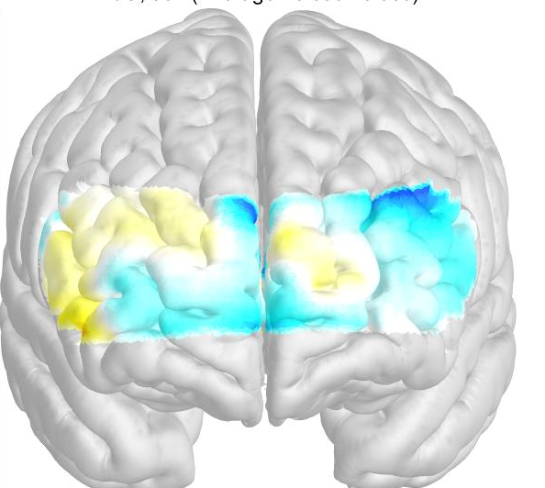
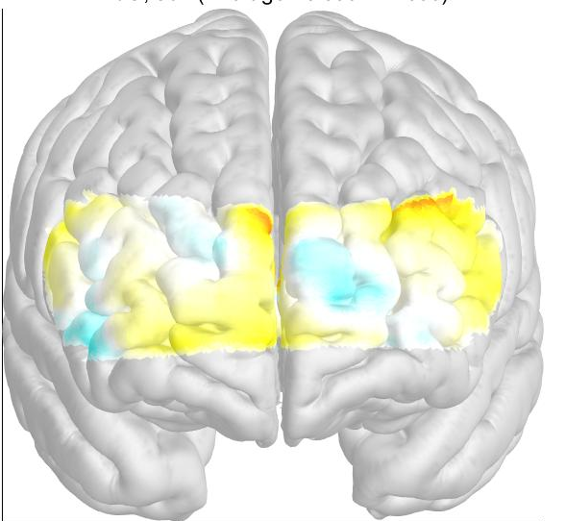
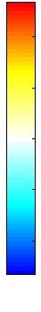
Supplementary Figure 1. Topographical images of oxygenated hemoglobin concentration pre- (session 0) and post-(session 16) NF training. The activation pattern in case 3 (A) and case 4 (B). NF = neurofeedback, 1st EH = 1st EH delay/hold period, ED = during emotional distraction, 2nd EH = 2nd EH delay/hold period.
(A)
 | 1st EH | ED | 2nd EH
Session 0
Session 16
(B)
 | 1st EH | ED | 2nd EH
Session 0
Session 16
HbO₂ level
X10⁻⁴
2
0
-2

