Slide 1
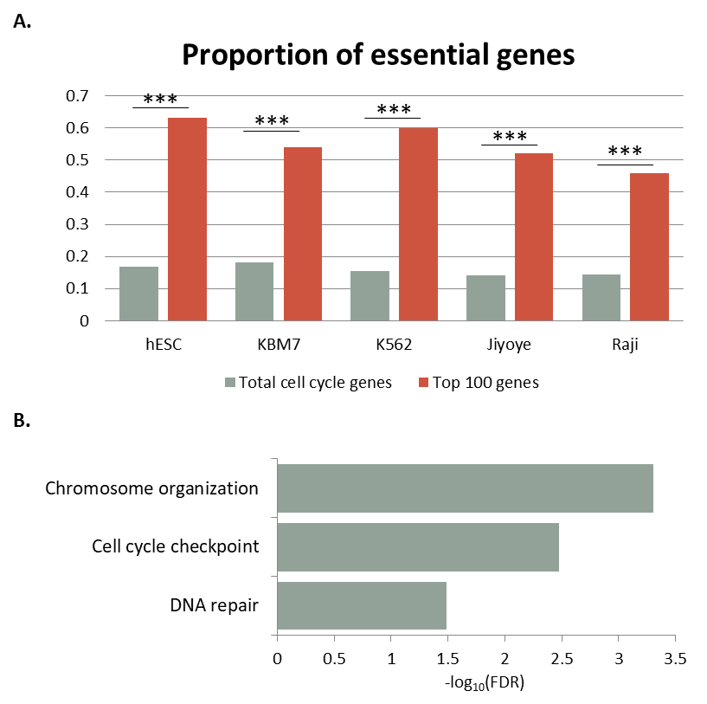
Supplementary Fig. 1

Slide 2
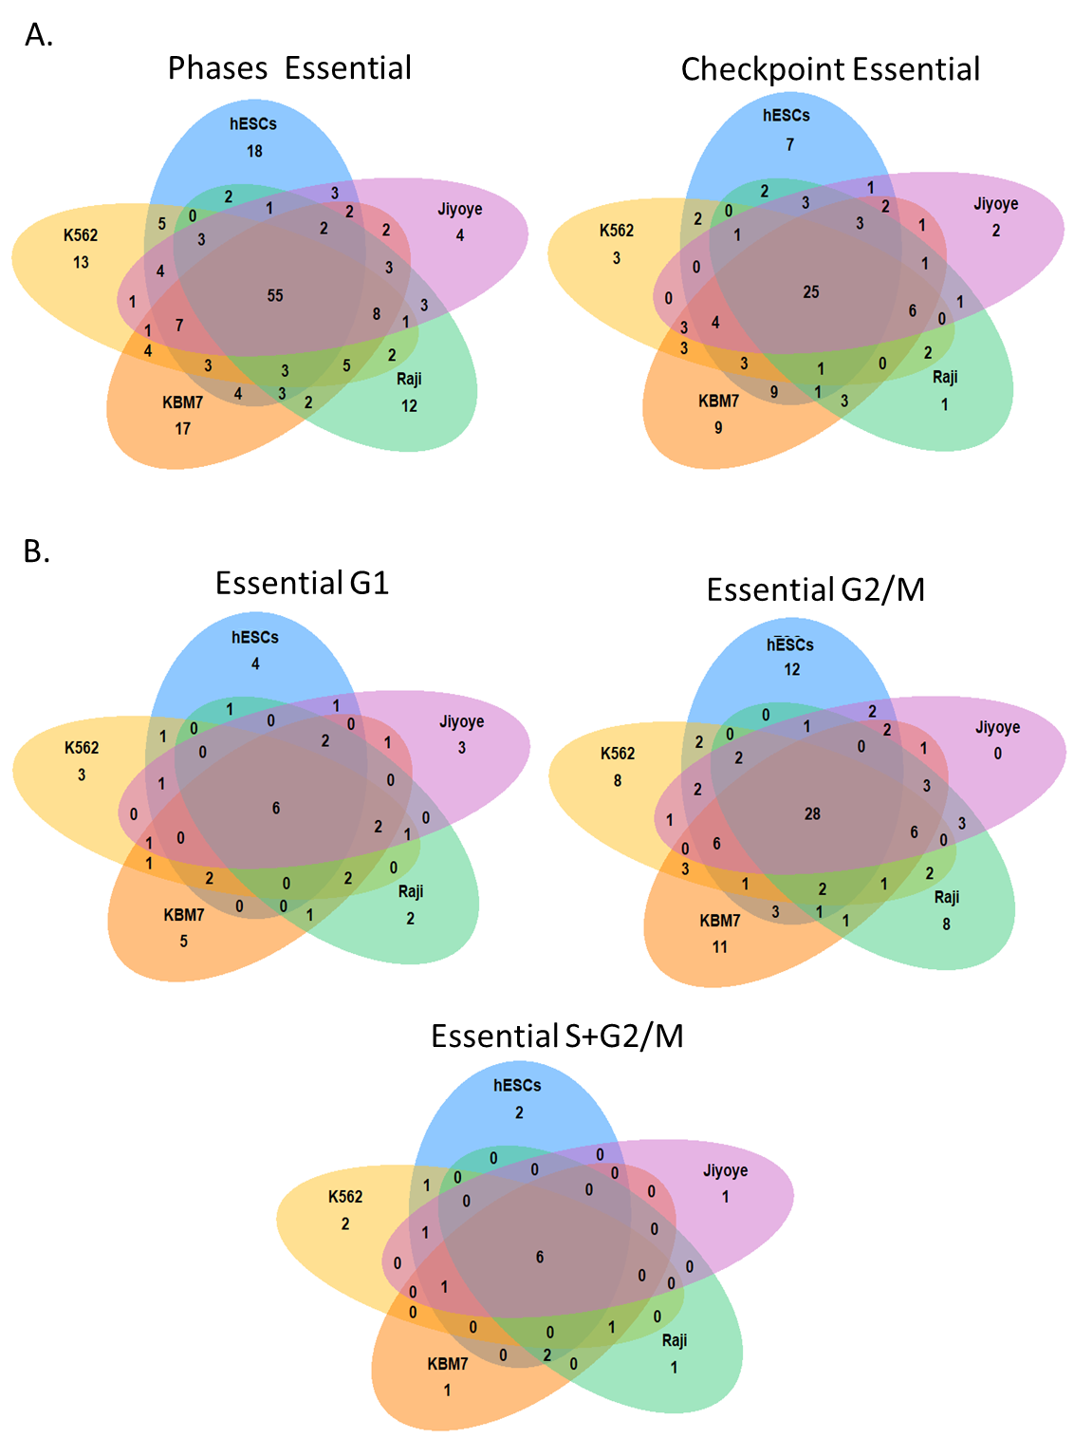
Supplementary Fig. 2

Slide 3
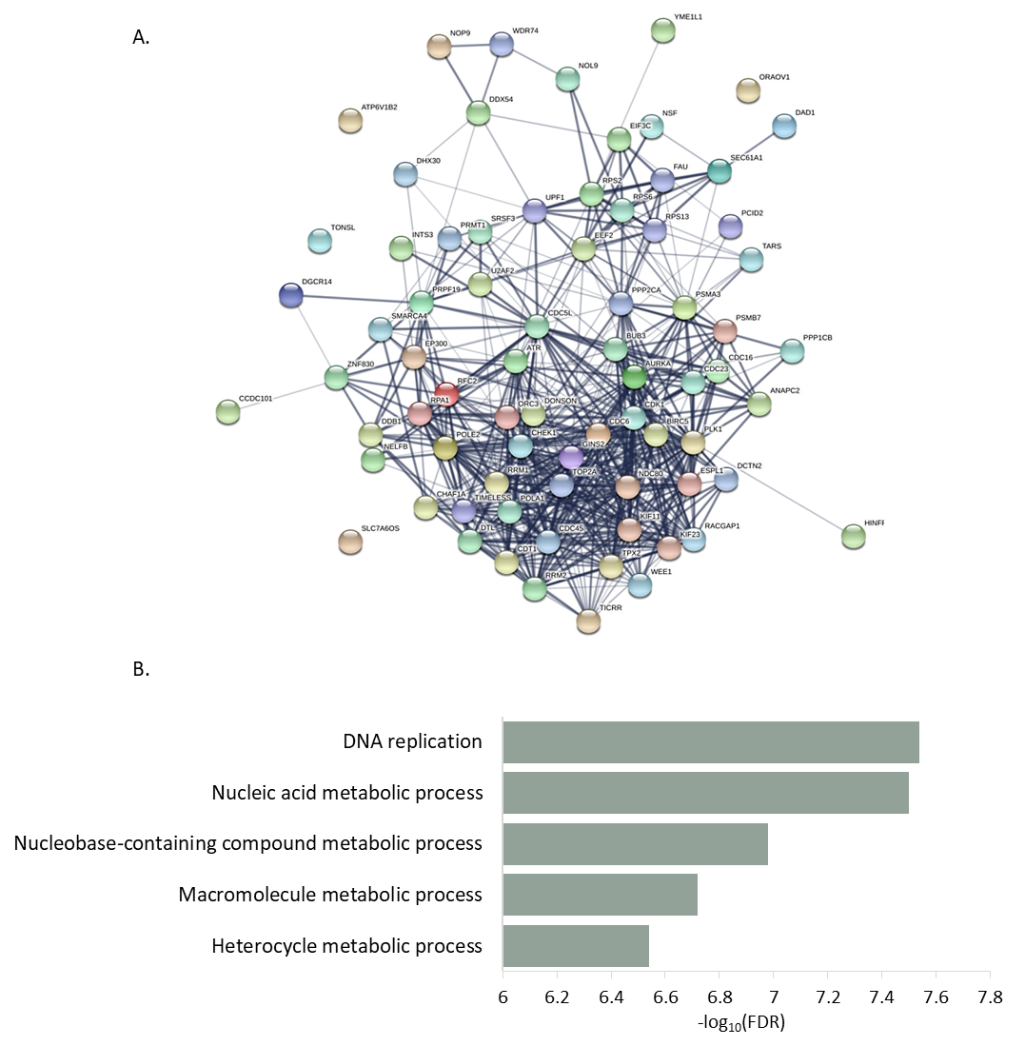
Supplementary Fig. 3

Slide 4
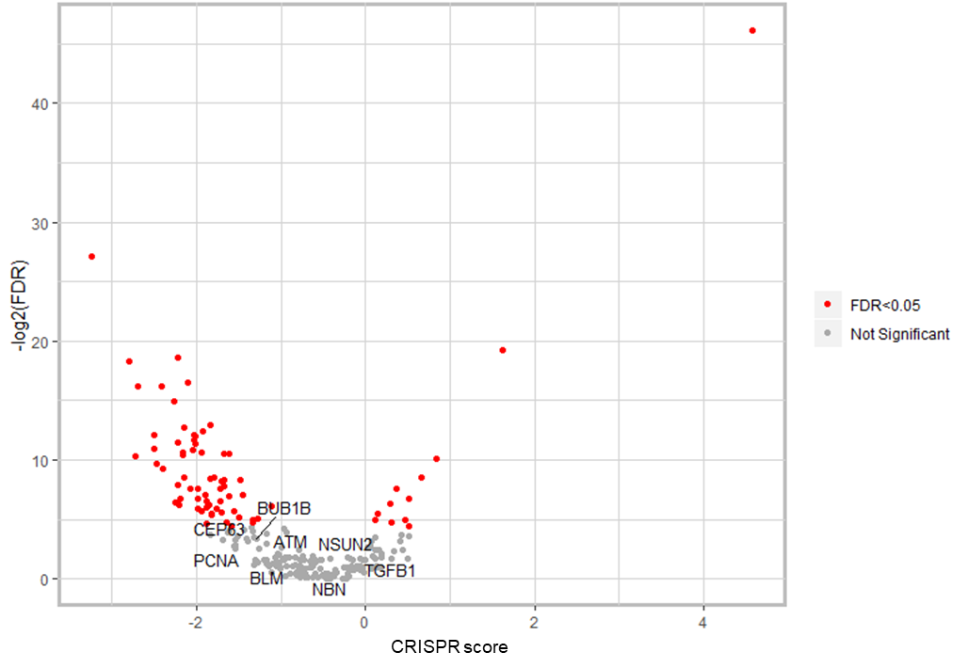
Supplementary Fig. 4

