Slide 1



Characterization of a Highly Effective Preparation for Suppression of Myocardial Glucose Utilization
Journal of Nuclear Cardiology | Official Journal of the American Society of Nuclear Cardiology
Sophia R. Larson, MD,ª Justin A. Pieper, MD,ª Edward A. Hulten, MD, MPH,^{b} Edward P. Ficaro, PhD,^{c} James R. Corbett, MD,^{d,e} Venkatesh L. Murthy, MD, PhD,^{d,e*} and Richard L. Weinberg, MD, PhD^{d*}
ª Department of Medicine, University of Michigan, Ann Arbor, MI
^{b} Fort Belvoir Community Hospital, VA and Uniformed Services University, Bethesda, MD
^{c} INVIA Medical Imaging Solutions, Ann Arbor, MI
^{d} Division of Cardiovascular Medicine, Department of Medicine, University of Michigan, Ann Arbor, MI
^{e} Division of Nuclear Medicine, Department of Radiology, University of Michigan, Ann Arbor, MI
Copyright American Society of Nuclear Cardiology
Sophia R. Larson, M.D.

Slide 2
BACKGROUND
Journal of Nuclear Cardiology | Official Journal of the American Society of Nuclear Cardiology
F-18 fluorodeoxyglucose (FDG) positron emission tomography/computed tomography (PET/CT) can visualize myocardial inflammation.
Because normal myocardium can metabolize both glucose and free fatty acids (FFAs), physiological accumulation of FDG in the myocardium can interfere with the recognition of abnormal FDG uptake.
Optimal protocols and normative myocardial FDG uptake values are not well-established.
Copyright American Society of Nuclear Cardiology

Slide 3
METHODS
Journal of Nuclear Cardiology | Official Journal of the American Society of Nuclear Cardiology
Study type: Retrospective
Study subjects: 111 patients with suspected cardiac inflammation referred for cardiac FDG PET/CT at the University of Michigan who were able to complete the dietary/metabolic protocol
  Dietary protocol: low carbohydrate high fat diet, fasting, high fat drink, and unfractionated heparin administration.
C. Study endpoints:
  Evaluation of adequate suppression of physiologic myocardial FDG uptake
  Measurement of blood pool & myocardial FDG uptake
Copyright American Society of Nuclear Cardiology

Slide 4
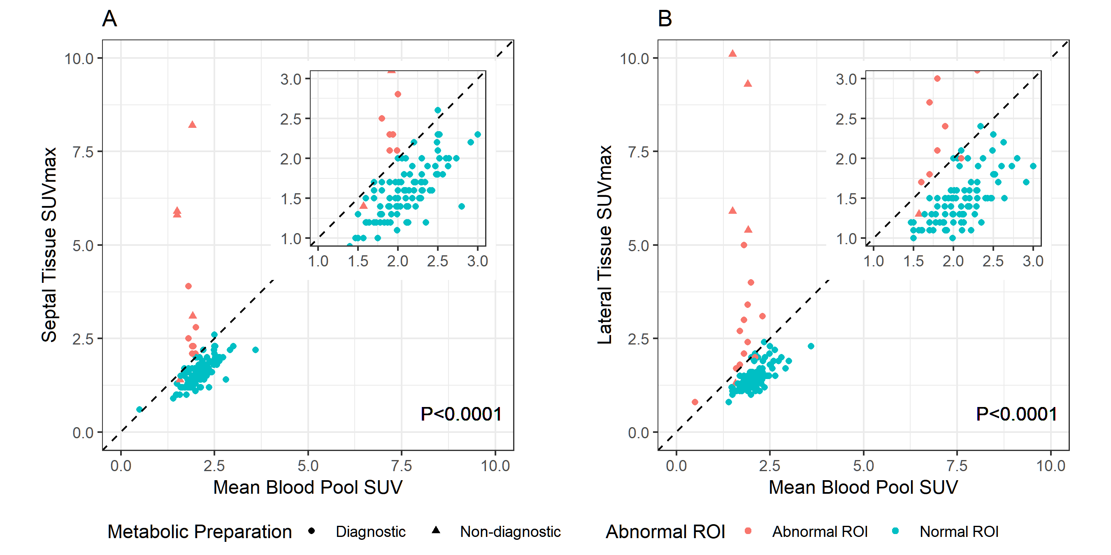
RESULTS
Journal of Nuclear Cardiology | Official Journal of the American Society of Nuclear Cardiology
Among patients with adequate metabolic preparation and normal myocardial region of interest (defined as no pathologic FDG uptake in the measured region of interest), myocardial SUV_{max} in both the septal and lateral walls was strongly related to blood pool SUV_{mean} and were consistently lower than blood bool SUV_{mean}.
Insert a key table or a key figure
If figure, insert legend
Relationship between septal (A) and lateral (B) myocardial tissue FDG uptake (SUV_{max}) and aortic blood pool activity (SUV_{mean}). P-values estimated using linear regression among diagnostic scans with normal septal/lateral ROIs.
Copyright American Society of Nuclear Cardiology

Slide 5
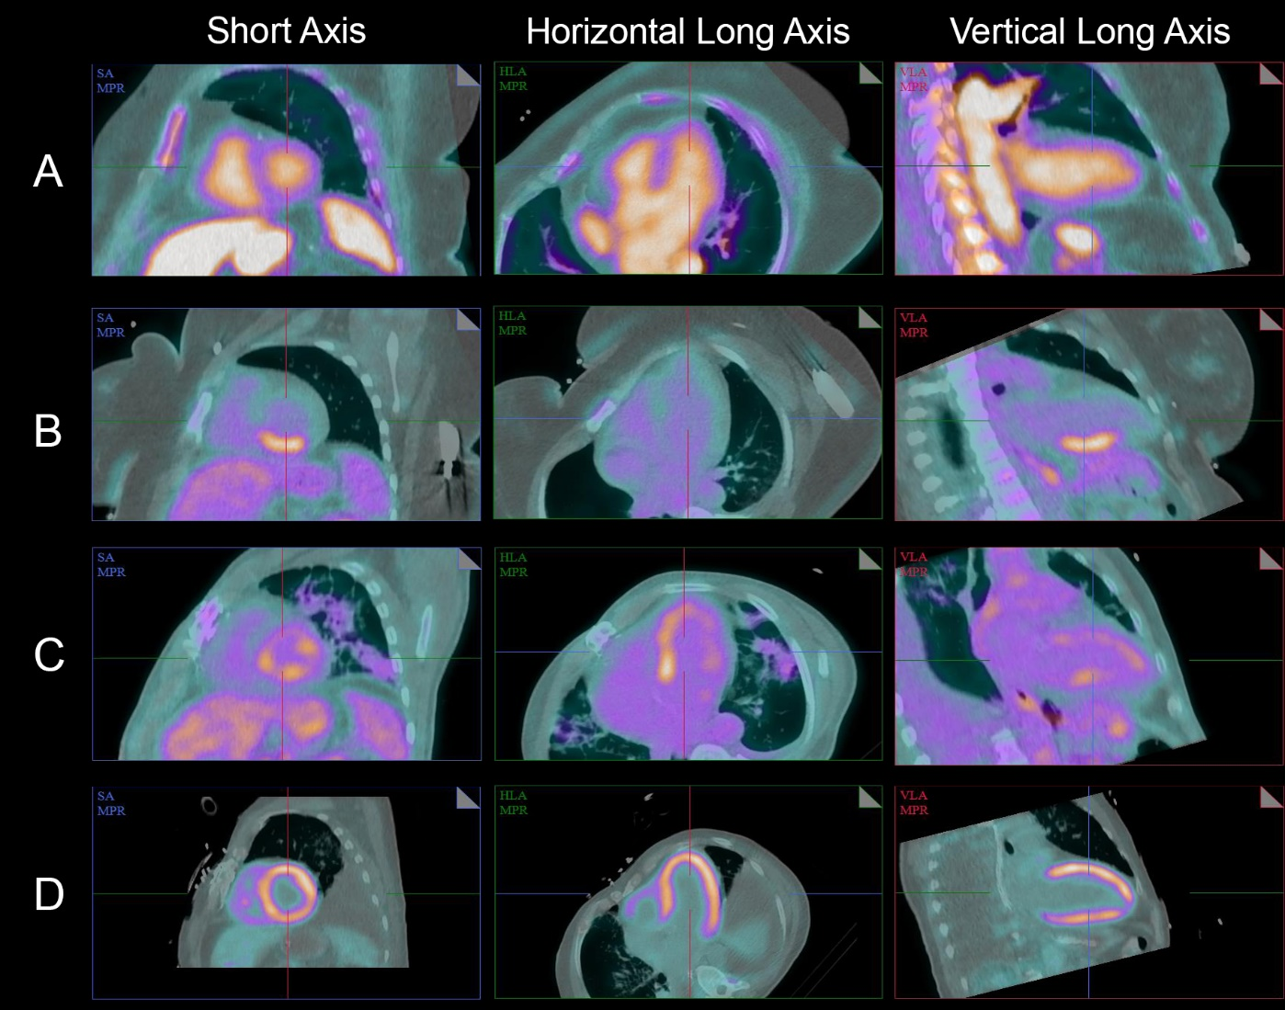
RESULTS
Journal of Nuclear Cardiology | Official Journal of the American Society of Nuclear Cardiology
Representative cases illustrating different patterns of myocardial FDG uptake in short axis (SA), horizontal long axis (HLA), and vertical long axis (VLA).
(A) No myocardial FDG uptake
(B) Focal FDG uptake in the inferior wall of the left ventricle
(C) Focal on diffuse left ventricular FDG uptake, and
(D) Diffuse left ventricular FDG uptake.
Copyright American Society of Nuclear Cardiology

Slide 6
CONCLUSIONS
Journal of Nuclear Cardiology | Official Journal of the American Society of Nuclear Cardiology
Using an intensive metabolic preparation protocol consisting of a low carbohydrate high fat diet, fasting, high fat drink, and unfractionated heparin administration, we achieved an excellent rate of myocardial glucose suppression (95% of scans).
In patients who followed this imaging preparation protocol, normal myocardial FDG SUV_{max} is consistently lower than the SUV_{mean} of the blood pool.
Copyright American Society of Nuclear Cardiology

