Slide 1
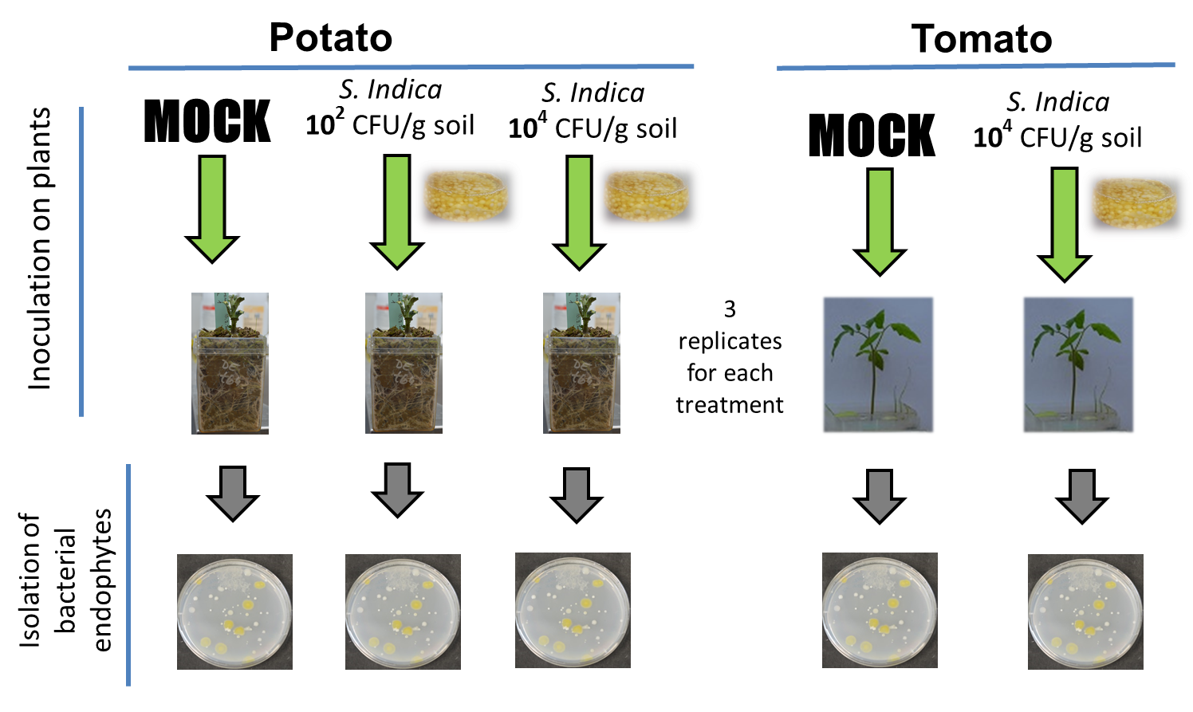
Suppl. figure 1. Summarizing of experiments used to isolate bacteria.

Slide 2
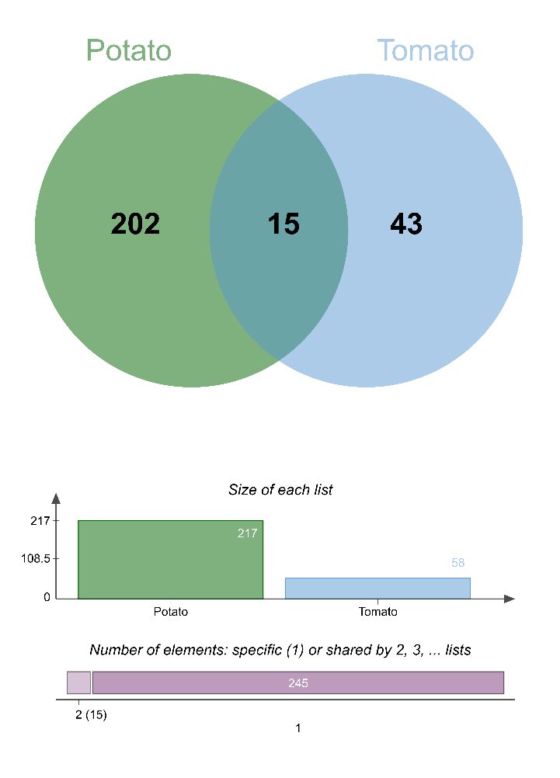
A
B
C
D
Suppl. figure 2. Abundance of bacterial isolates and strains, and the type of interaction with S. indica. Number of bacterial clusters (strains) and their phylogeny per type of interaction. A: total family abundance of isolates and clusters (strains) recovered from roots. B: clusters (strains) isolated from potato and tomato plants. C: relative abundance of strains at the genus level isolated from potato and tomato roots, and from plants pre-inoculated or not with S. indica. D: number of bacterial clusters (strains) and their phylogeny at the genus level per type of interaction.

Slide 3
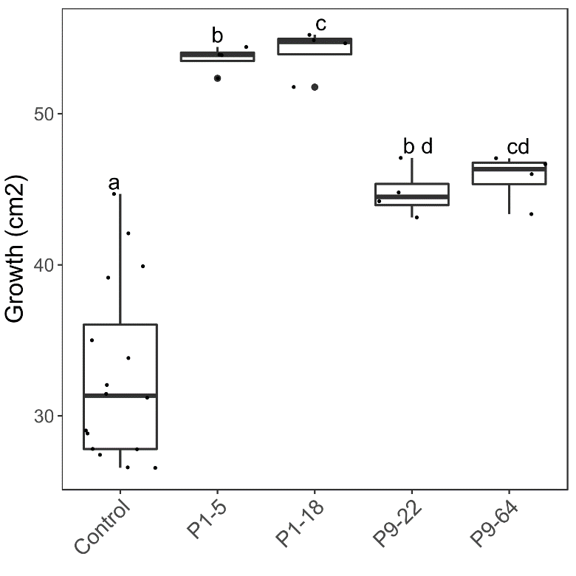
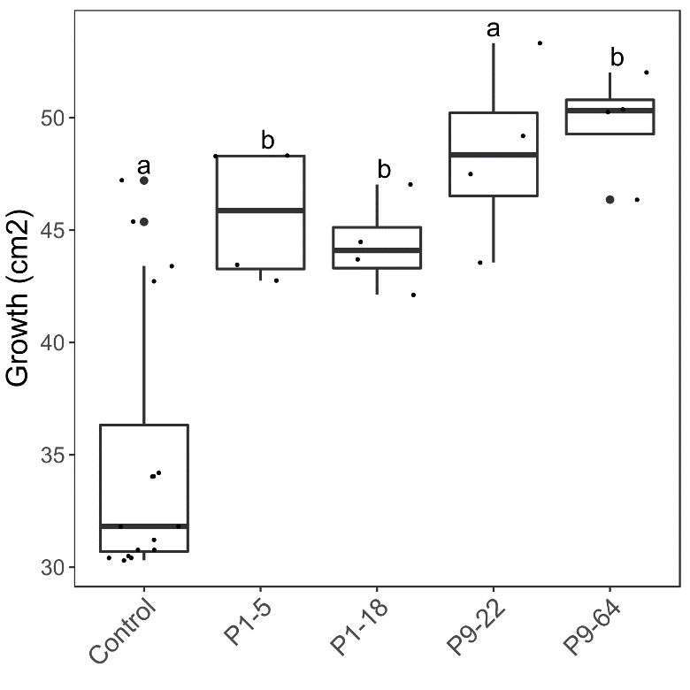
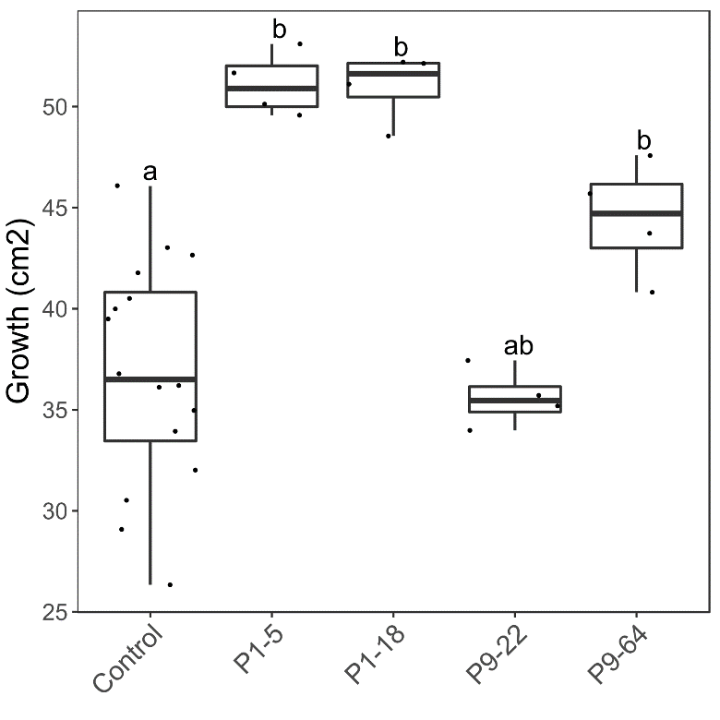
PDA / 9-day
PDA + NA / 4-day
PDA + NA / 9-day
Suppl. Figure 3: Effect of Mycolicibacterium (P1-5, P1-18, P9-22 and P9-64) on S. indica growth under different nutrient conditions and bacterial growth phase. Same letters represent non-significantly different mean values, according to Tukey’s test (P < 0.05), after ANOVA. n=4

Slide 4
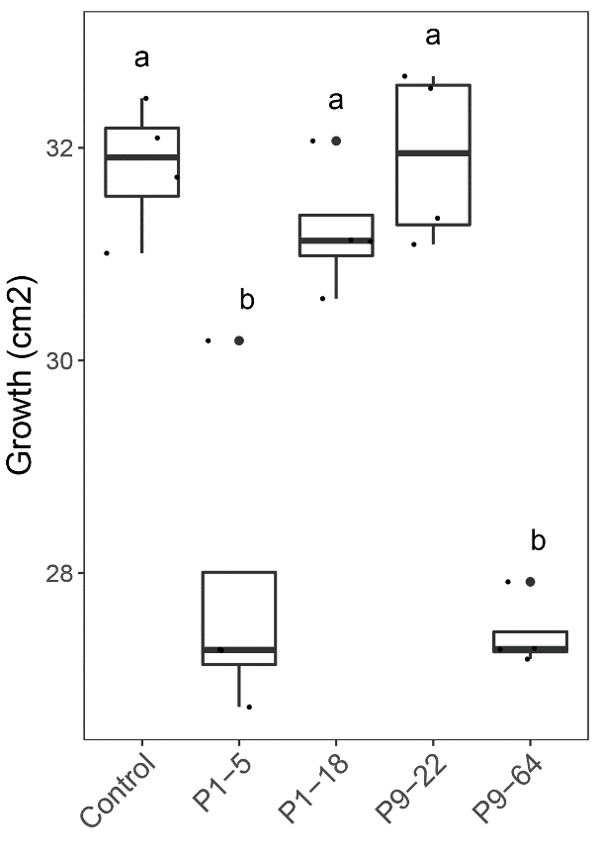
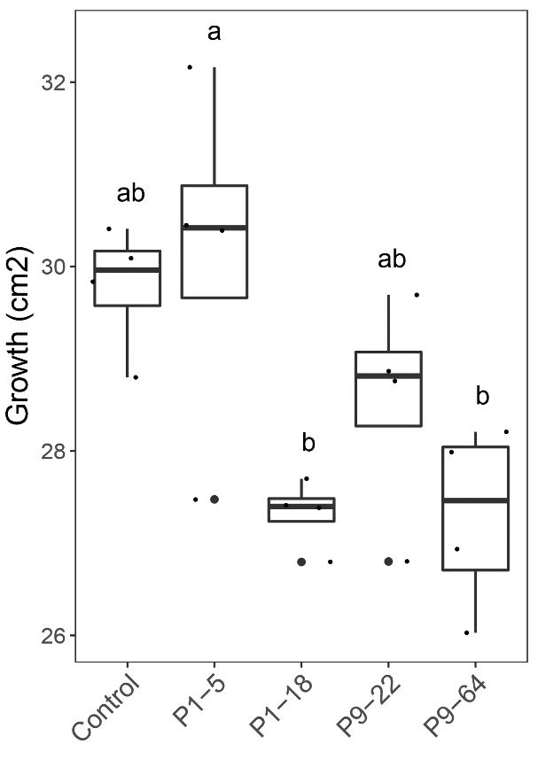
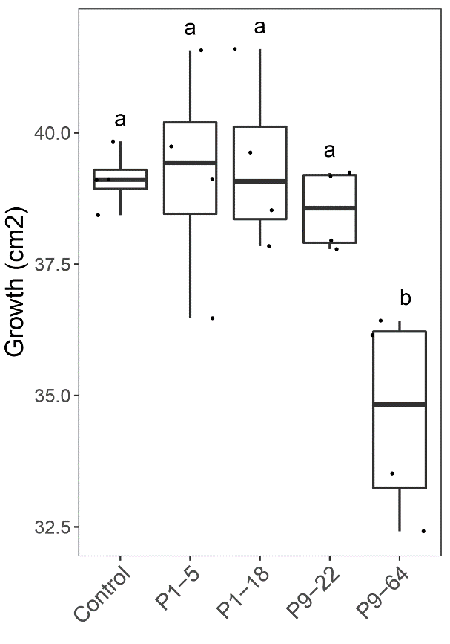
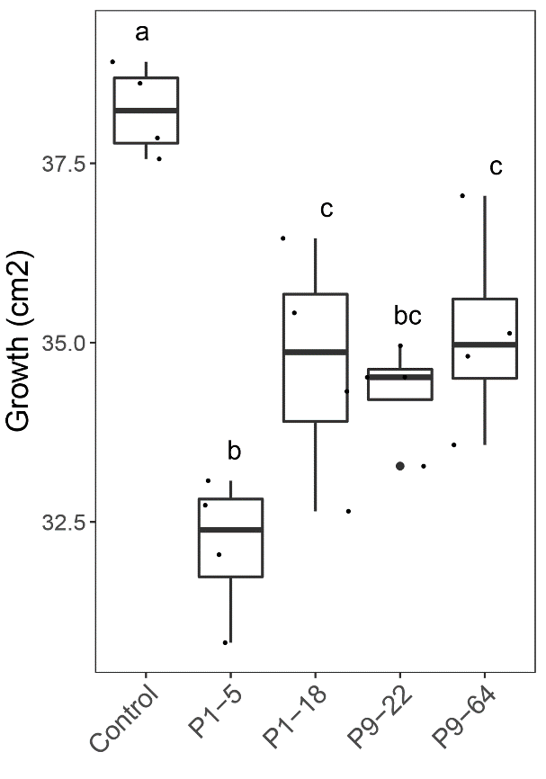
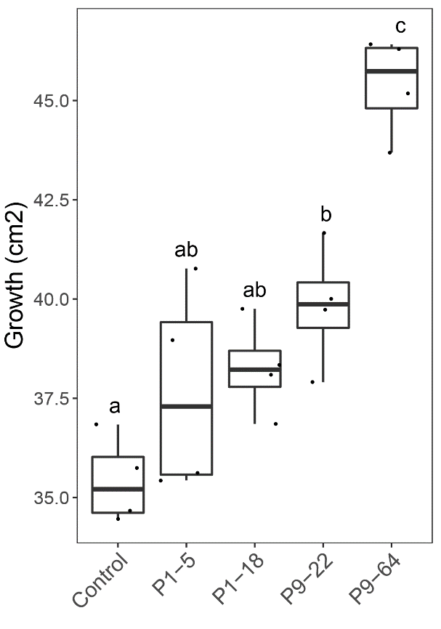
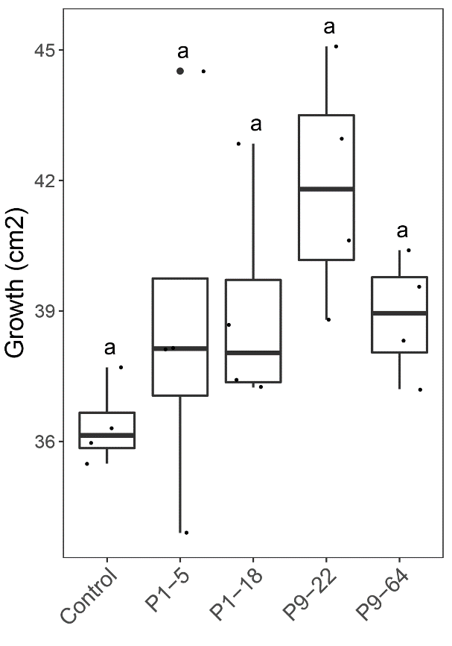
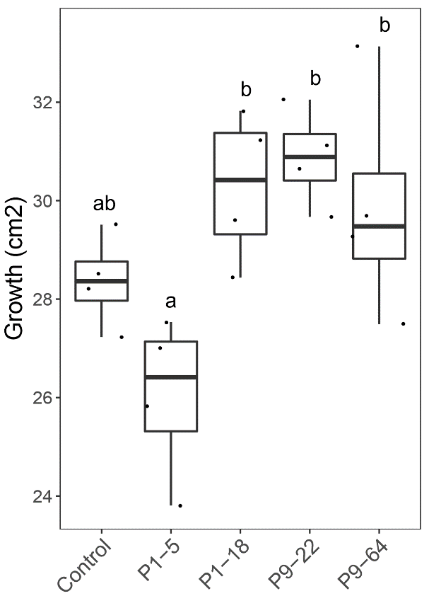
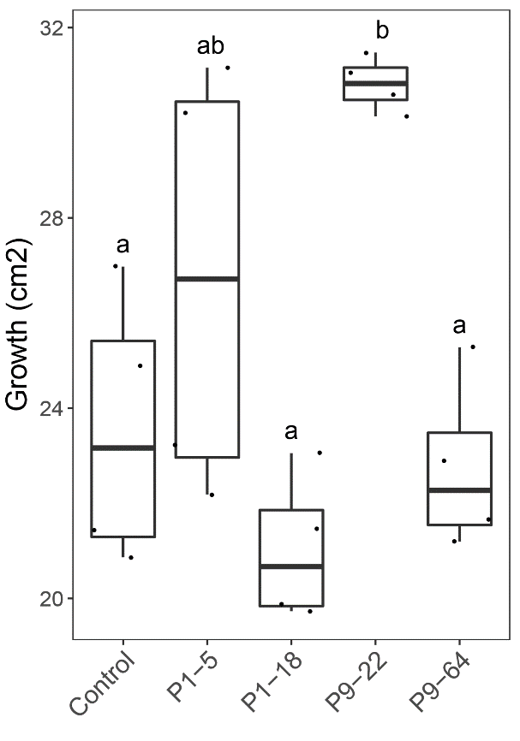
Fusarium oxysporum
PDA
PDA + NA
4-day pre-culture
9-day pre-culture
4-day pre-culture
9-day pre-culture
Rhizoctonia solani
PDA
PDA + NA
4-day pre-culture
9-day pre-culture
4-day pre-culture
9-day pre-culture
Suppl. Figure 4. Growth of Fusarium oxysporum and Rhizoctonia solani in presence of bacteria. Co-cultured on PDA or PDA+NA, and with bacteria pre-cultured for 4 or 9 days. Same letters represent non-significantly different mean values, according to Tukey’s test (P < 0.05), after ANOVA. n=4

