Slide 1
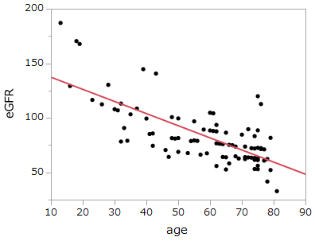
Supplementary data: Correlation between eGFR and age
r =-0.651, p <0.001

