Slide 1
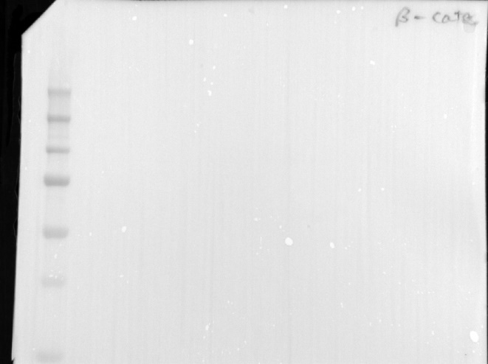
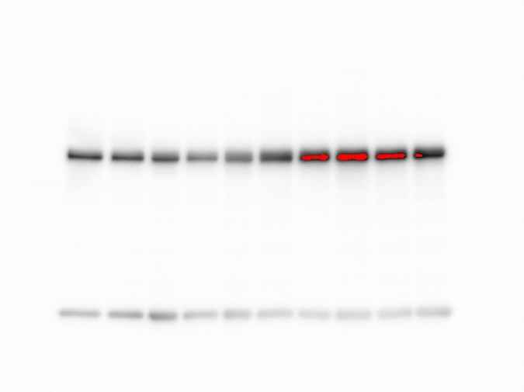
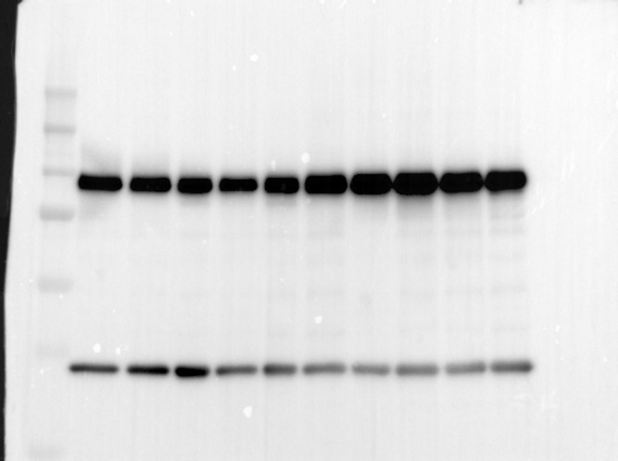
NESC ECSC
NESC ECSC
β-catenin 92 kDa
GAPDH 37 kDa
Exposure 5.42 sec
Exposure 9.8 sec
Figure S5. Full length of western blot of Figure 1E.
Notes:
Figure 1E
β-catenin GAPDH

Slide 2
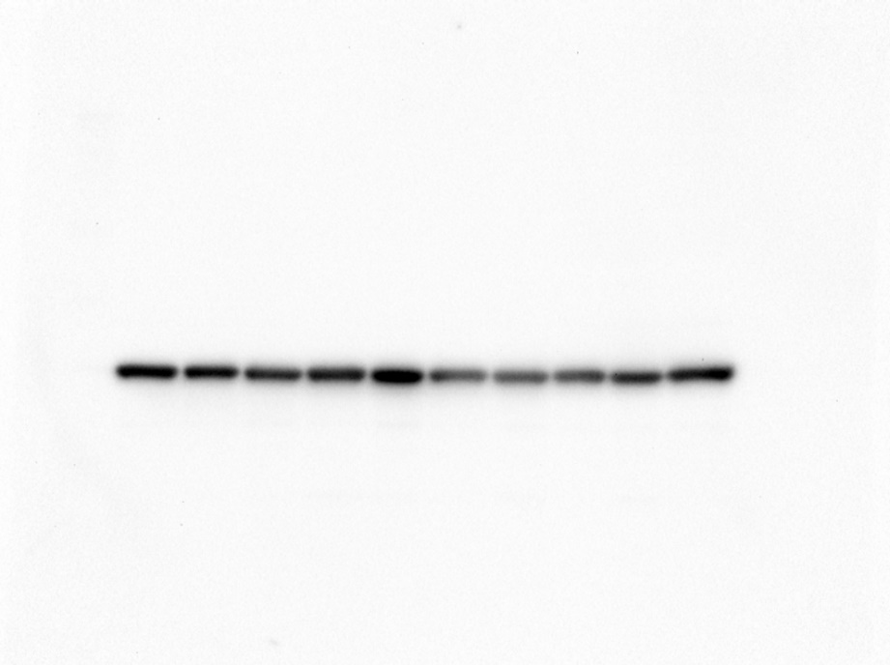
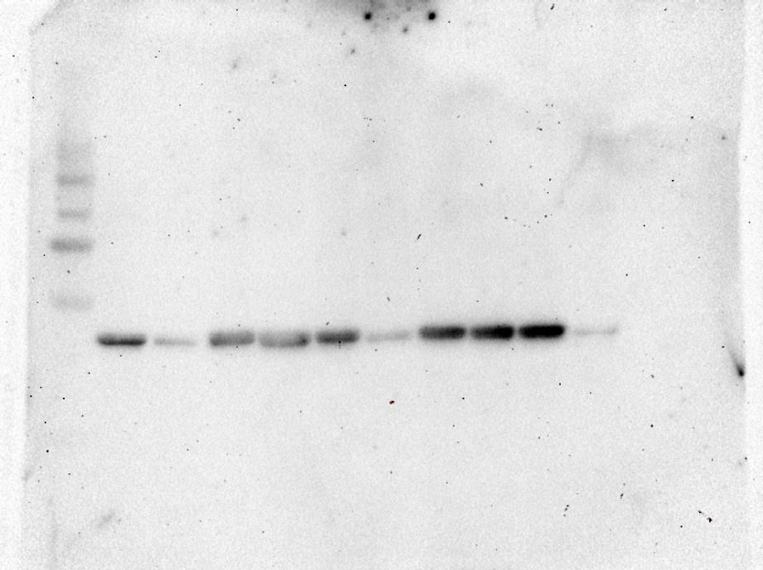
NESC ECSC
NESC ECSC
GAPDH 37 kDa
α-SMA 42 kDa
Exposure 126 sec
Exposure 1800 sec
Figure S6. Full length of western blot of Figure 4C

Slide 3
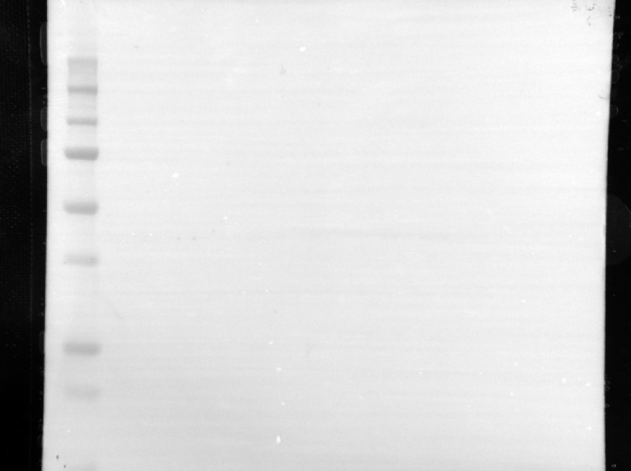
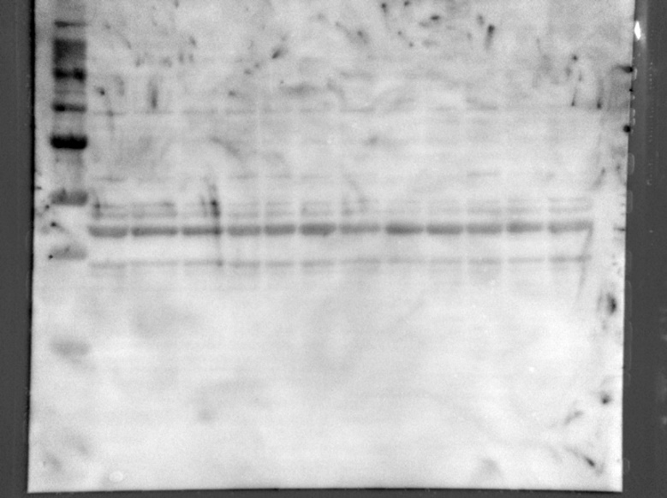
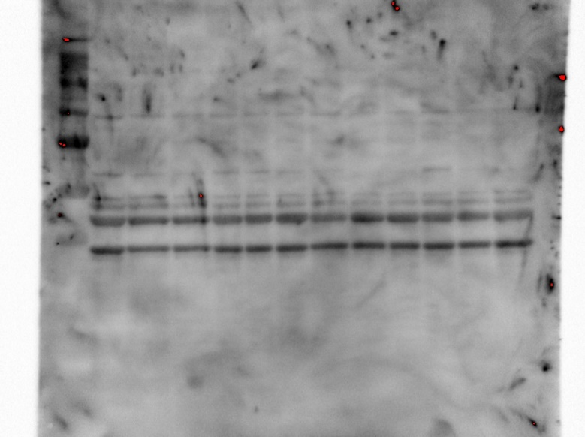
Control ICG-001 C-82
Control ICG-001 C-82
α-SMA 42 kDa
GAPDH 37 kDa
Exposure 1.5 sec
Exposure 7.2 sec
Figure S7. Full length of western blot of Figure 4E

