Slide 1
Supplementary Figure 1
A
B
Relative absorbance(450 nm)
Relative absorbance(450 nm)
C
D
Relative mRNA Level
Relative mRNA Level

Slide 2


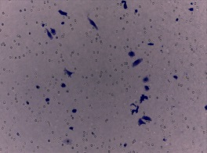
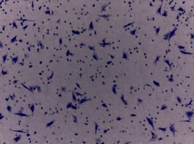
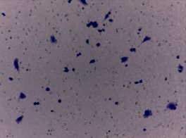
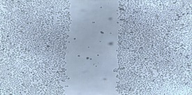
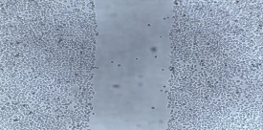
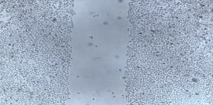
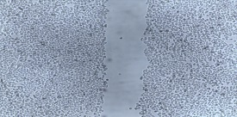
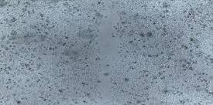
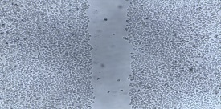
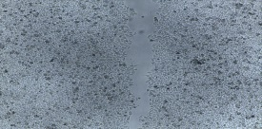
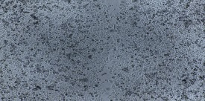
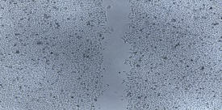
Supplementary Figure 2
siSHARPIN+siYAP
siSHARPIN
A
siControl
SHARPIN
YAP
GAPDH
Number of Migration Cells
***
B
C
siControl
siSHARPIN
siSHARPIN+siYAP
***
D
siControl
siSHARPIN
siSHARPIN+siYAP
E
0h
Wound closure(%)
Wound closure(%)
***
24h
***
**
48h
**

Slide 3
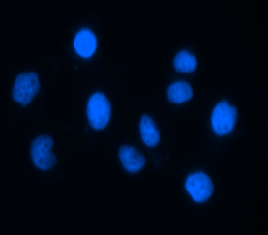
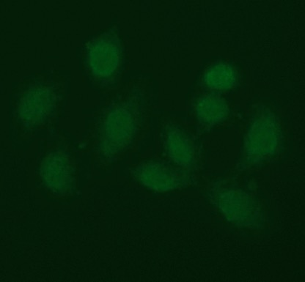
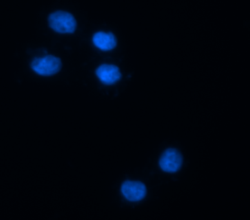
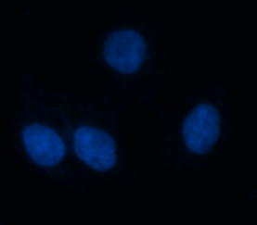
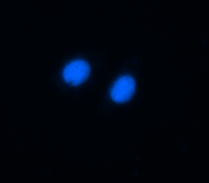

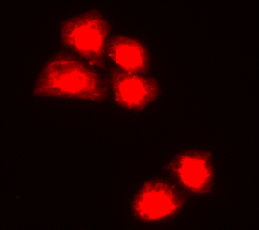
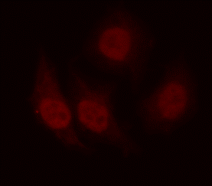






Supplementary Figure 3
A
B
DAPI
YAP
DAPI
SHARPIN
SiControl
SiControl
50 um
50 um
50 um
50 um
SiYAP
SiSHARPIN
50 um
50 um
50 um
50 um
C
Relative Gray density
siControl
siSHARPIN
D
CHX(h)
3
9
6
0
6
0
3
9
SHARPIN
P53
GAPDH

Slide 4






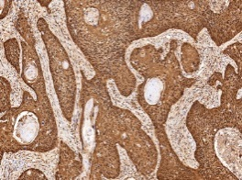
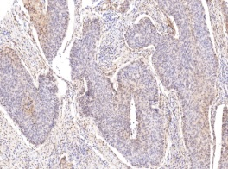
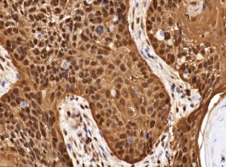
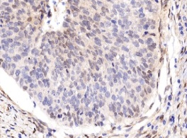
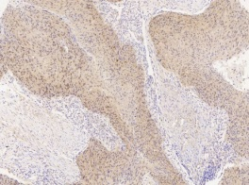
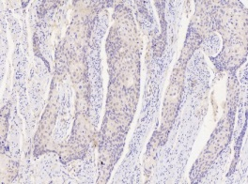
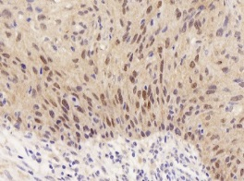
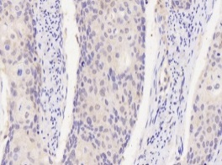
Supplementary Figure 4
A
B
siControl
siSHARPIN
Relative Gray density
CHX(h)
3
9
6
0
6
0
3
9
SHARPIN
YAP
GAPDH
C
YAP High
YAP Low
D
10X
YAP1 |  | SHARPIN
 | Positive | Negative | P Value
Positive | 30 | 153 | P<0.01
Negative | 26 | 20
40X
SHARPIN High
SHARPIN Low
10X
40X

Slide 5
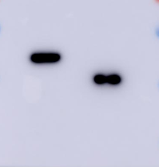
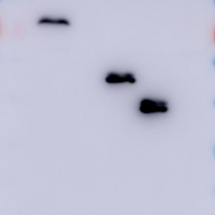
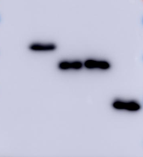
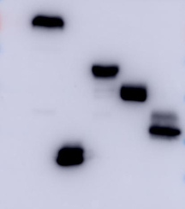




Supplementary Figure 5
-
WT
∆UBL
NZF
NT
-
Flag-SHARPIN
WT
171-504
Vector
Myc-YAP
1-171
1-292
292-504
Myc-YAP
-
+
+
+
+
Vector
-
+
+
+
+
+
Flag-SHARPIN
IP:Myc
IB:Flag
IP:Flag
IB:Myc
Flag
(SHARPIN)
Myc
(YAP)
Input
YAP
(Myc)
Input
Flag
(SHARPIN)
GAPDH
GAPDH

