Slide 1
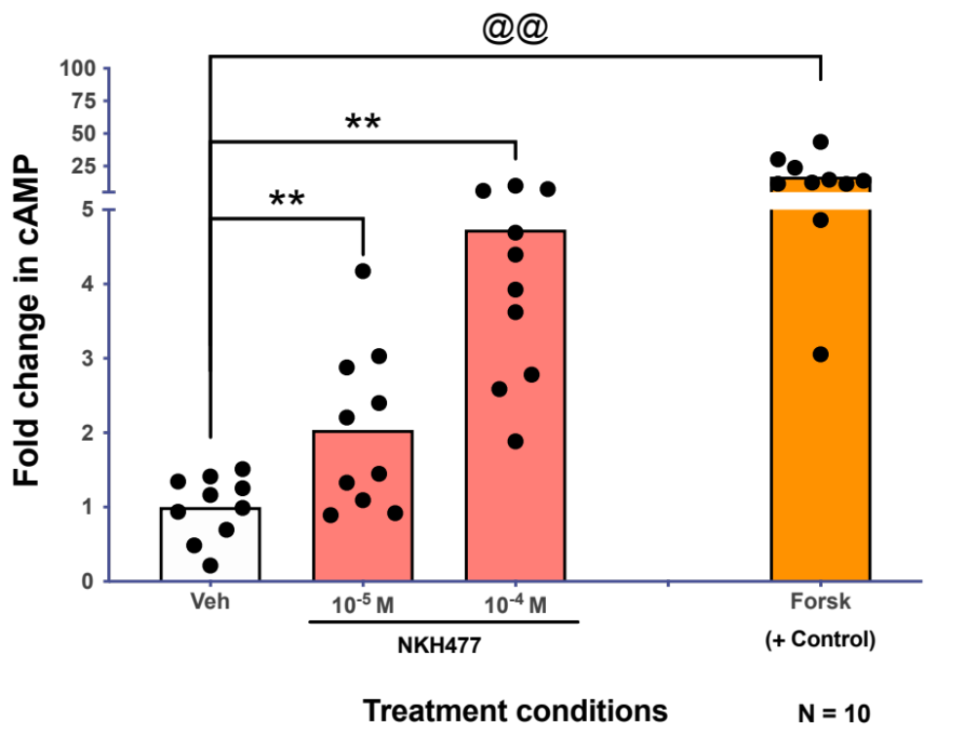
Supplemental Figure 1 – NKH477 significantly increases cAMP production in human macrophages

Slide 2
Supplemental Figure 1 – NKH477 significantly increases cAMP production in human macrophages. MDM were treated with the indicated concentrations of NKH477 (pink columns) for 5 minutes. Lysate was then collected and analyzed for production of cAMP. Treatment with NKH477 significantly increased cAMP production [one way rmANOVA, n =10, F (1.189, 10.70= 24.57), p = 0.0003] compared to the vehicle treated control. Post-hoc analysis showed both 10⁻⁵ and 10⁻⁴M NKH477 increased cAMP production (Tukey’s multiple comparison test, veh vs. 10⁻⁵M **p=0.007, veh vs. 10⁻⁴M **p=0.0012). Forskolin (orange column) was used as a positive control and analyzed separately using a paired t-test (n=10, **p=0.0023). All data is expressed as fold change relative to the mean of the vehicle control.

Slide 3
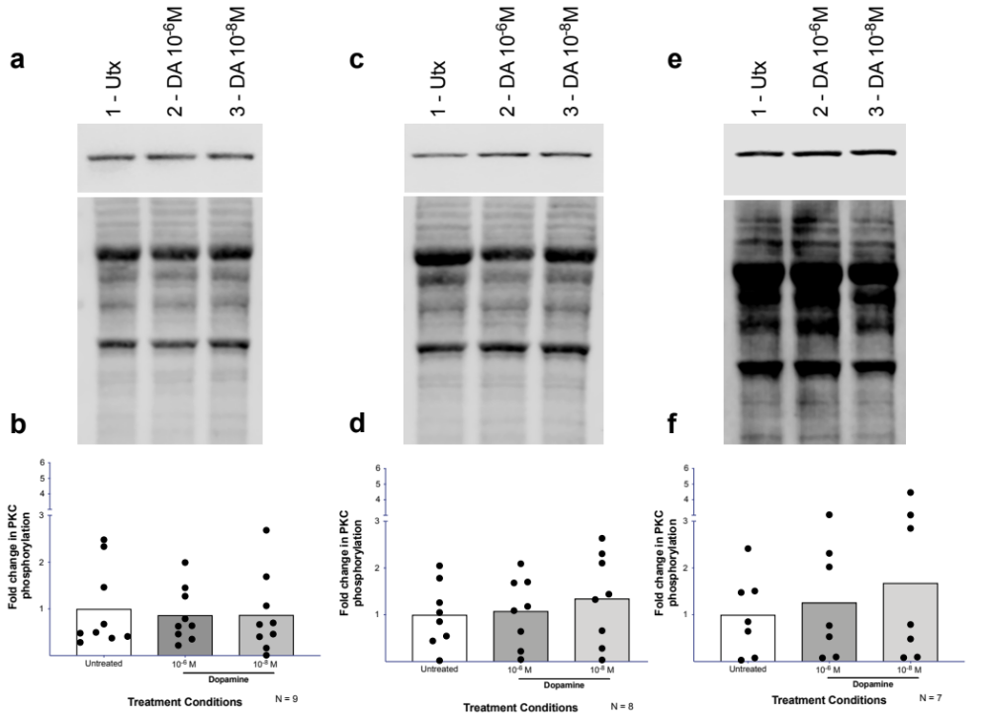
Supplemental Figure 2 - Dopamine-mediated activation of PKC not present after 1 minute
Notes:
Will be redoing the Western Blots to reflect analysis. 2.5 minute blot coming tomorrow.

Slide 4
Supplemental Figure 2 - Dopamine-mediated activation of PKC not present after 1 minute. MDM were treated with the indicated concentrations of dopamine for 2.5 minutes (A, B) , 5 minutes (C, D), and 10 minutes (E, F). Cells were then lysed and protein was analyzed for phospho-PKC (B11 Ser660) by Western Blot. Representative Western Blots are depicted in (A, C, E). None of the concentrations of dopamine increased PKC phosphorylation at 2.5 minutes [B, DA gray column, Untx white column, one way rmANOVA, n = 9, F (2.206, 17.65 = 1.985), p = 0.1640], 5 minutes [D, DA gray columns, Utx white column, one way rmANOVA, n = 8, F (1.411, 9.875= 3.971), p = 0.0649] or 10 minutes [F, DA gray columns, Untx white column, one way rmANOVA, n = 7, F (2, 12 = 2.313), p = 0.1414]. PMA was used as a positive control for all time points (data not shown). Phospho-PKC signal was normalized to total protein stain, and all data is expressed as fold change relative to the mean of the untreated control. For all Western Blots, 1-Untx, 2 - DA 10⁻⁶ M, 3 - DA 10⁻⁸ M.

