Slide 1
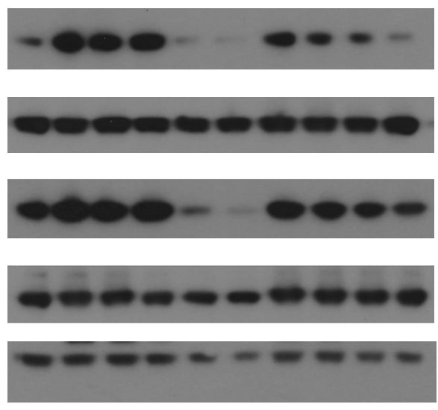
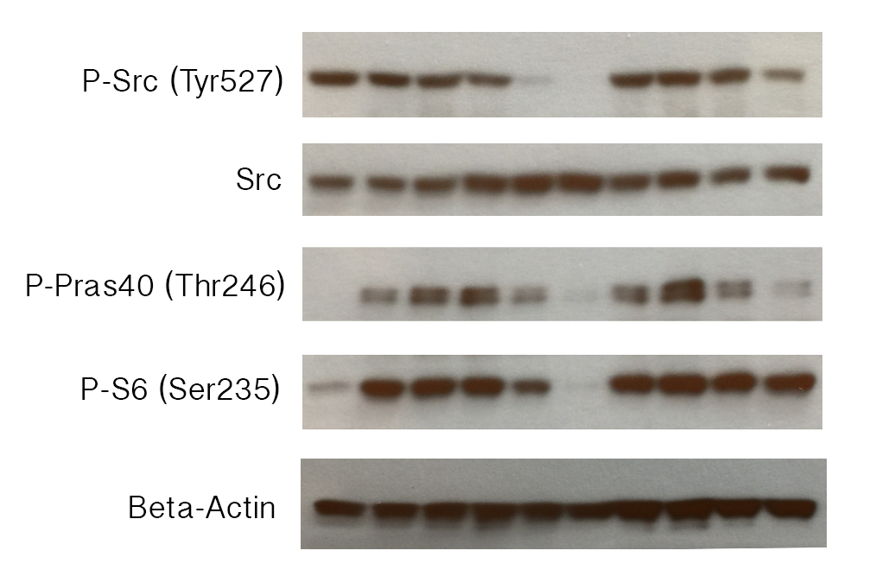
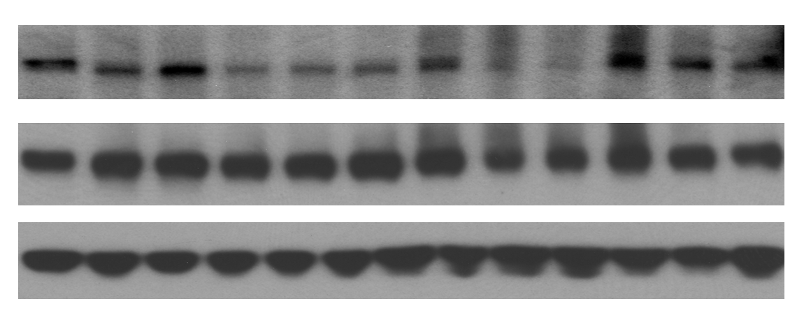
Supplemental Figure 4
a
b
Dasatinib
cRGD-Das-NDC
10 nM
100 nM
10 uM
100 nM
1 uM
10 nM
1 uM
10 uM
PDGF-BB (40 ng/ml)
- + + + + + + + + +
1
p-AKT
AKT
p-S6RP
2
3
S6RP
α-Tubulin
4
c
d
Dasatinib
cRGD-Das-NDC
Dasatinib q
cRGD-Das-NDC
100 nM
100 nM
10 nM
1 uM
1 uM
10 nM
100 nM
1 uM
10 uM
10 nM
100 nM
1 uM
10 uM
10 uM
10 uM
PDGF-BB (10 ng/ml)
- + + + + + + + + +
PDGF-BB (20 ng/ml)
- + + + + + + + +
p-Src
p-PDGFR𝛂
Src
PDGFR𝛂
p-PRAS40
β-Actin
β-Actin
Notes:
Figure 6: Design and in vitro efficacy of Dasatinib-C’ dots(Das-NDC) Figure 7A: Schematic depiction of enzymatic-driven release of dasatinib from its linker resulting in free dasatinib. 1) Chemical structure of linker-drug compound; 2) NDC and drug release. Extra- or intracellular enzymes recognize the dipeptide component of the linker leading to hydrolysis and release of modified-dasatinib. The modified-dasatinib then undergoes a spontaneous, intramolecular cyclization at physiologic pH resulting in native dasatinib drug conformation. This modified Dasatinib retains efficacy in vitro as demonstrated by western blots on RCAS derived glioma cells in Figure 7B. RCAS tumor derived cells were treated with indicated drugs for 4 hours followed by PDGF-BB 10ng/ml for 5 minutes. Cells were starved in stem cell medium without growth factors for 18 hours before treatment. The modified/linker Dasatinib-NDCs demonstrated downstream p-PRAS40 and p-S6 inhibition in a dose-dependent fashion at doses comparable to doses of free Dasatinib.

