Slide 1

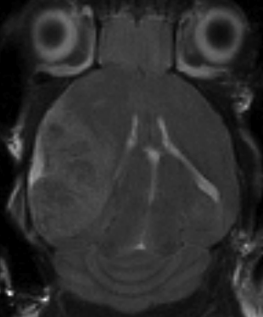
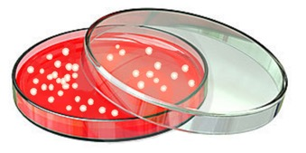
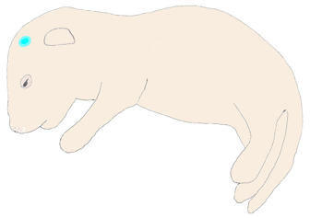
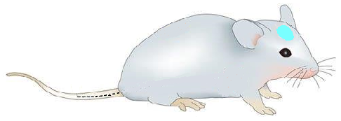

Supplementary Scheme 1
a
RCAS producing DF-1 cells
Intracranial injection
(neonate)
MRI
Tail vein injection of C’dot and intravital stains
b
cRGD-C’ dot
cRAD-C’dot
3hr
Hoechst
(prior to sac)
FITC-Dextran
RCAS-tumor bearing mice
¹²⁴I-cRGD-C’ dot
¹²⁴I-cRAD-C’dot
96hr
3hr
Hoechst
(prior to sac)
FITC-Dextran
//
Notes:
Schematic 1: RCAS tumor model and treatment paradigm: Figure 4A: Overview of generation of PDGF-driven RCAS glioma model followed by treatment with C’dots and intravital stains. PDGF-driven RCAS producing DF-1 cells are injected intracranially in newborn mice 24-48 hours after birth. MRI confirmation of tumor is performed 3-4 weeks following injection. Tumor bearing mice are then treated with in-vivo tail vein injection according to the design schematic in Figure 4B. Following confirmation of brain tumor on MRI, mice were given in-vivo injections of integrin targeting cRGD-C’dots or scrambled cRAD-C’dots via t.v. and sacrificed at 3 or 96 hours. 70kDa FITC-labeled Dextran was used as a surrogate marker to map blood brain barrier breakdown and was concurrently administered via t.v. in the 3 hour paradigm followed by the nuclear stain Hoechst administered within 10 minutes of sacrifice. In the 96-hour paradigm, C’dots were administered and animals were sacrificed 96 hours post-treatment, with FITC-Dextran administered via t.v. 3 hours prior to sacrifice and Hoechst within 10 minutes of sacrifice. In this manner, this paradigm outlines a method of concurrent intravital staining for visualization of three independent fluorescent signals with unique properties of temporal and spatial distribution and diffusion relative to the blood brain barrier. The 70kDa size of FITC-Dextran was utilized as it roughly approximates the size of the C’dot in order to evaluate the effect of size alone on distribution and retention.

