Slide 1
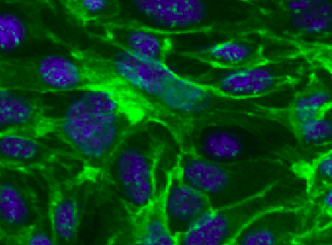
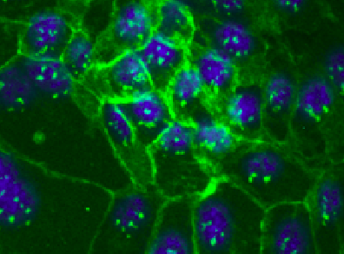
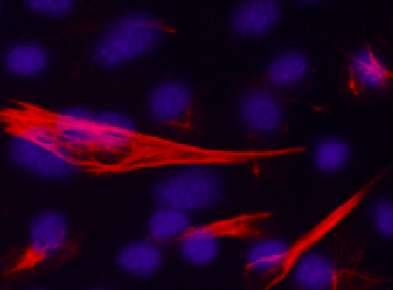
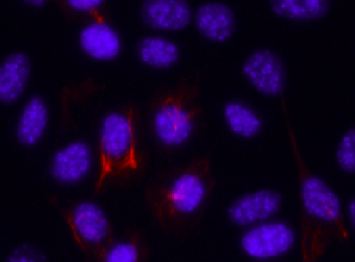
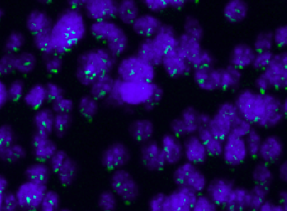
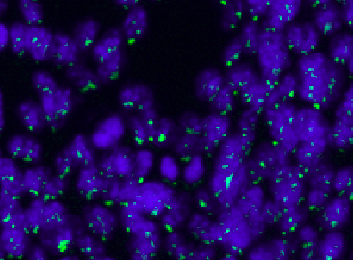
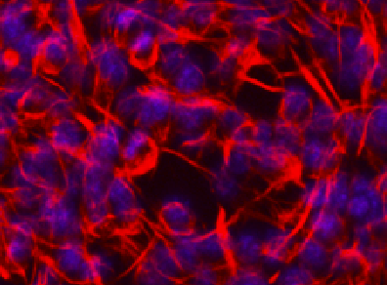
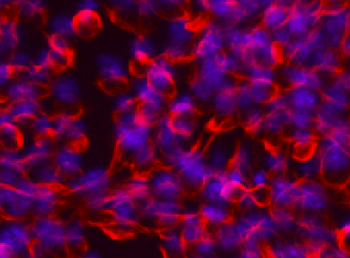







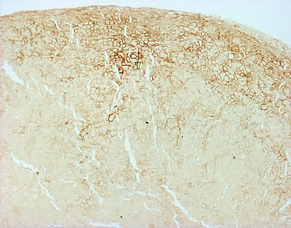
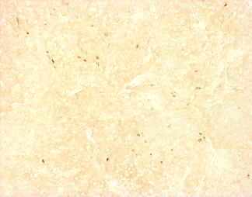
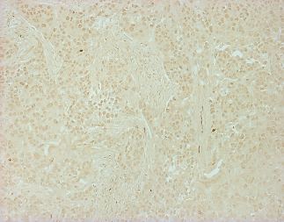
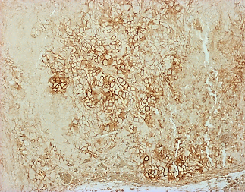
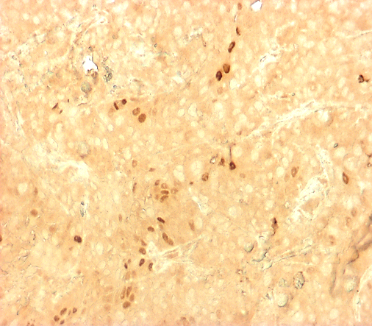
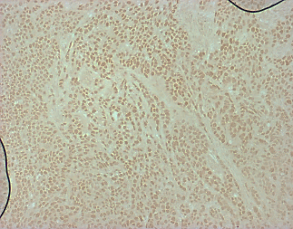
A
CUCON-1
CUCON-2
CUCON-1
CUCON-2
Fig. S1.
E-cadherin /DAPI
Vimentin /DAPI
CU110-1
CU110-2
CU110-1
CU110-2
B
K1 K4 K8 K13 K14 K15 K19
Relative expression
*
*
*
*
*
*
*
*
*
*
*
*
CU110-1
CU110-1
CU110-1
CU110-1
CU110-1
CU110-1
CU110-1
CUCON-1
CU110-2
CU110-2
CU110-2
CU110-2
CU110-2
CU110-2
CU110-2
CUCON-2
CUCON-1
CUCON-1
CUCON-1
CUCON-2
CUCON-1
CUCON-2
CUCON-1
CUCON-2
CUCON-1
CUCON-2
CUCON-2
CUCON-2
C
CD44
SOX2
BMI1
Control tumor
PIK3CA tumor

Slide 2
Fig. S2.
*
*

Slide 3

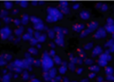
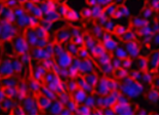
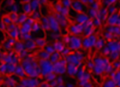
Fig. S3.
SCR
shPIK3CA
E-cadherin/Dapi
Vimentin/Dapi

Slide 4
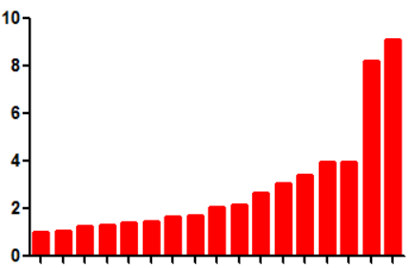
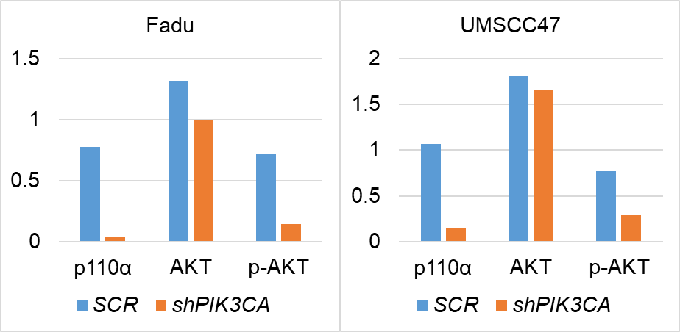


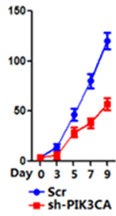
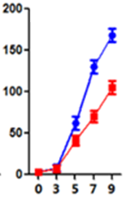
Fig. S4.
A
PIK3CA
Relative expression
10A
TU
10B
22B
22A
M4E
Fadu
M4C
HN6
SCC1
LNM1
SCC9
CAL27
SCC2
VU1311
VU1365
UMSCC47
B
shPIK3CA
shPIK3CA
SCR
SCR
p110α
AKT
pAKT^{ser473}
GAPDH
Fadu
UMSCC47
C
UMSCC47
Fadu
*
*
Proliferation (x10⁴ cells)

Slide 5
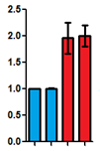



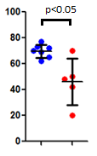
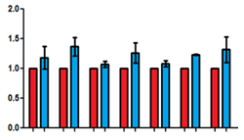

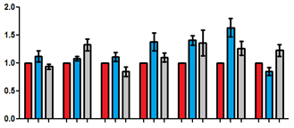


Fig. S5.
A
PIK3CA PIK3CB PIK3R1 PIK3R2
*
*
*
*
Relative expression
CU110-1
CU110-1
CU110-1
CU110-1
CUCON-1
CU110-2
CU110-2
CU110-2
CU110-2
CUCON-2
CUCON-1
CUCON-1
CUCON-1
CUCON-2
CUCON-2
CUCON-2
B
C
D
shPIK3R1
SCR
SCR
shPIK3R1
Intensity of p85α normalized by GAPDH
p85α
Relative expression
GAPDH
Zeb-1
Zeb-2
Snail-1
Vimentin
Twist-1
Sphere-forming
E-cadherin
Twist-2
Non sphere-forming
E
F
SCR
shAKT1
shAKT1
shAKT2
shAKT2
SCR
SCR
Relative expression
AKT1
AKT2
GAPDH
GAPDH
E-cadherin
Vimentin
Zeb-1
Zeb-2
Twist-1
Twist-2
Snail-1

