Slide 1
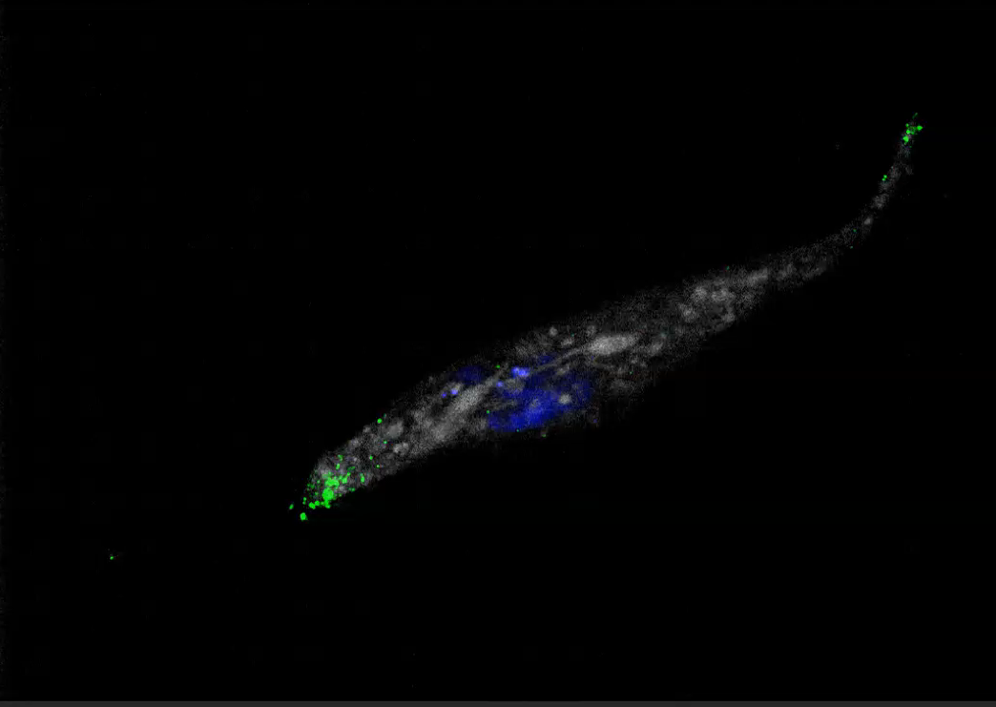
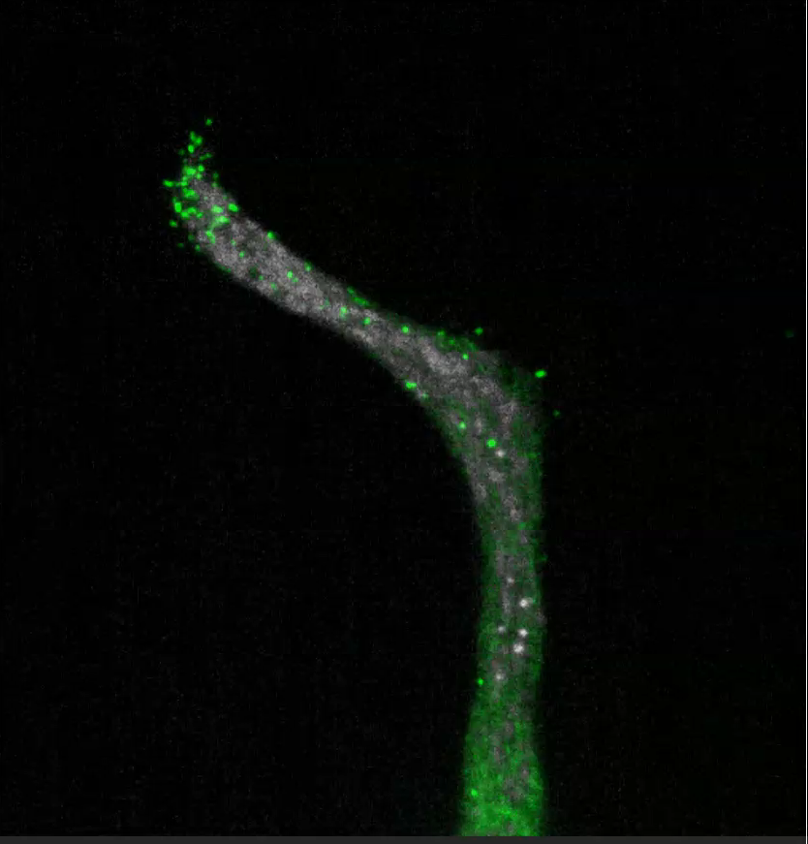
100µm
100µm
Supp Movies : Live cell imaging of LNCaP KLK14-GFP cells. Acquisition every 4 min over a period of 3 hours. (Green: KLK14-GFP; Grey: cell tracker; Blue: Nucleus)

