Slide 1
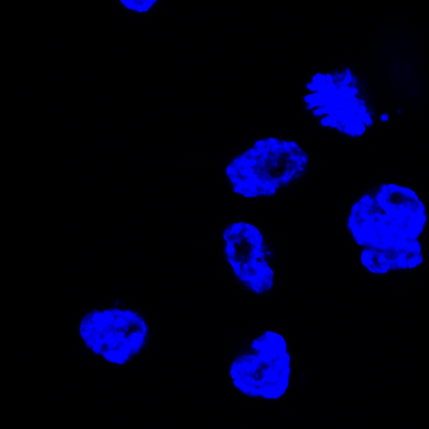
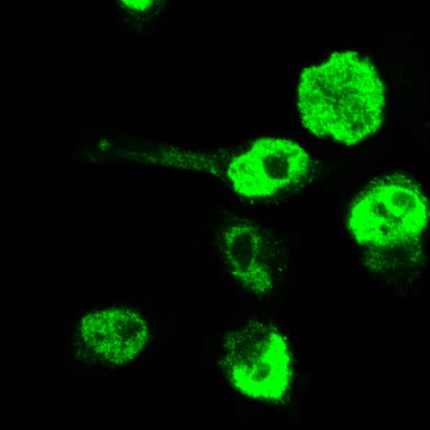
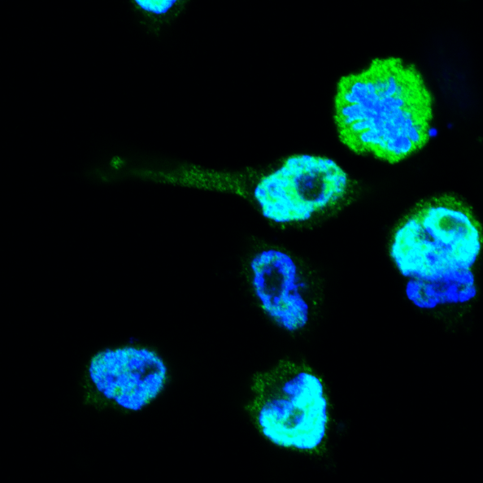
A
Anillin
DAPI
Merged
B
F-actin
Anillin
Merged
Control sgRNA
Anillin sgRNA 4
Figure S10

