Slide 1
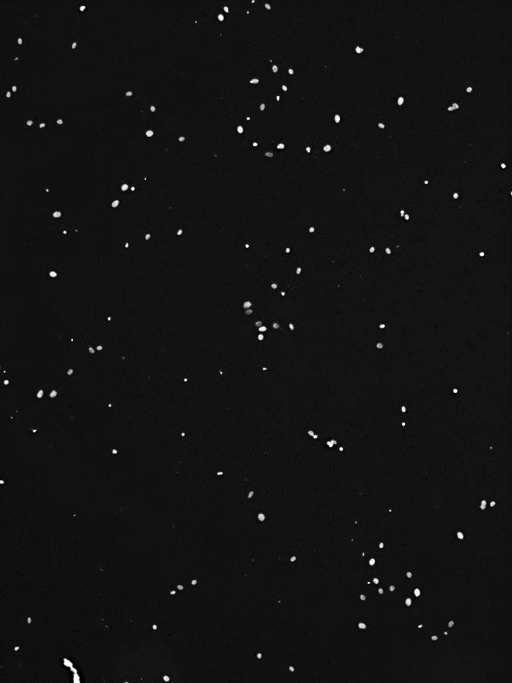
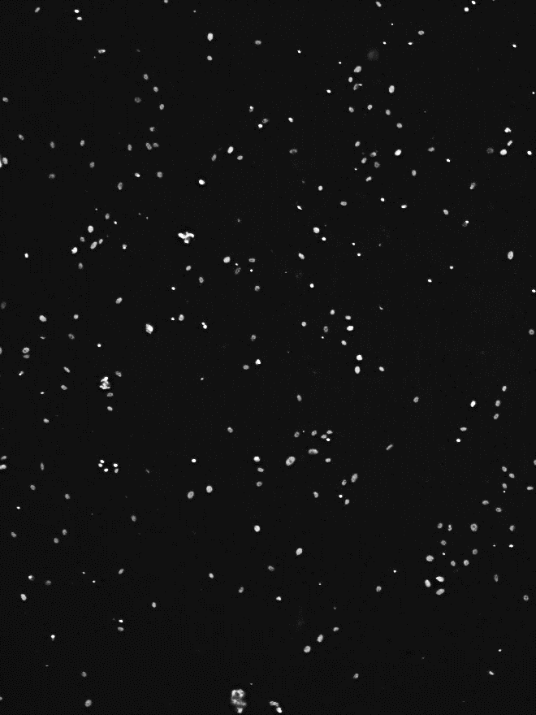
A
Control GFP
Anillin GFP
Control
GFP
tAnillin
GFP
kDa
kDa
250
Anillin
130
130
Anillin
GFP
28
72
55
GAPDH
72
36
GFP
55
Passage 2
28
B
GAPDH
36
Passage 6
Control GFP
tAnillin GFP
∗∗∗
Invaded cells
Control
GFP
tAnillin
GFP
C
Control GFP
tAnillin GFP
∗∗
Colony number
Control
GFP
tAnillin
GFP
Figure S2

