Slide 1
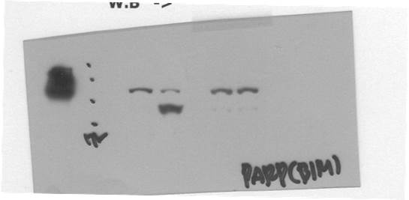


siCont
siBim
siCont
- + - + Balicatib+TRAIL
sub-G1 (%)
siBim
100 kD
PARP
75 kD
25 kD
Bim
- +
37 kD
actin
Balicatib+TRAIL
Supplementary Figure S1. Knock-down of Bim inhibits balicatib plus TRAIL-induced apoptosis. Caki cells were transfected with siCont or Bim siRNA (siBim) and treated with/without 20 μM balicatib plus 50 ng/mL TRAIL for 24 h. Apoptosis and protein expression were measured by flow cytometry and western blotting, respectively.

Slide 2
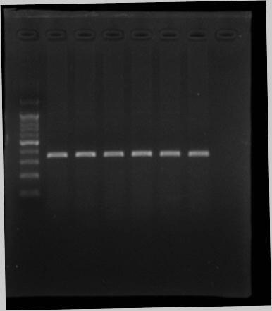
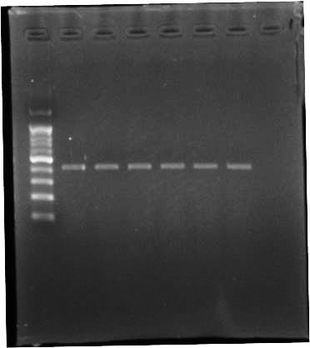
ODN 2 μM
400 bp
- 3 6 9 12 24 (h)
USP27x
USP27x mRNA
(Relative folds)
300 bp
500 bp
actin
400 bp
- 3 6 9 12 24
ODN 2 μM
Supplementary Figure S2. ODN had no effect on USP27x mRNA expression. Caki cells were treated with 2 μM ODN for the indicated time periods. USP27x mRNA expression were measured by RT-PCR (left panel) and real-time PCR (right panel).

