Slide 1
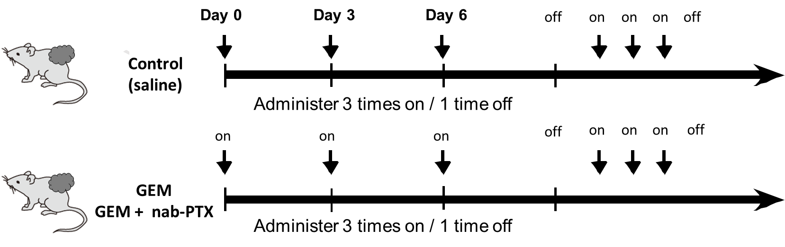
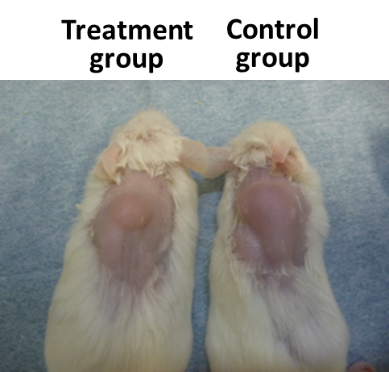
a
b
e
Figure S2. Verification of antitumor effects in PDX tumors (a) Chemotherapy (GEM, GEM + nab-PTX) was administered into PDXs by intra-abdominal injection on days 1, 3, and 6. After three injections, no administration was performed on day 9. For the control PDXs, saline was administered on the same schedule. (b) Figure of treated and control PDXs.
Notes:
Figure 2. Verification of antitumor effect in PDX tumor. A, A)We administered Chemotherapy(GEM, GEM + nab-PTX) into PDX by intra-abdominal injection for Day1, 3, 6. After 3 times injection, administration for Day9 was skipped. For the control PDX, saline is administered on the same schedule. B, Figure of treated PDX and control PDX. C,D, Tumor growth after treatment of chemotherapy. PDX mice were treated GEM (C), GEM+nab-PTX (D) after the tumor volume became more than 1500 mm³. We conducted experiments with 6 cases of GEM and 10 cases of GEM + nab-PTX combination therapy. E, Pathological findings in each point after treated GEM. The tumor growth curve after GEM treated on NOG58. (a) Control tumor, (b) GEM treated tumor. The tumor was grown till the same duration with control. (c) GEM treated tumor. The tumor was grown till the same size with control tumor. (a)-(c) upper pictures are low magnification and lower are high magnification.

