Slide 1
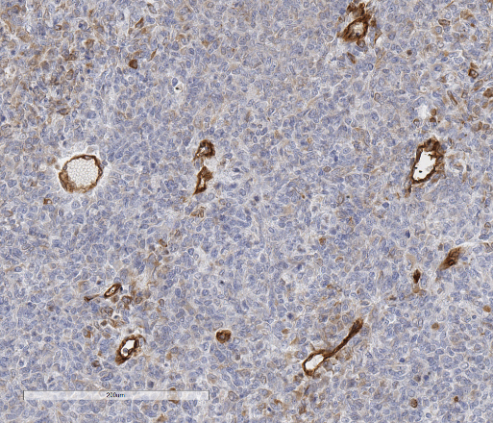
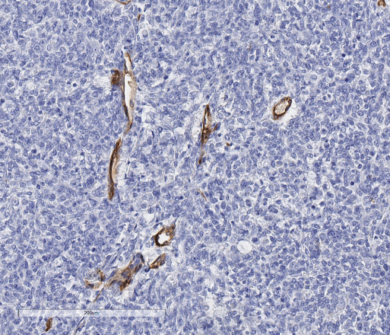
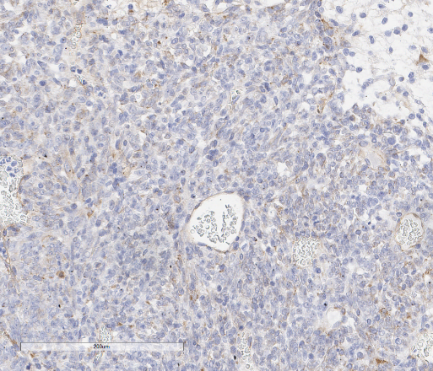
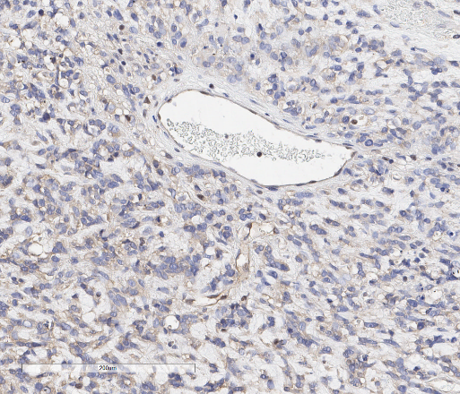
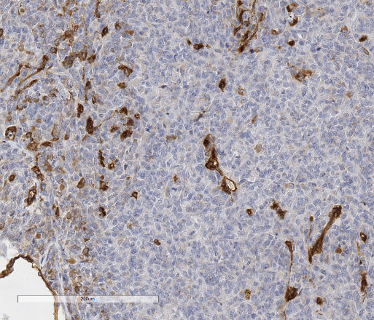
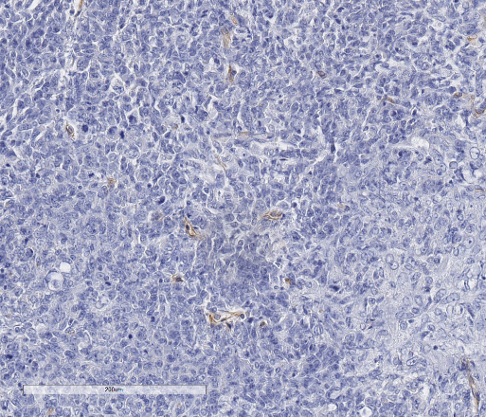
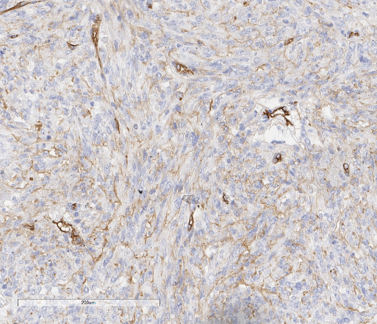
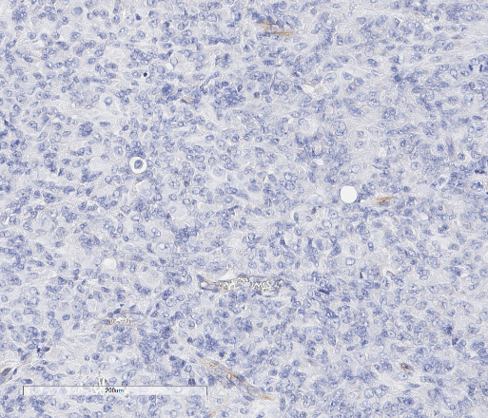
VUMC-AT/RT-01
PDX
Patient tumor
P-gp
Bcrp
P-gP
BCRP
Large blood vessels
200µm
200µm
200µm
200µm
Capillaries
200µm
200µm
200µm
200µm
Supplementary figure S7: Immunohistochemical staining of BCRP and P-gP in tumor tissue from VUMC-AT/RT-01 xenografts and the original patient tumor. Whereas in the PDX P-gP and BCRP expression of blood vessels is partially maintained, both transporter proteins are absent in blood vessels in the original patient tumor, with the exception of heterogeneous P-gP expression in intratumoral capillaries.

