Slide 1
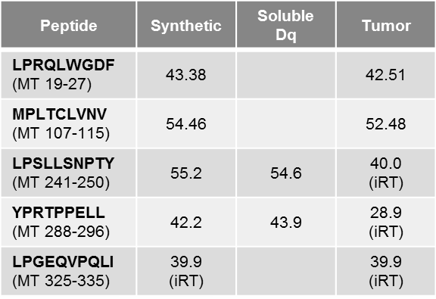
Supplemental Table 1. Retention times of synthetic vs. eluted peptides. The nanoLC retention times (RT) (minutes) reported for each PyMT peptide. For synthetic and MMTV-PyMT tumor-eluted peptides, internal retention time peptides (iRT) were introduced to the sample to allow normalizing RTs between runs, especially during SWATH acquisition. Data was analyzed using PEAKView 2.0 and Skyline software.
Notes:
Supplemental Table 1. Retention times of synthetic vs. eluted peptides. The nanoLC retention times (RT) (minutes) reported for each PyMT peptide. For synthetic and MMTV-PyMT tumor-eluted peptides, internal retention time peptides (iRT) were introduced to the sample to allow normalizing RTs between runs, especially during SWATH acquisition. Data was analyzed using PEAKView 2.0 and Skyline software.

Slide 2
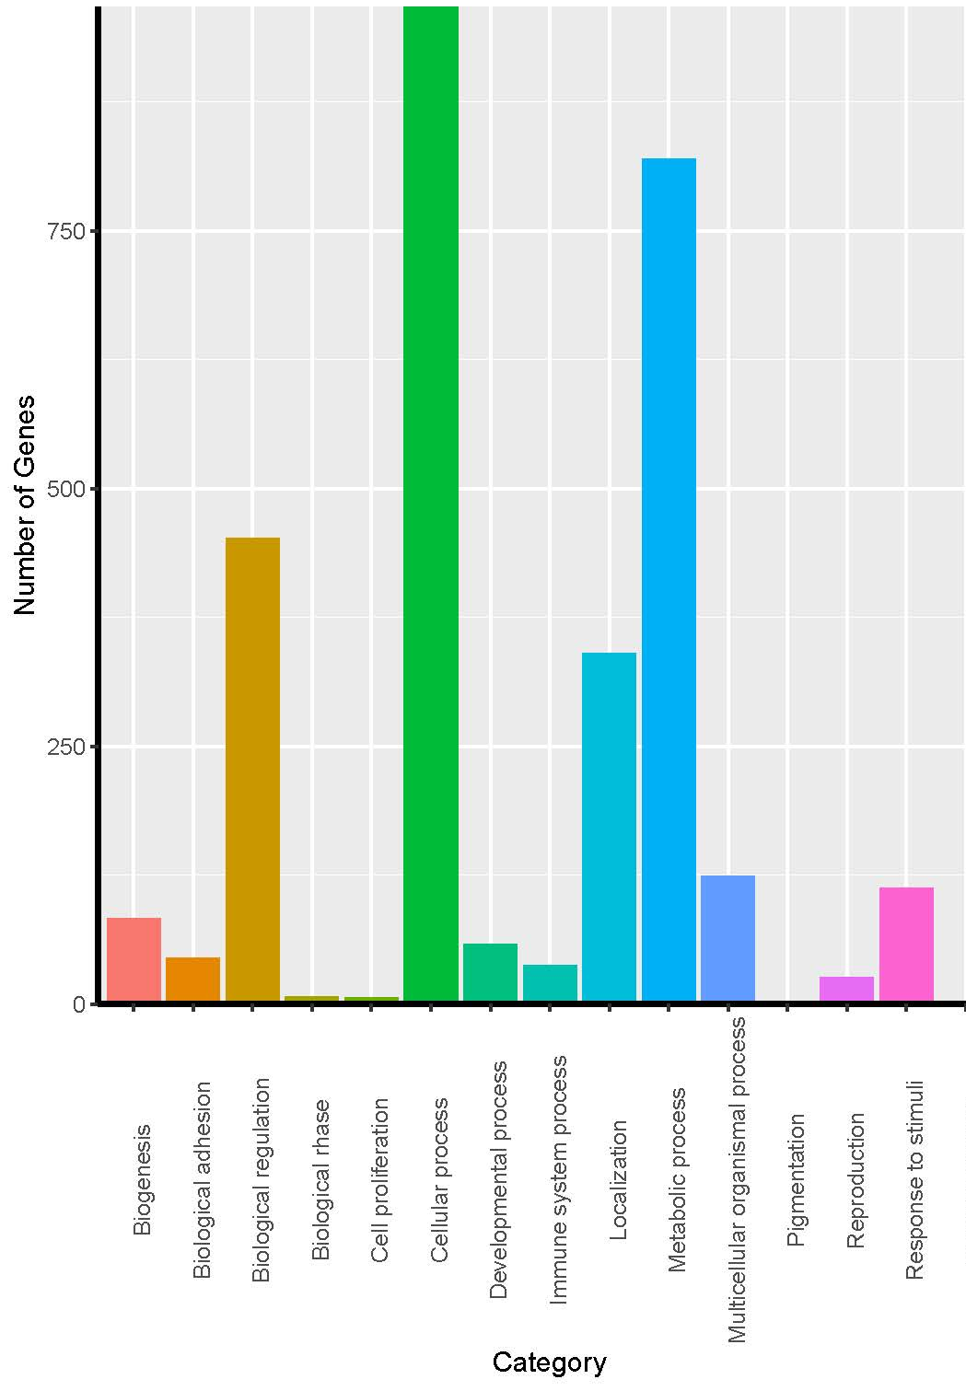
Supplemental Figure 1. Source protein analysis of peptides eluted from HeLa-H-2D^{q} sMHC using PANTHER v.14.1 Go-Slim Biological Process annotation data set. A total of 2896 gene IDs extracted from source protein description information output by PEAKS Studio X were compared against a reference Mus Musculus genome. Statistical overrepresentation test was performed by Fisher’s exact test with a false-discovery rate (FDR) of p<0.05; only statistically significant results are displayed.
Notes:
Supplemental Figure 1. Source protein analysis of peptides eluted from HeLa-H-2D^{q} sMHC using PANTHER v.14.1 Go-Slim Biological Process annotation data set. A total of 2896 gene IDs extracted from source protein description information output by PEAKS Studio X were compared against a reference Mus Musculus genome. Statistical overrepresentation test was performed by Fisher’s exact test with a false-discovery rate (FDR) of p<0.05; only statistically significant results are displayed.

Slide 3
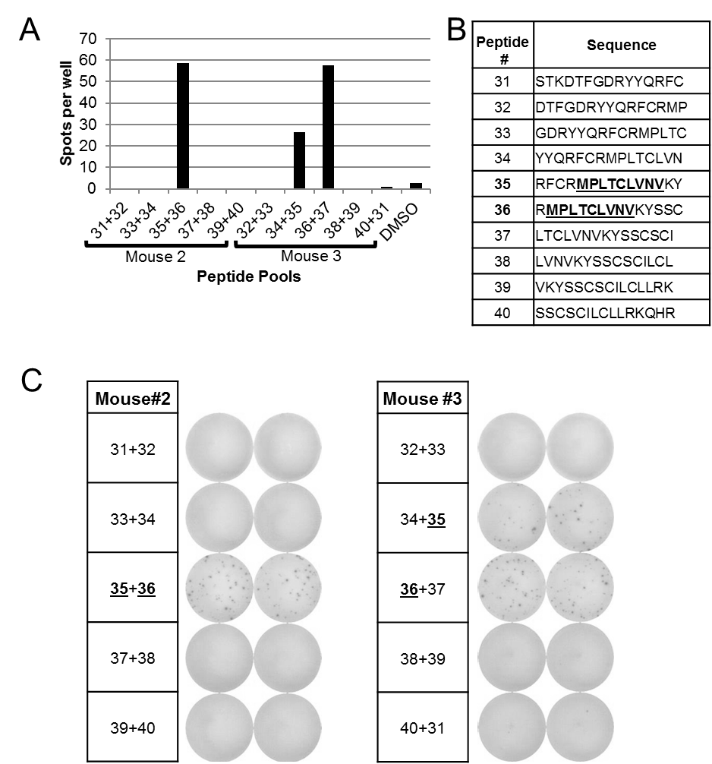
Supplemental Figure 2. PyMT Epitope Mapping from pool 3 (Peptide #31-40). A) Quantified anti-IFNγ ELISPOTs of mouse 2 and 3. Mouse #2 received peptides 31+32, 33+34, etc. while mouse #3 received peptides 32+33, 34+35, etc. B) Table revealing the overlapping PyMT 15-mer amino acid sequences. Bold = minimal epitope, C) ELISPOT raw data of Mouse 2 & 3 reveals immunogenic peptide is contained within peptides 35 and 36.
Notes:
Supplemental Figure 2. PyMT Epitope Mapping from pool 3 (Peptide #31-40). A) Quantified anti-IFNγ ELISPOTs of mouse 2 and 3. Mouse #2 received peptides 31+32, 33+34, etc. while mouse #3 received peptides 32+33, 34+35, etc. B) Table revealing the overlapping PyMT 15-mer amino acid sequences. Bold = minimal epitope, C) ELISPOT raw data of Mouse 2 & 3 reveals immunogenic peptide is contained within peptides 35 and 36.

Slide 4
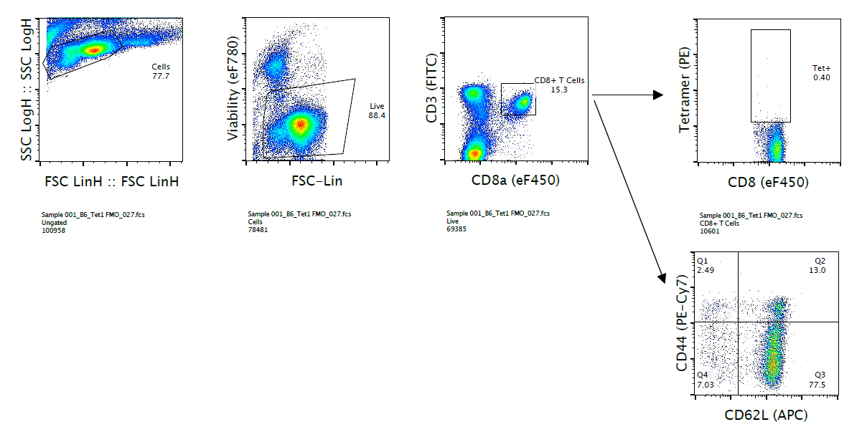
Supplemental Figure 3. Gating strategy for PyMT tetramer staining. Gating of primary splenocytes: viability > CD3+ CD8a+ > Tetramer+ or CD44/CD62L levels.
Notes:
Supplemental Figure 3. Gating strategy for PyMT tetramer staining. Gating of primary splenocytes: viability > CD3+ CD8a+ > Tetramer+ or CD44/CD62L levels.

Slide 5
A
B
Implant Tumor Cells
DNA
Vaccine
Euthanize
0
2
4
6
weeks
C
D
Supplemental Figure 4. Therapeutic PyMT DNA Vaccination has limited efficacy against tumor growth: A) Timeline of MMTV-PyMT tumor implantation with 250,000 cells, DNA vaccination and booster, and experimental endpoint (2cm^3), B) average and C) individual tumor growth in mock (black) vs. PyMT (red) vaccinated groups, D) anti-IFNg ELISPOT responses with splenocytes from transgenic PyMT mice after overlapping PyMT 15mer stimulation. Peptides were pooled in groups of 10 with DMSO and PMA/Ionomycine controls. Both mice were the transgenic MMTV-PyMT/FVB strain (Jackson Labs Stock #002374) and exhibited multiple spontaneously arising tumors >2cm^3.
Notes:
Supplemental Figure 4. Therapeutic PyMT DNA Vaccination has limited efficacy against tumor growth: A) Timeline of MMTV-PyMT tumor implantation with 250,000 cells, DNA vaccination and booster, and experimental endpoint (2cm^3), B) average and C) individual tumor growth in mock (black) vs. PyMT (red) vaccinated groups, D) anti-IFNg ELISPOT responses with splenocytes from transgenic PyMT mice after overlapping PyMT 15mer stimulation. Peptides were pooled in groups of 10 with DMSO and PMA/Ionomycine controls. Both mice were the transgenic MMTV-PyMT/FVB strain (Jackson Labs Stock #002374) and exhibited multiple spontaneously arising tumors >2cm^3.

Slide 6
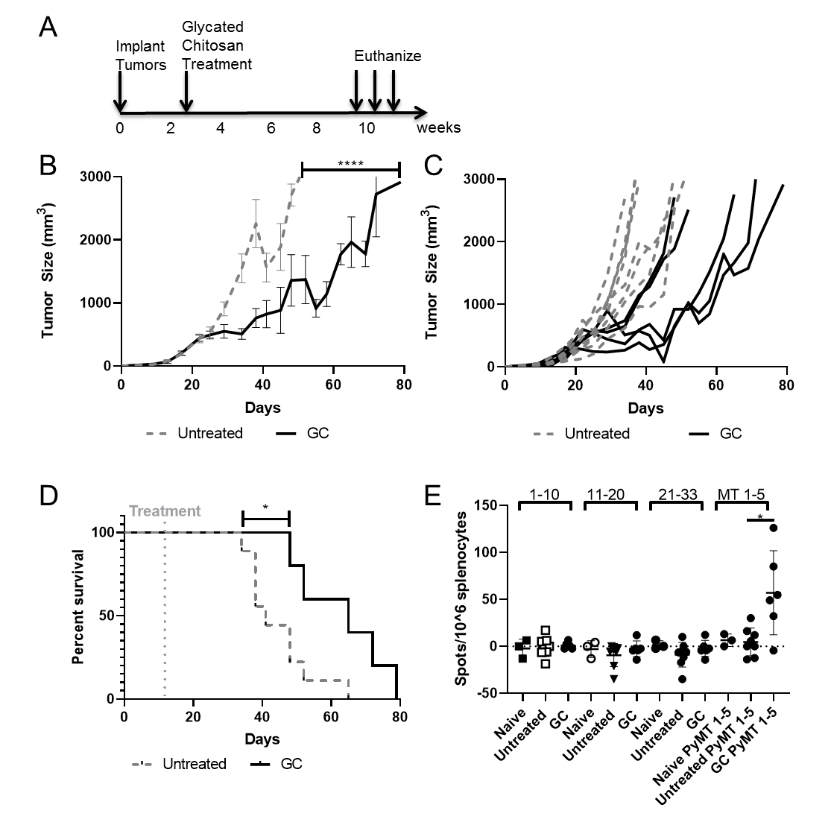
Supplemental Figure 5: PyMT-peptide responses induced by N-dihydrogalactochitosan (GC) treatment correlate with anti-tumor immunity. A) Experimental setup: 100,000 tumor cells were injected into mammary fat pads of FVB mice. At 0.1 cm³, tumors received intratumoral injections with 0.1 ml 1%GC (n=5). Tumor-bearing mice without GC treatment were used as controls (n=9). Mice were euthanized and splenocytes harvested once tumors reached 2 cm³. B) Average, and C) Individual tumor volumes of GC-treated and control mice , with non-linear regression curve fit analysis (C), ****p<0.0001. D) Survival curves of untreated vs. GC-treated mice, log-rank test, *p=0.018. E) Anti-IFNγ ELISPOT studies using splenocytes from naïve, untreated, or GC-treated mice. Mice were euthanized 10 days after treatment and splenocytes were harvested for peptide restimulation assays. Previously published cancer-associated self-peptides were pooled into 3 groups (Supplemental File 4) and PyMT peptides were pooled. 250,000 cells per well were incubated with pooled peptides for 24hr prior to ELISPOT analysis, non-paired student’s t-test *p-0.03.
Notes:
Supplemental Figure 5: PyMT-peptide responses induced by N-dihydrogalactochitosan (GC) treatment correlate with anti-tumor immunity. A) Experimental setup: 100,000 tumor cells were injected into mammary fat pads of FVB mice. At 0.1 cm³, tumors received intratumoral injections with 0.1 ml 1%GC (n=5). Tumor-bearing mice without GC treatment were used as controls (n=9). Mice were euthanized and splenocytes harvested once tumors reached 2 cm³. B) Average, and C) Individual tumor volumes of GC-treated and control mice , with non-linear regression curve fit analysis (C), ****p<0.0001. D) Survival curves of untreated vs. GC-treated mice, log-rank test, *p=0.018. E) Anti-IFNγ ELISPOT studies using splenocytes from naïve, untreated, or GC-treated mice. Mice were euthanized 10 days after treatment and splenocytes were harvested for peptide restimulation assays. Previously published cancer-associated self-peptides were pooled into 3 groups (Supplemental File 4) and PyMT peptides were pooled. 250,000 cells per well were incubated with pooled peptides for 24hr prior to ELISPOT analysis, non-paired student’s t-test *p-0.03.

Slide 7
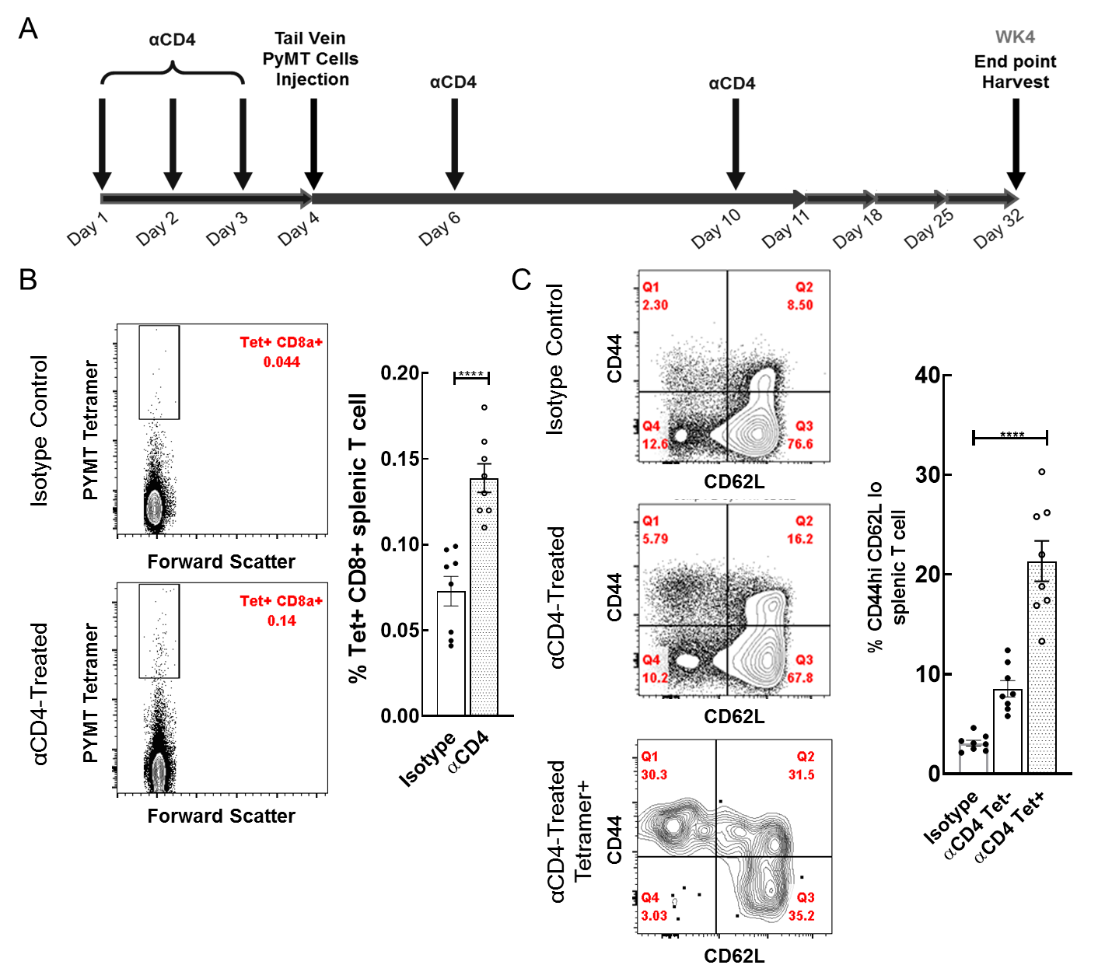
Supplemental Figure 6: PyMT-specific T cells are present in metastatic settings A) Experimental setup of metastasis study: Anti-CD4 (GK1.5) or Isotype (LTF-2) control antibodies (100ug) were injected prior and subsequent to tail vein injection of 500,000 PyMT tumor cells. Lungs and spleens were harvested four weeks post-tumor injection, B) Pooled PyMT tetramer staining of CD3+CD8a+ splenocytes four weeks after metastatic lung-seeding of tumors. Graph represents comparison of isotype vs. anti-CD4 treatment, student t-test p<0.0001, C) Representative flow cytometric analysis of CD44 and CD62L expression in CD3+CD8a (+/- tetramer staining, +/- CD4 depletion). Graph represents comparison of tetramer+ cells to parent gates of CD3+CD8a+ cells, one-way ANOVA p=0.0009.
Notes:
Supplemental Figure 6: PyMT-specific T cells are present in metastatic settings A) Experimental setup of metastasis study: Anti-CD4 (GK1.5) or Isotype (LTF-2) control antibodies (100ug) were injected prior and subsequent to tail vein injection of 500,000 PyMT tumor cells. Lungs and spleens were harvested four weeks post-tumor injection, B) Pooled PyMT tetramer staining of CD3+CD8a+ splenocytes four weeks after metastatic lung-seeding of tumors. Graph represents comparison of isotype vs. anti-CD4 treatment, student t-test p<0.0001, C) Representative flow cytometric analysis of CD44 and CD62L expression in CD3+CD8a (+/- tetramer staining, +/- CD4 depletion). Graph represents comparison of tetramer+ cells to parent gates of CD3+CD8a+ cells, one-way ANOVA p=0.0009.

