Slide 1
Supplemental Figure 1
Control
HFD
Control reversal
HFD reversal
A
B
C

Slide 2
Supplemental Figure 1
A) Organ weights (liver, epididymal and retroperitoneal fat pad) corrected for total body weight. HFD induced epididymal and retroperitoneal fat-pad expansion, which resolved following conversion to CON diet n=10/group. Data analysed by one way ANOVA with Tukey post hoc test for multiple comparisons. σ=p<0.05, σσ=p<0.01. Error bars=SEM.
B) HFD induces glucose intolerance, which resolves following conversion to CON diet. n=10/group. **=p<0.001 HFD versus all other groups at 90 minutes (2-way repeated measures ANOVA with Tukey post hoc test). NS = non-significant in all comparisons.
C) HFD induces insulin resistance as determined by HOMA-IR score which resolves following conversion to CON diet n=10/group. Data analysed by one way ANOVA with Tukey post hoc test for multiple comparisons. σσ=p<0.01.

Slide 3
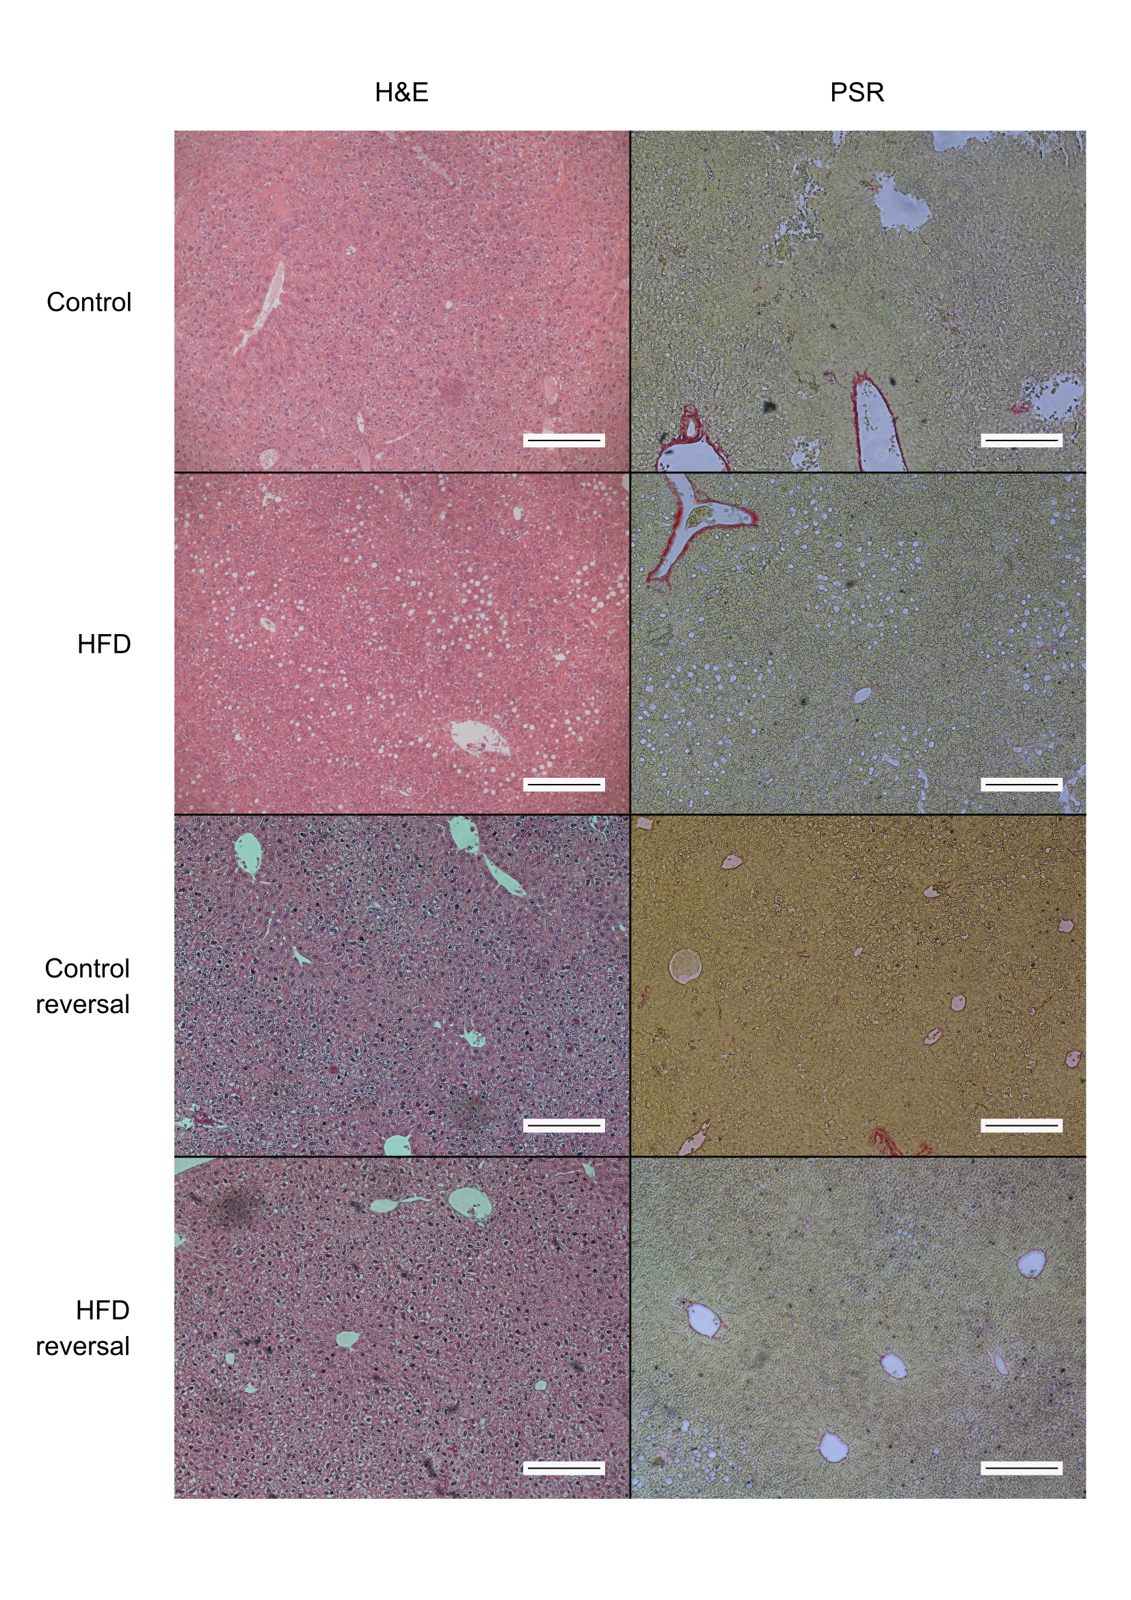
Supplemental Figure 2

Slide 4
Supplemental Figure 2: Haematoxylin and Eosin (H&E) or Picosirius Red (PSR) stained liver; scale bar 100 microns. Black arrows indicate macrovesicular spaces typical of hepatic steatosis

Slide 5
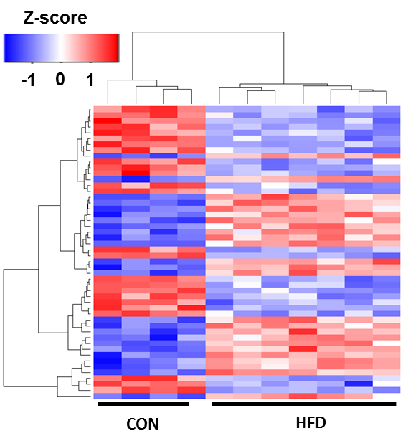
Supplemental Figure 3

Slide 6
Supplemental Figure 3
Heatmap analysis of 17-week HFD and CON liver microarray mRNA data. The top 200 varying transcripts are shown with associated Z score depicting comparatively up (red) and down (blue) regulated transcripts. Dendrogram demonstrates unsupervised clustering of individuals and genes by Euclidian distance. n=4 CON; 8 HFD.

Slide 7
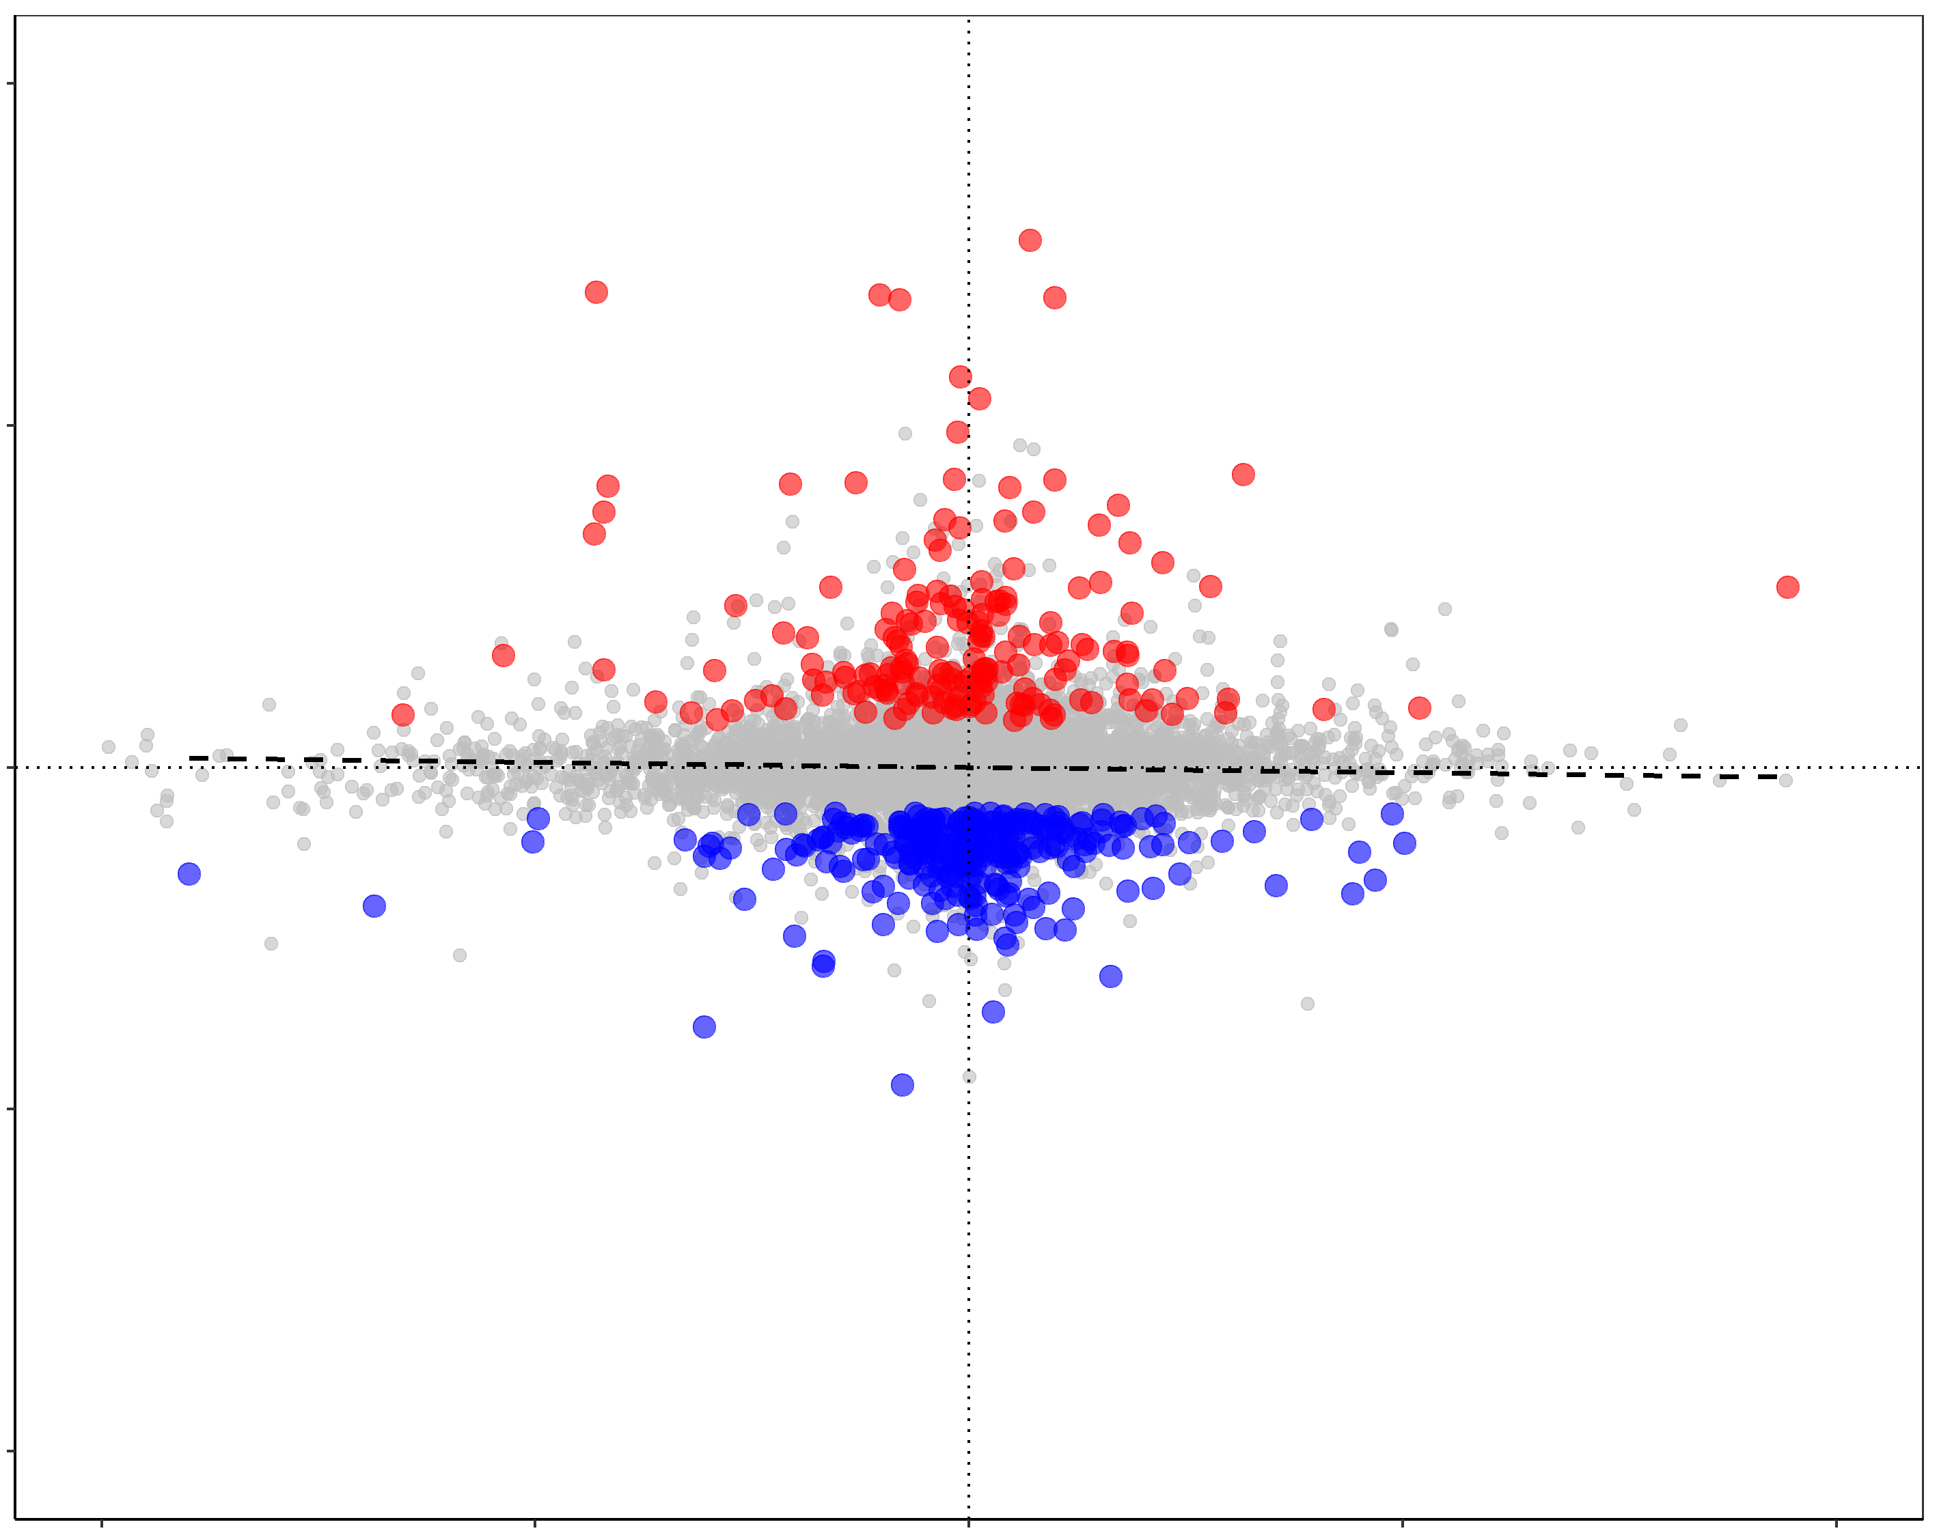
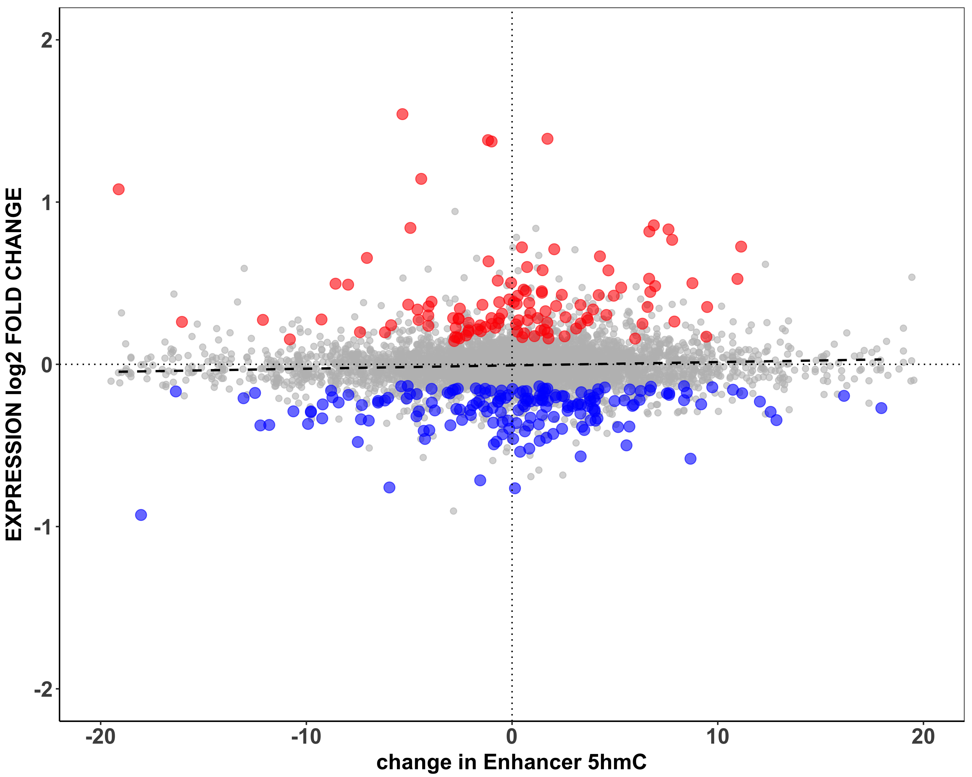
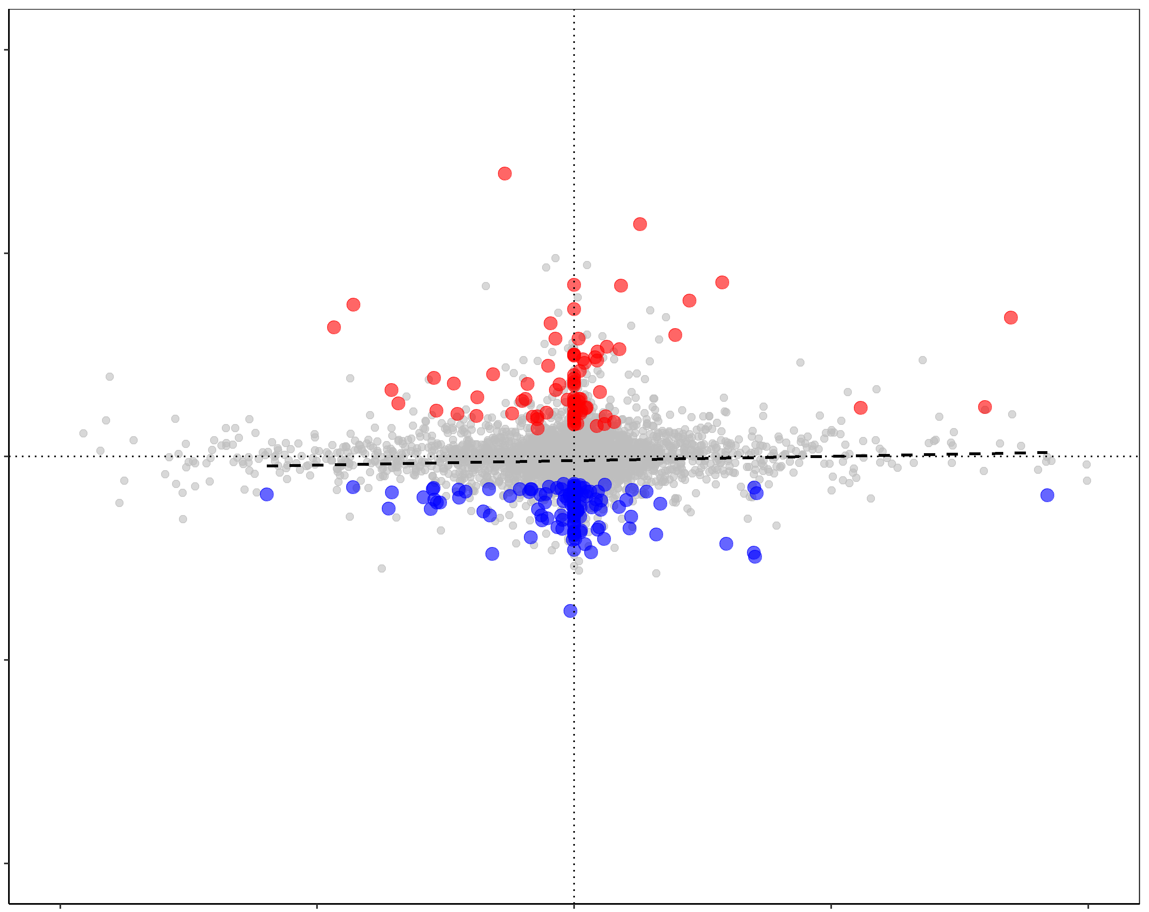
Supplemental Figure 4
Promoter
2
p = 0.778
R² =-0.002
1
Log₂ Fold Change Expression
0
-1
-2
-20
-10
0
10
20
Δ Promoter 5hmC
2
Enhancer
p = 0.7034
R² = -0.002
1
Log₂ Fold Change Expression
0
-1
-2
-20
-10
0
10
20
Δ Enhancer 5hmC
2
TSS
p = 0. 6945
R² =- -0.0036
1
Log₂ Fold Change Expression
0
-1
-2
-20
-10
0
10
20
Δ TSS 5hmC
Scatter plots of changes in promoter, enhancer and TSS 5hmC levels versus transcriptional change in HFD and CON; Δ5hmC refers to difference in mean number of normalised reads per 150bp window.

Slide 8
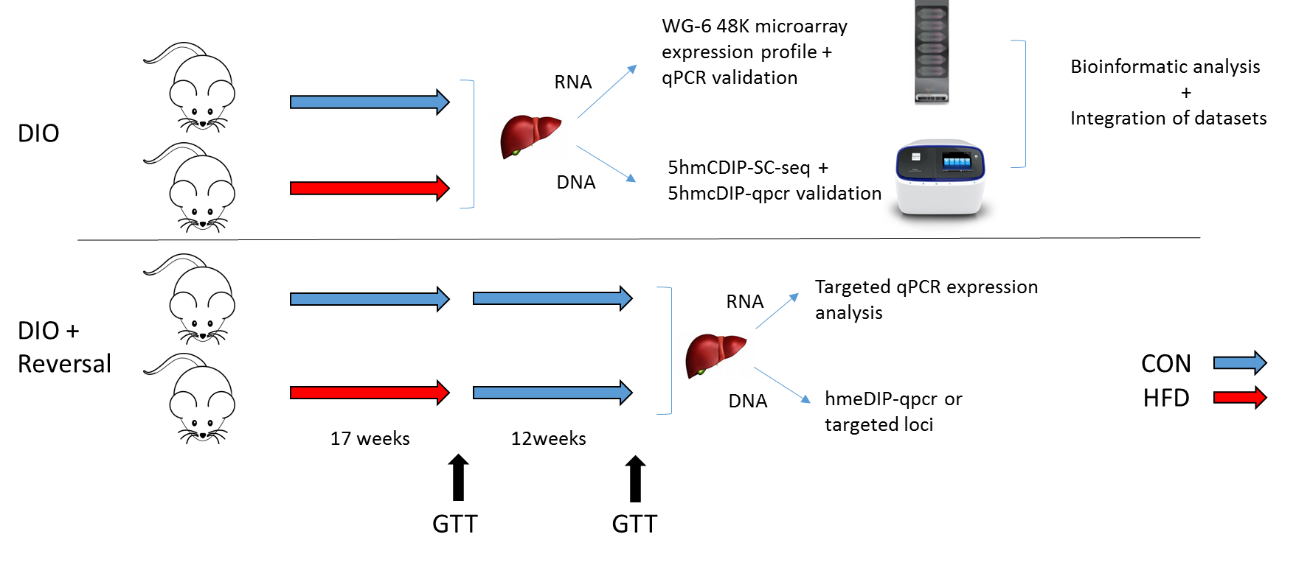
Supplemental figure 5
Supplemental Figure 5: Schematic diagram of experimental set up

